Slide 1
Formulas and Labels for Beer/Malt Beverages
California Craft brewers conference
December 2, 2021

Slide 2
Agenda
Introduction
Formulas
Labels
Questions

Slide 3
TTB Disclaimer
This information is being presented to help the public to understand and comply with the laws and regulations that the Alcohol and Tobacco Tax and Trade Bureau (TTB) administers.
It is not intended to establish any new, or change any existing, definitions, interpretations, standards, or procedures regarding those laws and regulations.
In addition, this presentation may be made obsolete by changes in laws and regulations.
Please consult the applicable laws and regulations for the most current requirements.
Sample documents (such as records, returns, and labels) are for illustrative purposes only and contain fictitious data.

Slide 4
Formulas for Beer/Malt Beverages
Stacey Cochiara
Formula specialist

Slide 5
Common Formula Questions
What is a formula?
Why is a formula required?
At What Stage do I Apply for Formula Approval?
When is a formula required?
How do I apply for formula approval?

Slide 6
What is a Formula?
A formula is the recipe for your beer/malt beverage
It must include a quantitative list of ingredients
It must include a description of how the product is produced
It must indicate a total yield or batch size
In some instances a sample of the product must also be submitted to TTB for laboratory analysis
See Formula Basics page on TTB.gov

Slide 7
Where is the Formula Requirement?
TTB regulations contain the requirement that formula approval must be obtained for certain products
Domestic (27 CFR 25.55)
Imported (27 CFR 7.31(d))

Slide 8
Why is a Formula Required?
We use the information found in the formula to:
Classify the product for tax and labeling purposes
Ensure that the product does not contain any prohibited ingredients
Determine if limited ingredients are used within prescribed limitations or if they will impact labeling
Provide a suggested statement of composition for labeling purposes

Slide 9
At What Stage do I Apply for Formula Approval?
Domestic - Formula approval (if required) must be obtained prior to producing the beer
Imported – Formula approval (if required) must be obtained prior to applying for a certificate of label approval

Slide 10
When is a Formula Required?
Formula approval is required if the brewer uses any of the following ingredients or processes*:
Flavors with alcohol
Compounded flavors
Colors
Artificial sweeteners
Food Materials (unless exempted by Attachment 1 of TTB Ruling 2015-1)
The beverage is frozen and ice crystals are removed (e.g., ice beer)
*Not a complete list

Slide 11
Ingredients and Processes that are Exempt from Formula Requirements
TTB Ruling 2015-1 exempts certain traditional ingredients and processes when used to make malt beverages
Attachment 1 specifies which ingredients and processes are exempt, for example:
Honey, vanilla beans
Barrel-aging

Slide 12
Ingredients and Processes that are Exempt from Formula Requirements
TTB Ruling 2015-1 does not exempt extracts or flavors containing alcohol
Vanilla beans are exempt, but vanilla extract is not exempt
Exempt ingredients cannot comprise more than 49% of the fermentables
TTB can still request a formula and samples for analysis at any time, even when exempt ingredients are used

Slide 13
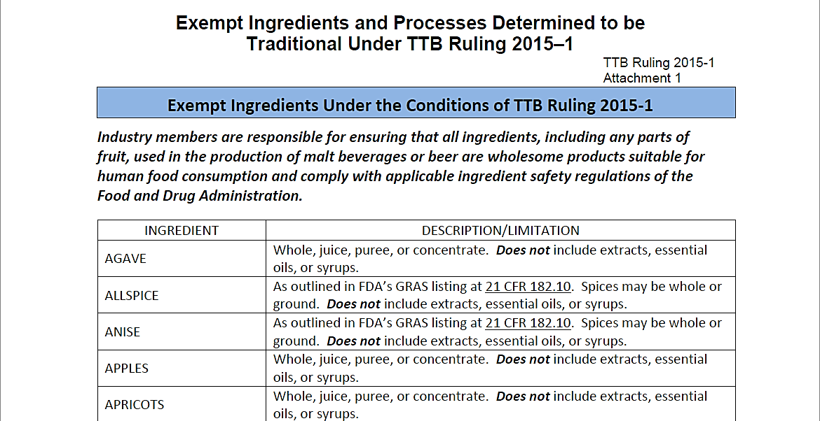
TTB Ruling 2015-1 | Attachment 1

Slide 14
Combinations of Exempt and Non -Exempt Ingredients
If you use both exempt and non exempt ingredients, formula is required
Passion fruit, vanilla beans
Guava
Passion fruit and vanilla beans are exempt
Guava is not exempt

Slide 15
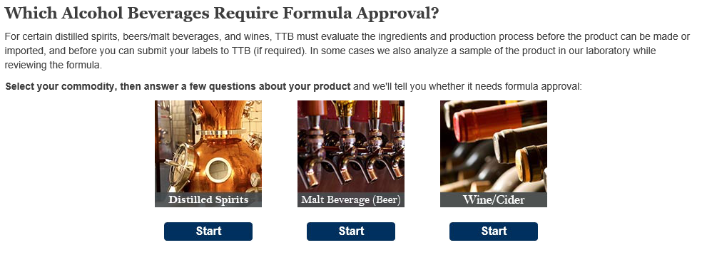
Which Beers Require Formula Approval?
Use our online tool Which Alcohol Beverages Require Formula Approval? or check the list in TTB G 2016-1A to learn which beers require formula approval

Slide 16
What TTB Looks For When Reviewing Formulas
Have you used the correct designation (class and type) – Is the base produced according to the stated standard?*
What is the GRAS (Generally Recognized As Safe) status of certain ingredients
*See 27 CFR 7.10, 7.24, and 25.15

Slide 17
What TTB Looks For When Reviewing Formulas (Cont.)
Have you used any limited or prohibited ingredients
Did you submit all the correct supporting documents needed for certain ingredients
Ingredient Specification Sheet (Spec Sheet)
Flavor Ingredient Data Sheets (FIDS)
Limited Ingredient Calculation Worksheet

Slide 18
Flavor Ingredient Data Sheet (FID Sheet or FIDS)
A FID Sheet is a document that includes information about certain ingredients used to make a compounded flavor
Submit one FID Sheet for each compounded flavor used in your product
See TTB G 2017- 4 for additional information and examples

Slide 19
Flavor Ingredient Data Sheet (Cont.) (FID Sheet or FIDS)
The FID Sheet allows TTB to:
Ensure that the compounded flavor has been evaluated by the TTB Nonbeverage Products Laboratory
Verify that your beverage does not contain any ingredients in excess of the limits prescribed by TTB or by FDA
Ensure the appropriate labeling of your product
Ensure your product complies with TTB restrictions governing how much of the alcohol in your beverage may be derived from flavors and other nonbeverage ingredients containing alcohol

Slide 20
Flavor Ingredient Data Sheet (Cont.) (FID Sheet or FIDS)
Flavor manufacturer supplies it to the brewer
FID based on exchange between flavor producer and TTB Nonbeverage Laboratory
It lists concentration of limited ingredients in PPM
Lists any colors used in flavor
States alcohol content of flavor
This information, combined with the use rate, determines classification of the flavor

Slide 21
TTB Limited Ingredients
TTB allows 4 artificial flavor materials to be present at certain levels in alcohol beverages without affecting the label declaration:
Synthetic maltol
Ethyl maltol
Synthetic vanillin
Ethyl vanillin
If these limits are exceeded, a natural flavor is treated as an artificial flavor in the product

Slide 22
Limited Ingredient Calculation Worksheets
Limited Ingredient Calculation Worksheets are used to calculate the total amounts of ingredients that have limits on their use per TTB and FDA requirements
Complete and submit one for each malt beverage made with one or more compounded flavors

Slide 23
Limited Ingredient Calculation Worksheets (Cont.)
Also useful as a product development tool
Allows you to confirm that new product formulas are in compliance with limited ingredient requirements, and whether a flavor will be labeled as artificial prior to submitting the formula
See TTB G 2017-6 for additional information and examples

Slide 24
Beer/Malt Beverages with Flavors that Contain Alcohol
If final ABV is less than or equal to 6 percent:
at least 51 percent of the alcohol in the final product must come from the malt base
no more than 49 percent of the alcohol in the final product can come from the flavor and other nonbeverage materials
27 CFR 7.11 & 22(a)(5), 27 CFR 25.15

Slide 25
Beer/Malt Beverages with Flavors that Contain Alcohol (Cont.)
If final ABV is greater than 6 percent:
no more than 1.5 percent of the volume of the malt beverage can consist of alcohol from flavors and other nonbeverage ingredients containing alcohol
An alcohol content statement must appear on the label if any alcohol in the malt beverage was derived from added flavors
27 CFR 7.11 & 22(a)(5), 27 CFR 25.15

Slide 26
Ingredient Specification Sheet (Spec Sheet or Technical Data Sheet)
A spec sheet is a document or label that lists or describes the contents of an ingredient that is made from more than one component
Submit a spec sheet for each ingredient that is made from more than one component, e.g., a fruit juice made from water, apples, and sugar

Slide 27
Ingredient Specification Sheet (Cont.) (Spec Sheet or Technical Data Sheet)
Should not be used for compounded flavors (use FID sheet)
See TTB G 2017-3 for additional information and examples

Slide 28

FDA Requirements
FDA has authority over food and ingredient safety
Approved Food Additives
21 CFR parts 170-186
Generally Recognized as Safe
Traditional use in food prior to 1958
Scientific determination
Traditional medicines/dietary supplements are not necessarily GRAS
Importer/producer is responsible for providing evidence that an ingredient is GRAS

Slide 29
GRAS Ingredients
GRAS – Generally Recognized As Safe
Under sections 201(s) and 409 of the Federal Food, Drug, and Cosmetic Act, any substance that is intentionally added to food is a food additive, that is subject to premarket review and approval by FDA, unless the substance is generally recognized to be safe
Using only GRAS ingredients does not impact whether or not a formula is required

Slide 30
Prohibited and Limited Ingredients
FDA maintains a list of prohibited ingredients at 21 CFR part 189
Certain non-prohibited ingredients may be used within prescribed limits
TTB Limited Ingredients

Slide 31
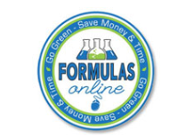
How Do I Apply for Formula Approval?
Formulas Online
Step-by-step guidance
Data validation checks along the way
Application status updates via email
Formulas Online Customer Page
See webinar presentation: How to Register and Submit Formulas through Formulas Online

Slide 32
Formulas Online Helpful Hints
Supply a quantitative list of ingredients
Provide a complete method of manufacture
Indicate at what stage flavors are added to the product
Provide the common name and scientific name (genus and species) for any unusual herbal ingredients

Slide 33
Formulas Online Helpful Hints
Ensure that ingredients are considered GRAS (generally recognized as safe) by the FDA before you submit
Make sure you’ve uploaded all the applicable supporting documents, e.g., FIDS, Spec Sheet, etc., based on your list of ingredients

Slide 34
Formula Resources
Beer Resources
TTB Beer Rulings www.ttb.gov/beer/rulings | Alcohol Beverage Formula Approval Guidance https://www.ttb.gov/formulation
TTB Beer Industry Circulars www.ttb.gov/beer/industry-circulars | Does my Beer/Malt Beverage Require a Formula? www.ttb.gov/formulation/mbev
TTB Beer Frequently Asked Questions (FAQs) www.ttb.gov/beer/beer-faqs | TTB G 2016-1A –Beer/Malt Beverages Requiring Formula Approval or Laboratory Sample Analysis Chart www.ttb.gov/public-guidance/ttb-g-2016-1a
Formula Approval with Laboratory Sample Analysis https://www.ttb.gov/formulation/formula-approval-with-laboratory-sample-analysis | Determine If and How Ingredients May be Used in Your Beverage https://www.ttb.gov/formulation/determining-if-and-how-ingredients-may-be-used-in-your-beverage

Slide 35
Labels for Malt Beverages
Nicole Candelora
Quality Assurance Coordinator

Slide 36
Agenda
In this session we’ll cover:
Mandatory label information
Keg collars
Prohibited labeling practices

Slide 37
Mandatory Label Information

Slide 38
Mandatory Label Information
Must be on the Brand Label:
Must be on the Brand Label:
May be on Any Label:
Brand name (27 CFR 7.23)
Class (27 CFR 7.24)
Name and address (Domestic) (27 CFR 7.25)
Net contents (27 CFR 7.27)
Alcohol content (for malt beverages containing alcohol derived from added flavors or other nonbeverage ingredients (other than hops extract)) (27 CFR 7.22)
Government Health Warning (27 CFR 16.21-22)
Name and address (Imported) (27 CFR 7.25)
Country of origin (Imported)
Declaration of certain ingredients (when used): (27 CFR 7.22)
Aspartame
Sulfites
FD&C yellow #5
Cochineal extract or carmine

Slide 39
Mandatory Label Information General Requirements
Must be readily legible under ordinary conditions, and must appear on a contrasting background
Other than the brand name, must be in English, with exceptions for malt beverages bottled for consumption in Puerto Rico
For information about type size requirements, refer to
27 CFR 7.28 General Requirements, or
TTB Malt Beverage BAM (Beverage Alcohol Manual)
27 CFR 7.28

Slide 40
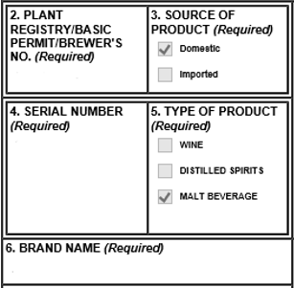
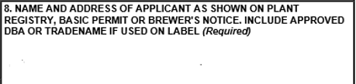
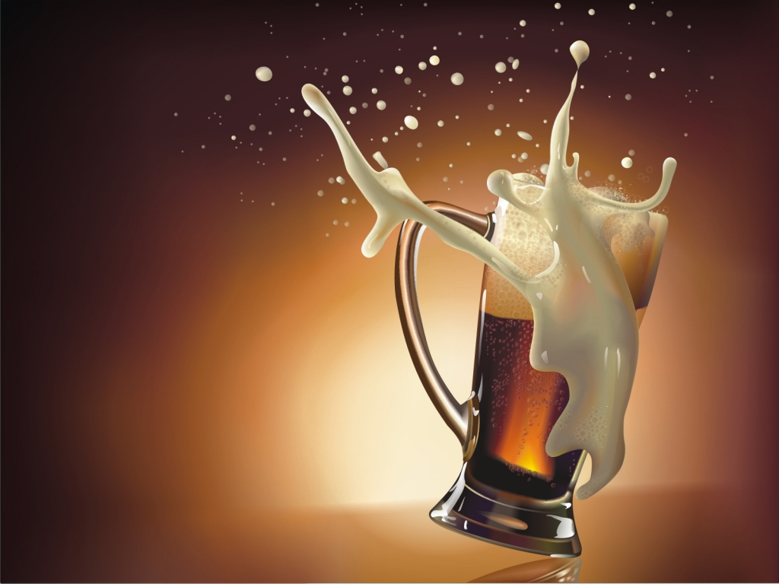
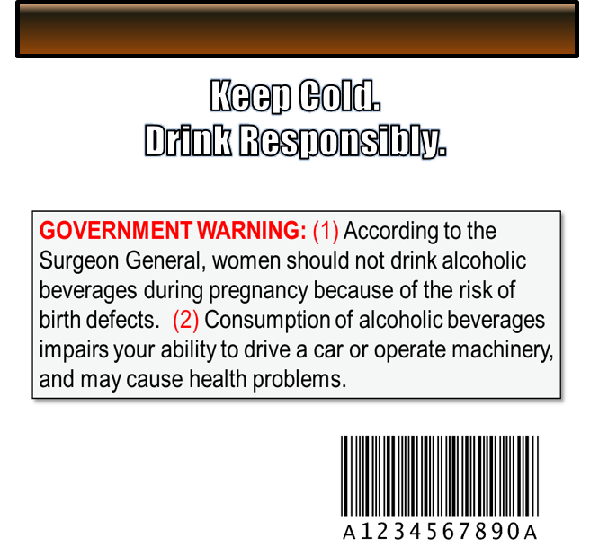






Mandatory Label Information | Example
Fake Brewery Name
1234 Road
Arlington, VA
BRAND LABEL:
BACK LABEL:
Fake Brewery Name
Arlington, VA
Example
Mandatory Label Information:
Brand Name
Name and Address
Class/Type
Net Contents
Government Warning
Alcohol Content (Optional)
Example
Golden Ale
5 % ALC/VOL
1 Pint
Creative Commons-licensed Image

Slide 41

Mandatory Label Information Brand Name
Name under which the malt beverage is marketed
If you do not identify a brand name, then the name of the bottler or importer is considered the brand name
Common Mistakes:
Brand name on the label is not correctly entered on the application
Class/type is entered in the brand name field on the application
Example:
ALE
27 CFR 7.23

Slide 42
Mandatory Label Information Name and Address
City and state of bottler/packer
Trade name or DBA (doing business as) is allowed
Principal place of business of the producing brewer may be used in lieu of listing all brewing locations when owning multiple brewing locations
27 CFR 7.25

Slide 43
Name and Address | Common Mistakes
Name and address are missing from the label
City and state on label do not match the address on the Brewer’s Notice
Contract brewer/producer has not added the contractee’s DBA/trade name to their Brewer’s Notice
Label contains name and address of the contractee and not the contract brewer/producer

Slide 44
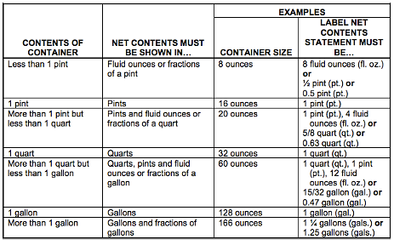
Mandatory Label Information Net Contents
Must use English units of measure (fluid ounces, pints, quarts, gallons)
May show both metric and English units on the label
1 pint 9.4 fl. oz. (750 mL)
27 CFR 7.27

Slide 45
Net Contents| Common Mistakes
Stating just oz. instead of fl. oz.
Stating 16 fl. oz. instead of 1 pint (may list both)
Needs Correction:
1 Pint (473 mL)
1 Pint
16 OZ
16 FL OZ
473 mL
Acceptable Formats:
Not converting measurements into pints and fluid ounces (22 fl. oz. vs. 1 pint 6 fl. oz.)
Showing only metric units (750 mL)

Slide 46
Mandatory Label Information Alcohol Content
Alcohol By Volume:
Mandatory if any alcohol is derived from added flavors or other added nonbeverage ingredients (other than hops extract) containing alcohol
Otherwise, it is optional (unless required by state law)
Alcohol By Weight:
You may optionally include alcohol by weight together with the statement of alcohol by volume
Approved Formats:
Alcohol By Volume: | Alcohol By Weight:
Alcohol (ALC) __% by Volume (VOL) | Alcohol (ALC) ___% by Weight
Alcohol (ALC) by Volume (VOL) __% | Alcohol (ALC) by Weight __%
__% Alcohol (ALC) by Volume (VOL) | ___% Alcohol (ALC) by Weight
__% Alcohol (ALC)/Volume (VOL) | ___% Alcohol (ALC) / Weight
27 CFR 7.71

Slide 47

Alcohol Content | Common Mistakes
Using an incorrect format
ABV and ABW are not permitted - you must spell out the words or use the abbreviations allowed by 27 CFR 7.71(b)(3)
Example: 5% ABV vs. 5% ALC/VOL
Leaving off part of the phrase or the percent symbol (%)
Not listing alcohol content on the label for products that contain added alcohol from a flavor

Slide 48
Mandatory Label Information Health Warning Statement
Must be readily legible under ordinary conditions and on a contrasting background
Must be separate and apart from all other label text
The words GOVERNMENT WARNING must appear in capital letters and bold type
GOVERNMENT WARNING: (1) According to the Surgeon General, women should not drink alcoholic beverages during pregnancy because of the risk of birth defects. (2) Consumption of alcoholic beverages impairs your ability to drive a car or operate machinery, and may cause health problems.
27 CFR part 16

Slide 49
Mandatory Label Information Class and Type - General
The specific identity of a malt beverage
The designation of malt beverages is based on trade understandings of the characteristics generally attributed to the particular malt beverage
Ale, Beer, Malt Liquor, Stout, Ice Beer, Porter, and India Pale Ale are all acceptable as the class designation of a malt beverage
27 CFR 7.24

Slide 50
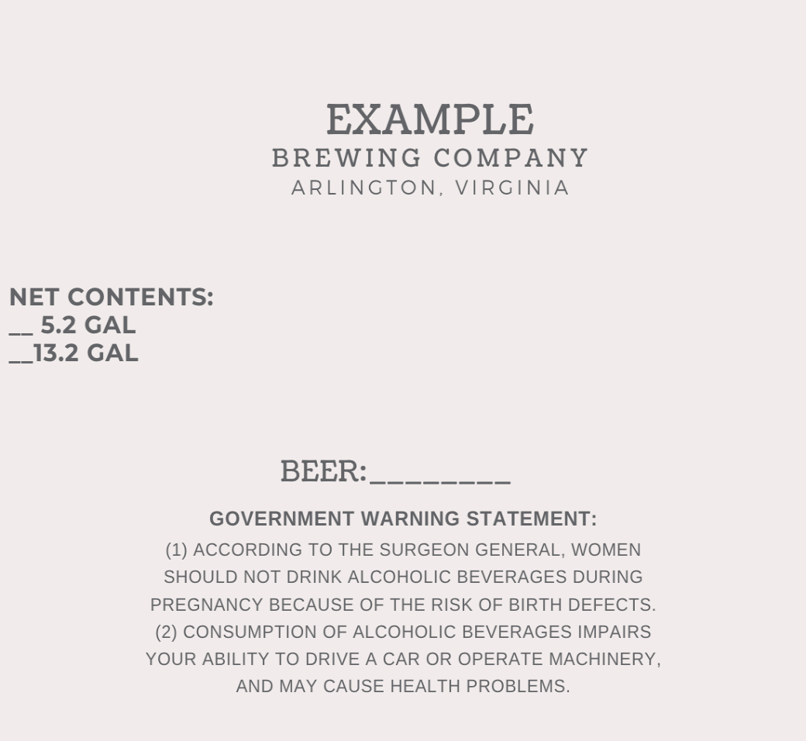
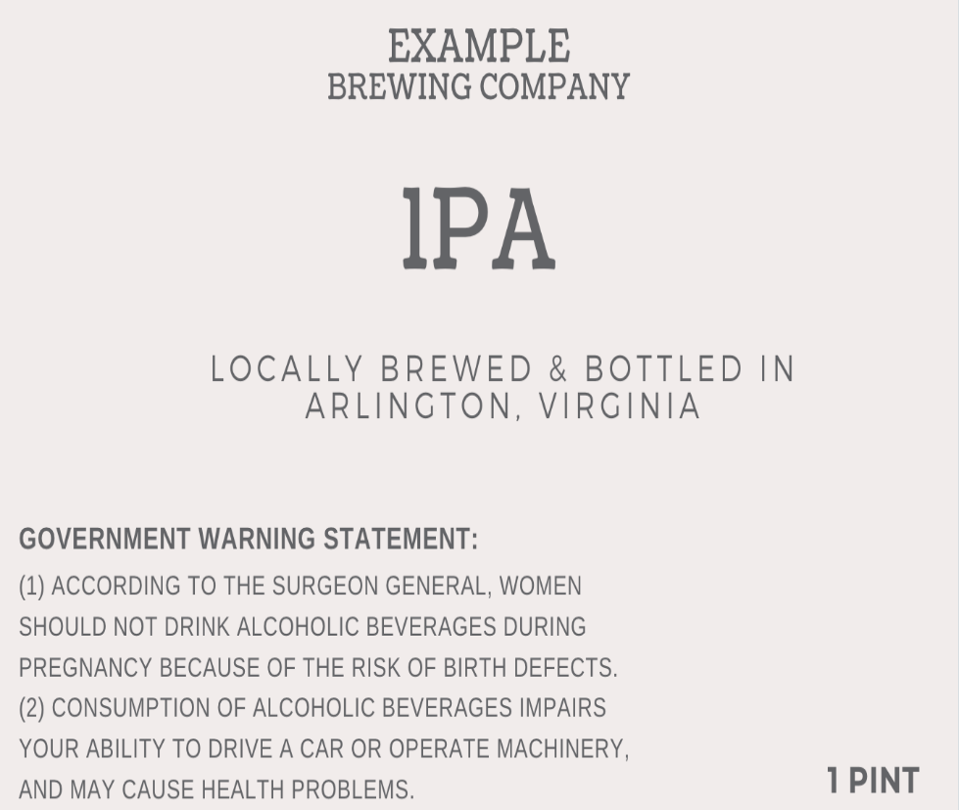
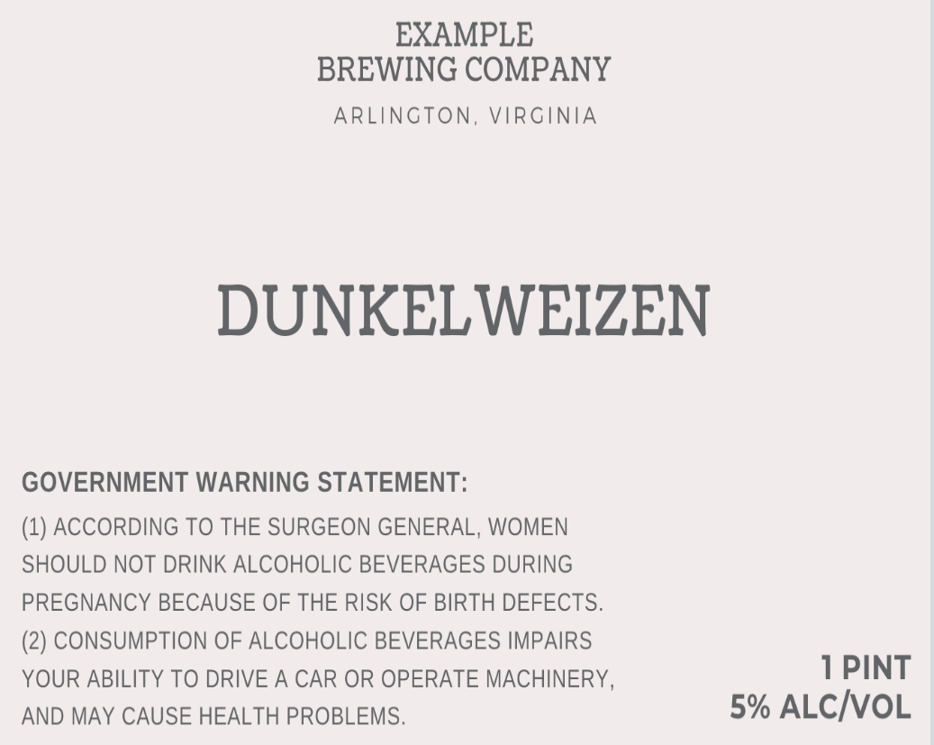



Class/Type | Common Mistakes
Dunkelweizen and styles, such as Hefeweizen, Bock, Tripel, Bier, etc. are not sufficient class designations in and of themselves, and need to be further qualified by adding Ale, Beer etc. afterwards.
IPA is not sufficient as a class/type statement. Ale or India Pale Ale must appear on the brand label.
::
::
The class designation (ale, stout, etc.) is missing. [Beer with a colon is considered a heading, and not a class/type.]
::
Image from canva.com/templates/labels

Slide 51
Mandatory Label Information Class and Type – Malt Beverage Specialty Products
Products not known to the trade under a particular designation are commonly called malt beverage specialty products
MB specialty products require formula approval prior to applying for label approval, unless they have been specifically exempted from formula approval
27 CFR 7.24(a)
Notes:
TTB commonly refers to these products as malt beverage specialty products

Slide 52
Mandatory Label Information Class and Type – Formulated Specialty Products
If formula approval is required, the product must be labeled with a distinctive or fanciful name, together with an adequate and truthful statement of the composition
Hazelnut Porter – Porter Brewed with Hazelnuts
Fanciful name
Statement of Composition
27 CFR 7.24(a)
Notes:
TTB commonly refers to these products as malt beverage specialty products

Slide 53
MB Specialties that Require Formulas | Common Mistakes
Fanciful name is missing on the label and/or application
Statement of composition does not accurately reflect the flavoring materials in the product as per the formula
Statement of composition is missing the base beer
For example, Made with Vanilla Extract vs. Ale with Vanilla Extract

Slide 54
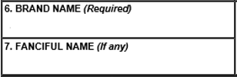

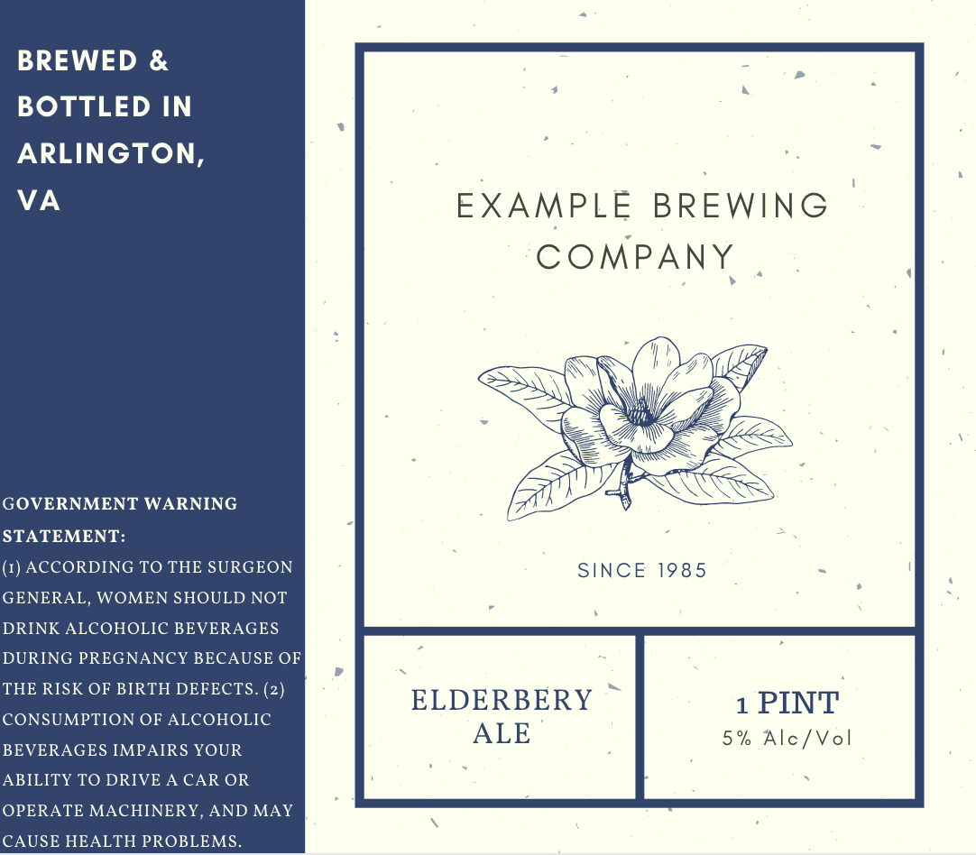
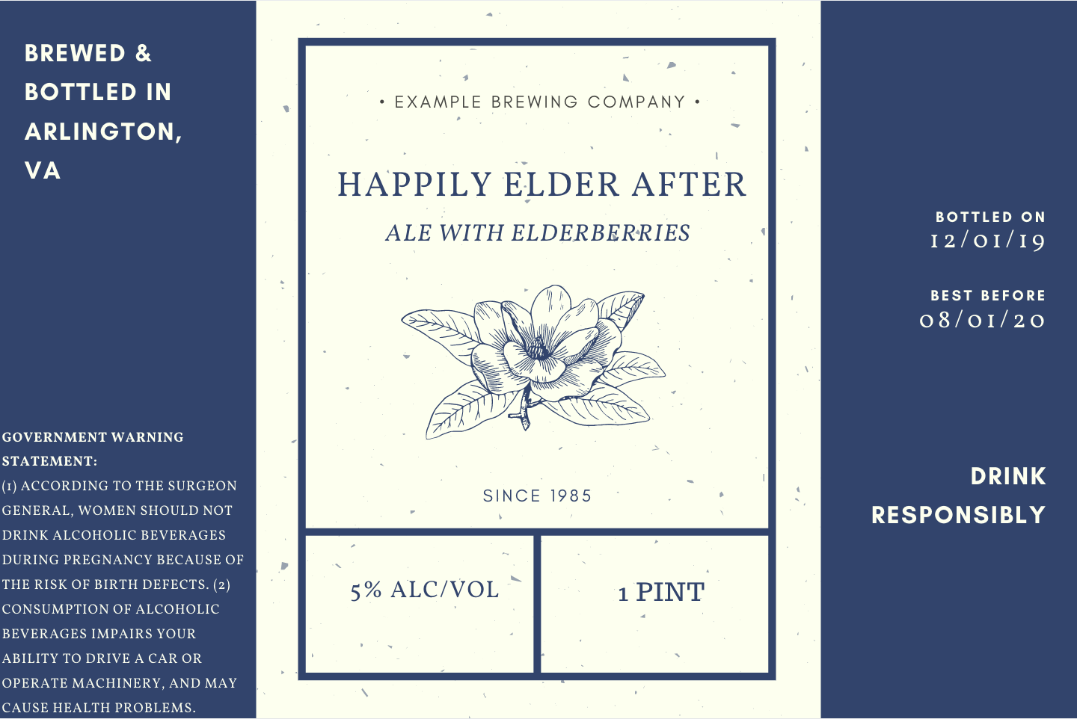
Class and Type | Formulated MB Specialty Product
The fanciful name is missing. On formulated malt beverages, a fanciful name is required to appear on the brand label
Example Brewing Company
Happily Elder After
The label must have a statement of composition that identifies the products class and type, which is currently missing. A designation does not satisfy this requirement because the product is formulated
:
:
Image from canva.com/templates/labels

Slide 55
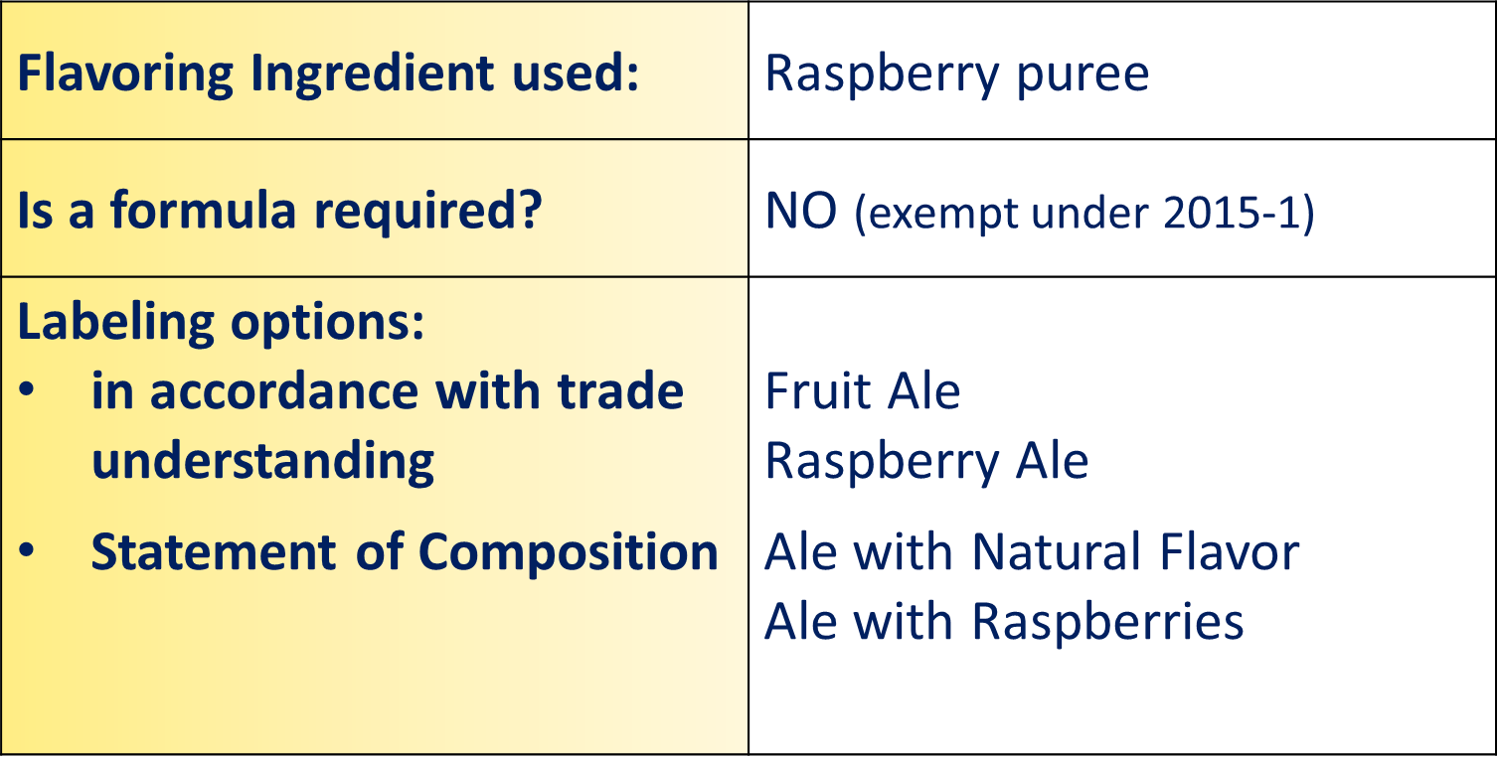
Mandatory Information Class and Type – Formula Exempt MB Specialties
Specific malt beverage ingredients and processes are exempt from formulas under TTB Ruling 2015-1
The process of aging beer is exempt, however DS or wine barrels, woodchips, or staves should have no discernible quantity of spirits or wine
Labeling Requirements:
Class/type may be stated as either a Designation or Statement of Composition
Fanciful Names are not required
Aging of a product does not need to be called out as part of the Class/type

Slide 56
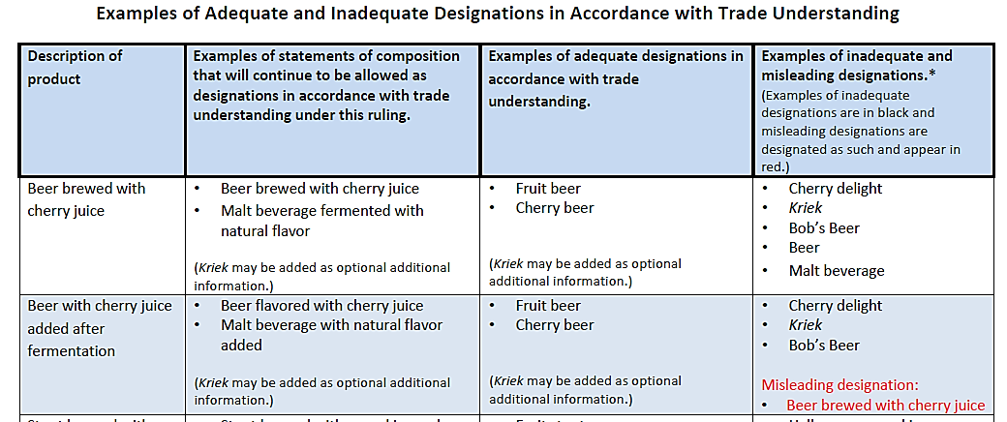
2015-1 Examples of Designations – Attachment 2

Slide 57
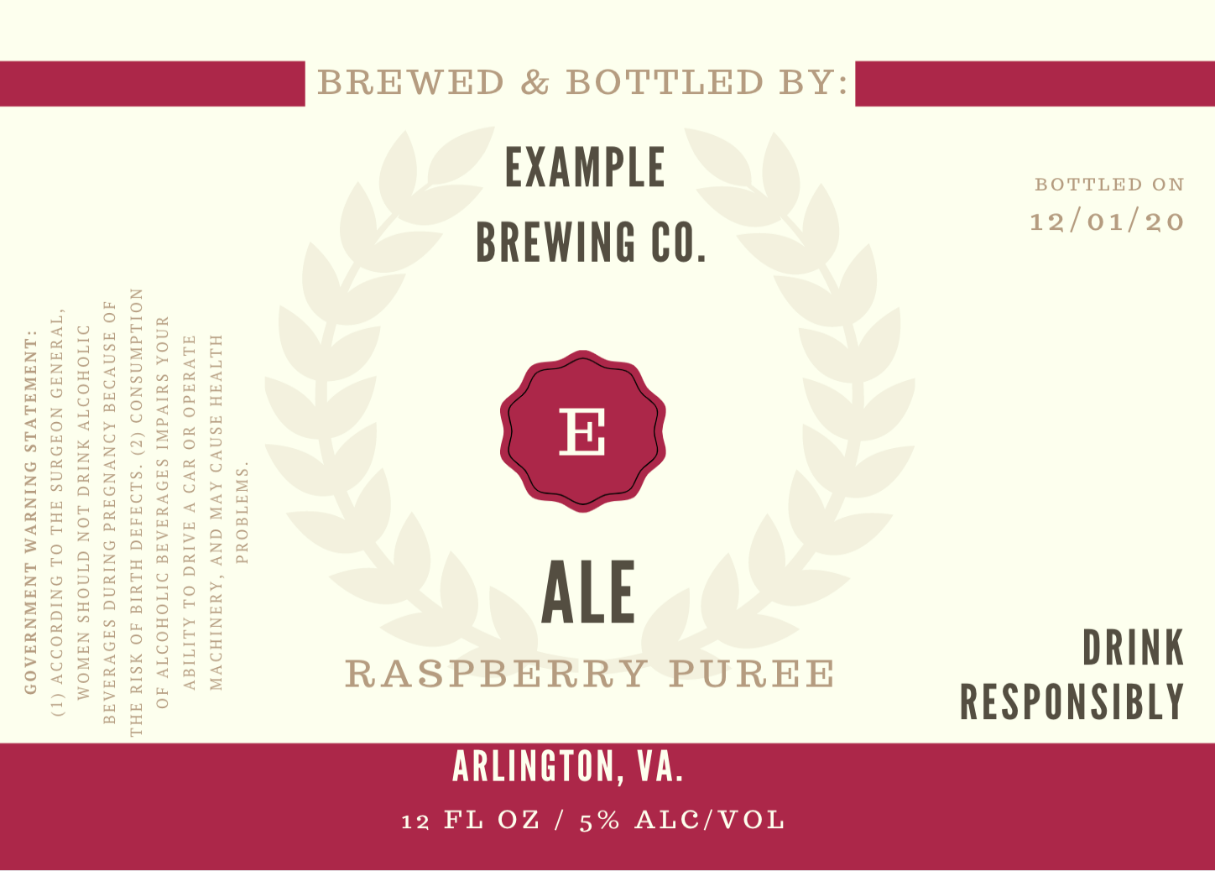
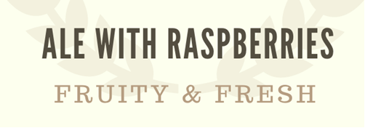





Class and Type | Formula Exempt MB Specialties
Examples of acceptable designations/statement of composition:
This label does not have a class and type statement or designation in accordance with TTB Ruling 2015-1
::
Image from canva.com/templates/labels

Slide 58
MB Specialties Exempt from Formulas | Common Mistakes
Product ingredients are not sufficiently conveyed by the style’s name, for example, as gose or wit
Statement of composition or designation is missing
Class designation of base product is missing in the statement of composition
Acceptable:
Ale with Blueberries
Needs Correction:
Made with Blueberries

Slide 59
Geographical Names Class and Type
Geographical names for distinctive types of malt beverages shall not be applied to malt beverages produced in any place other than the particular region indicated by the name unless qualified with text such as STYLE or PRODUCT OF THE USA or other text to indicate the true place of production
Common Mistakes
India Pale Lager or India Session Ale appearing without qualifiers (such as Style or Product of USA)
Product of the USA does not appear in direct conjunction with the geographically significant reference (text or imagery)
27 CFR 7.24(f)-(h)

Slide 60
Geographical Names of Distinctive Types Class and Type
Names that have lost geographic significance (no qualifier required)
Examples of names that still have geographic significance* (qualifier required)
India Pale Ale
Baltic Porter
Bohemian
Russian Imperial Stout
Imperial Russian Stout
Scotch Ale
Scottish Ale
Belgian
Berliner
English
Irish
Kolsch
Mexican
Vienna
New England
West Coast (or similar)
*Not a Complete List

Slide 61

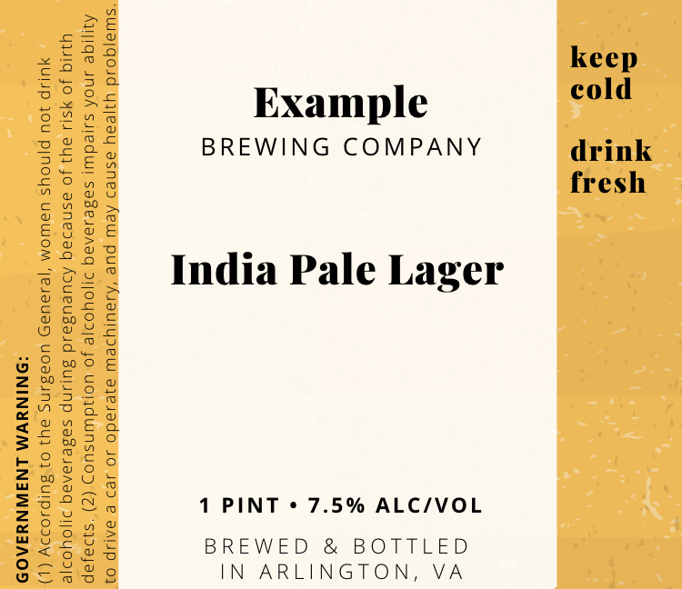
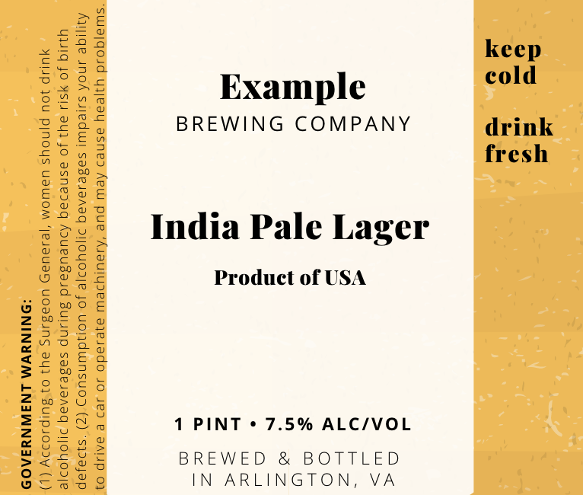
Geographic Significance | Example
Geographically significant malt beverage styles produced in a country other than the one indicated must be properly qualified with style or a phrase such as Product of USA
Unlike India Pale Ale, India Pale Lager has not lost its geographic significance

Slide 62
Keg Collars

Slide 63
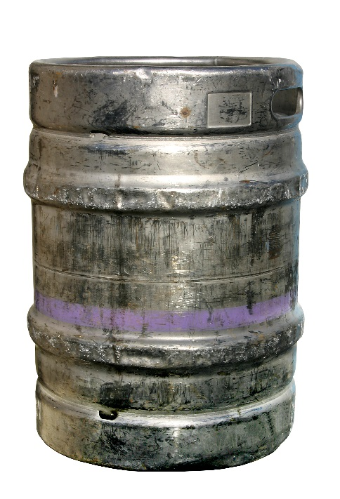
Kegs
Kegs are consumer containers, just like bottles or cans
When a COLA is required, mandatory labeling requirements must be met
Labels bearing mandatory information must be firmly affixed and may include:
Keg caps
Collars
Stickers
Combination of formats
Information can be handwritten on the label
Except for GOVERNMENT WARNING

Slide 64

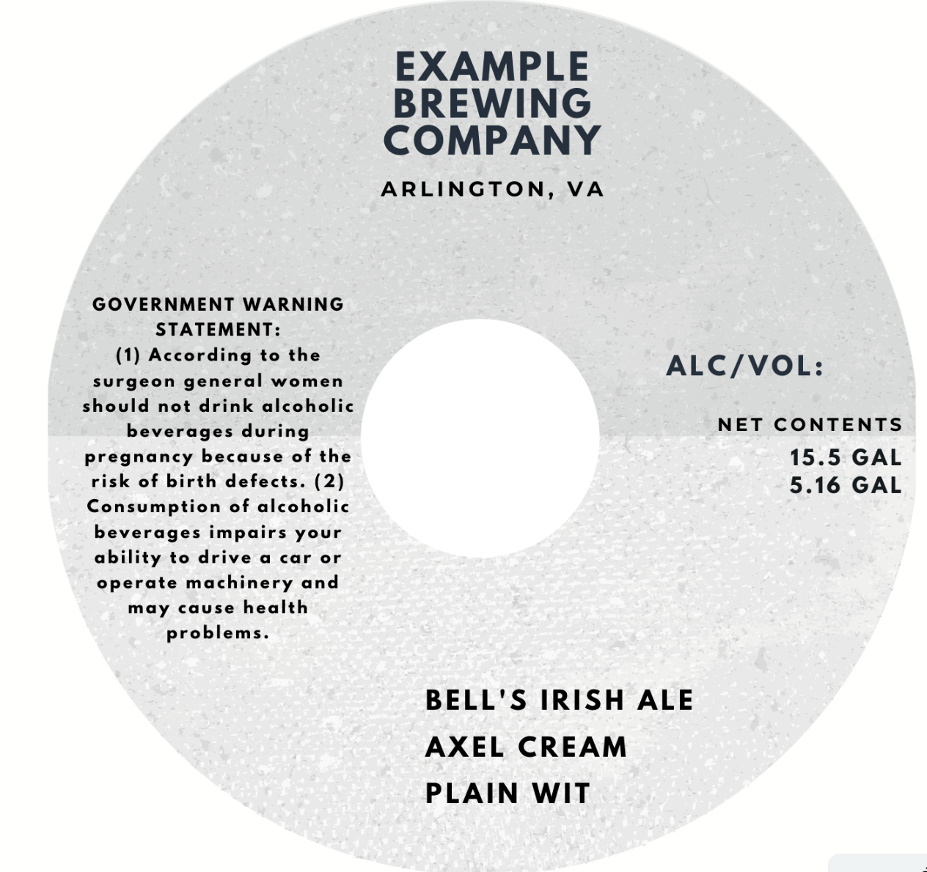
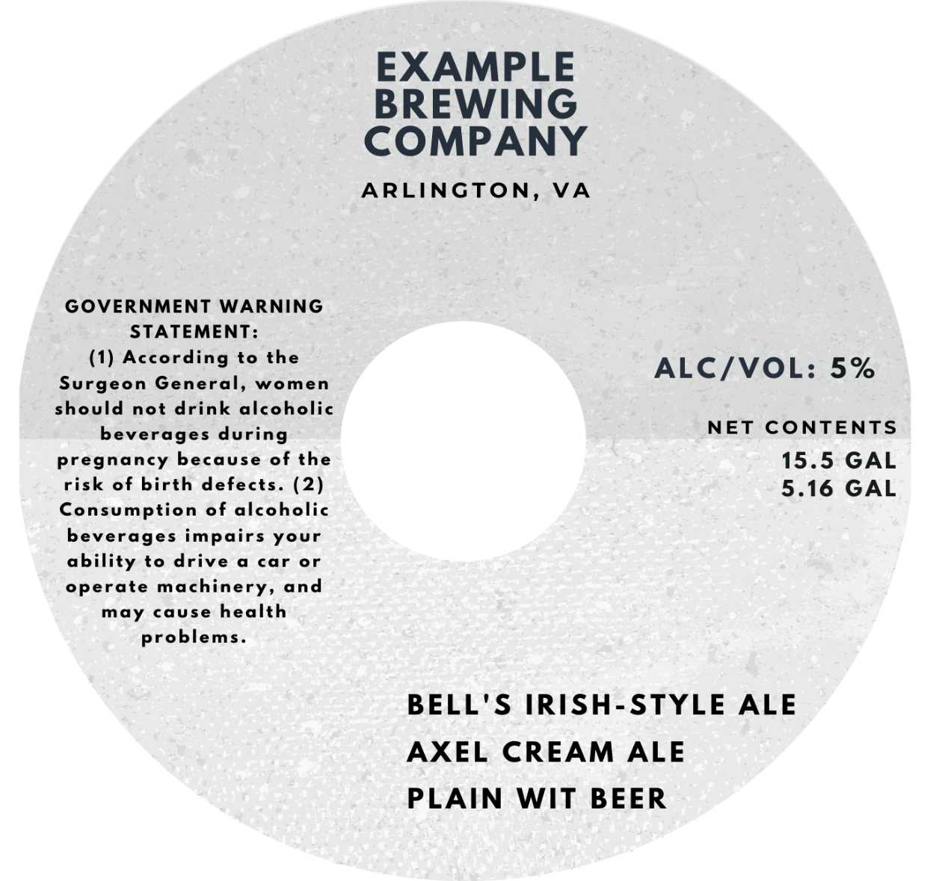

Keg Label Common Mistakes| Example
The Government Health Warning is not compliant. The S and G in Surgeon General must be capitalized. Also, a comma must appear after General and machinery.
The alcohol content cannot be left blank and must be listed in the identified section. However, it is an allowable revision post approval.
:
:
Missing x
X
Irish is geographically significant and must be further quailed (e.g. Irish-Style). Cream and Wit are missing the Class/Type designation at the end.
When multiple class and type designations are present on keg labels, you are required to designate the product to which the application applies.
X

Slide 65
Prohibited Labeling Practices

Slide 66
Examples of Things Prohibited from Appearing on Malt Beverage Labels
Any statement that is false or untrue
Any statement ... relating to any guarantee
Any misleading information, such as:
Text that implies that the product is a distilled spirit or contains a distilled spirit
Misleading health-related claims
Implied government endorsements
27 CFR 7.29

Slide 67
Commonly Used Optional Information
Rulings of Interest:
2004-1 Caloric and Carbohydrate Representations
2020-2 Gluten Content Statements
2013-2 Voluntary Nutrient Content Statements
Frequently Asked Questions (FAQs) of Interest:
FAQs on TTB Ruling 2013-2 (Serving Facts Statements)
FAQs on Sugar Content Statements
FAQs on Major Food Allergen Labeling
FAQs on Organic Labeling
FAQs on Alcohol
FAQ [AF3]: How do I calculate the number of servings per container?

Slide 68
Labeling Resources
Beer Resources
TTB Beer Rulings www.ttb.gov/beer/rulings | Beer-Beverage Alcohol Manual (BAM) www.ttb.gov/beer/beverage-alcohol-manual
TTB Beer Industry Circulars www.ttb.gov/beer/industry-circulars | Do I Need a Formula? Tool www.ttb.gov/formulation/mbev
TTB Beer Frequently Asked Questions (FAQs) www.ttb.gov/beer/beer-faqs | TTB G 2016-1A –Beer/Malt Beverages Requiring Formula Approval or Laboratory Sample Analysis Chart www.ttb.gov/public-guidance/ttb-g-2016-1a
Allowable Revisions to Approved Labels www.ttb.gov/labeling/allowable-revisions | Labeling Laws and Regulations www.ttb.gov/labeling/laws-and-regulations

Slide 69
Contact Us
Questions?
Contact the Alcohol Labeling and Formulation Division at: Toll Free at 866-927-ALFD (2533), OR Use our Alcohol Labeling and Formulation Division (ALFD) Contact Form
Representatives are Available: 8 a.m. to 4:30 p.m. ET Monday - Friday (except on federal holidays)

