Slide 1
FAET Return Walkthrough
Presented by:
Ronnie King - Chief, Tax – B, National Revenue Center (NRC)
Daniel Peralta - Counsel (Field Operations)
Jesse Longbrake – FAET Program Manager, Regulations and Rulings Division
Robert Fielding – Excise Tax Auditor, Tax Audit Division, Eastern I
Ryan Coombs – Excise Tax Auditor, Tax Audit Division, Eastern I
Janelle Christian – Industry Outreach Program Manager
NOTICE: Videotaping and re-broadcasting this presentation is strictly prohibited and may be a violation of Federal law.

Slide 2
Walkthrough of the Firearms and Ammunition Excise Tax (FAET) Return
the national shooting sports foundation
Shot Show 2020
January 23, 2020 | Las Vegas, Nevada
Alcohol and Tobacco Tax and Trade Bureau

Slide 3
TTB Disclaimer
This information is being presented to help the public to understand and comply with the laws and regulations that the Alcohol and Tobacco Tax and Trade Bureau (TTB) administers.
It is not intended to establish any new, or change any existing definitions, interpretations, standards, or procedures regarding those laws and regulations.
In addition, this presentation may be made obsolete by changes in laws and regulations.
Please consult the applicable laws and regulations for the most current requirements.

Slide 4
Agenda
Background
Filing the FAET Return and Paying Tax
FAET Return Details (line-by-line walkthrough)
What to Expect in a TTB Audit (separate presentation)
Preview

Slide 5
Background
Legal Framework
Statutory Authority: 26 U.S.C. 4181
FAET Tax Collections Trend
Disposition of the Revenue
Definition of a Firearm
Definition of Ammunition
Preview

Slide 6
Legal Framework
Title 26 United States Code – Internal Revenue Code (26 U.S.C. _)
Title 27 Code of Federal Regulations – Alcohol, Tobacco Products, and Firearms: this presentation focuses on Part 53, which contains TTB’s firearms and ammunition regulations (27 CFR Part 53)
Interpretive Guidance on TTB’s Website – IRS Revenue Rulings, ATF Rulings, TTB Rulings, Industry Circulars, Announcements
Interpretive Guidance Not on TTB’s Website – IRS Private Letter Rulings, ATF Letter Rulings, TTB Technical Advice Letters

Slide 7
Where FAET begins: 26 U.S.C. 4181
Imposition of tax
There is hereby imposed upon the sale by the manufacturer, producer, or importer of the following articles a tax equivalent to the specified percent of the price for which so sold:
Articles taxable at 10 percent-
Pistols.
Revolvers.
Articles taxable at 11 percent-
Firearms (other than pistols and revolvers).
Shells, and cartridges.

Slide 8
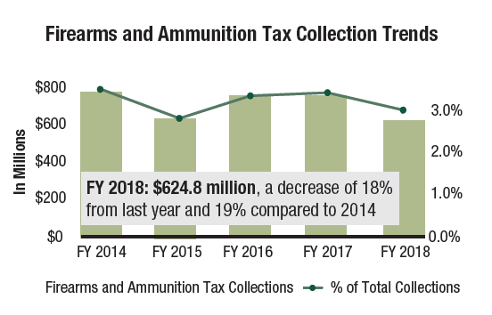
A little perspective…
Source: TTB Fiscal Year 2018 Annual Report
Compare to FY 2008: $312.6 million (almost exactly half of the amount being collected currently)

Slide 9

Disposition of Revenue
Pittman-Robertson Wildlife Restoration Act of 1937: Mandates that all FAET revenue (and bow and arrow revenue) be used for Federal aid to wildlife restoration fund, hunter safety programs and maintenance of public target ranges for execution of programs. This money is distributed to the states.
Department of the Interior (Fish and Wildlife Service) is responsible for administration of the trust fund. The Secretary of the Interior can deduct up to a set amount of collected revenues for administration.
By contrast, TTB administers and collects this money and receives no portion of collections for its administrative costs.

Slide 10
Definition of a Firearm
Firearms are, “Any portable weapons…from which a shot, bullet, or other projectile may be discharged by an explosive.” See 27 CFR 53.11
Non-firearms under this definition include:
Starter Pistols
BB Guns
Trade Show Guns (if firing mechanism is disabled)

Slide 11
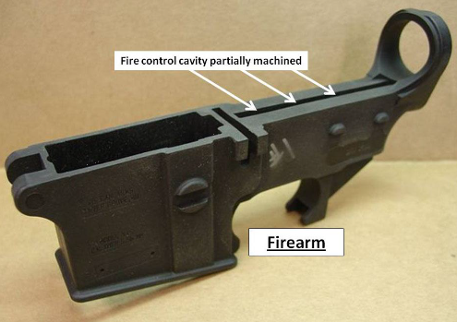
Definition of a Firearm
TTB’s definition of a firearm is very different than ATF’s definition under the Gun Control Act of 1968. For instance:
ATF considers receivers like the one pictured to be a firearm. TTB doesn’t.
ATF does not consider many muzzle loading guns to be firearms. TTB does.

Slide 12

Definition of Ammunition
Shells and cartridges, “Include any article consisting of a projectile, explosive, and container that is designed, assembled, and ready for use without further manufacture in firearms, pistols, or revolvers.” See 27 CFR 53.11
Most notable example of what doesn’t fall under this definition?
Blank ammunition
(explosive and container, but no projectile)

Slide 13
Return Filing and
Tax Payment
Pay.gov
Paper Filing
Return and Payment Due Dates
Preview

Slide 14

Pay.gov
TTB recommends using Pay.gov to file returns and pay taxes. Learn more at
https://www.ttb.gov/what-we-do/online-services/pay-gov
Important Point: Pay.gov uses ACH for electronic fund transfers. The payment must be completed no later than 4 p.m. Eastern Time one business day prior to the due date.

Slide 15
Paper Filing
The paper version of the tax return, TTB F 5300.26, is available at https://www.ttb.gov/images/pdfs/forms/f530026.pdf
The latest version of the tax return must be used. The version dated 06/2017 was released in February 2019.
EFT payments to go along with paper filing may be made outside of Pay.gov. Advance notice is required and there is a minimum four quarter commitment. See https://www.ttb.gov/tax-audit/tax-payments-by-eft for details on how the payments are made.

Slide 16
Return and Payment Due Dates
Quarterly returns (the most common type) must be filed by the last day of the month following the end of the quarter. See 27 CFR 53.153 for details.
Example: return due 7/31/2020 for quarter ending 6/30/2020
Adjustments are made if the due date falls on a Saturday, Sunday, or legal holiday. TTB posts a schedule each year that accounts for this (e.g. https://www.ttb.gov/tax-audit/2020-firearms-due-dates)

Slide 17
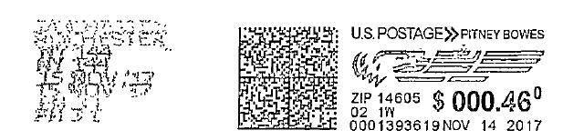
Return and Payment Due Dates
Top Ten NRC - Problem (#1)
If mailed, the postmark date is the date of filing. If there is doubt about the postmark, the taxpayer bears the burden of proving that a return was timely filed. We strongly recommend mailed returns be certified or, at a minimum, stamped at the post office counter.
Third party postage is NOT an official postmark. The Pitney Bowes stamp on the right may have been dated November 14, but the postmark on the left was November 15.

Slide 18
FAET Return Details
Part I – General
Part II – Calculation of Taxes on Sales or Uses During This Tax Period
Part III – Calculation of Tax Liability for this Tax Period
Schedule A – Increasing Adjustments
Schedule B – Decreasing Adjustments
Certification
Preview

Slide 19
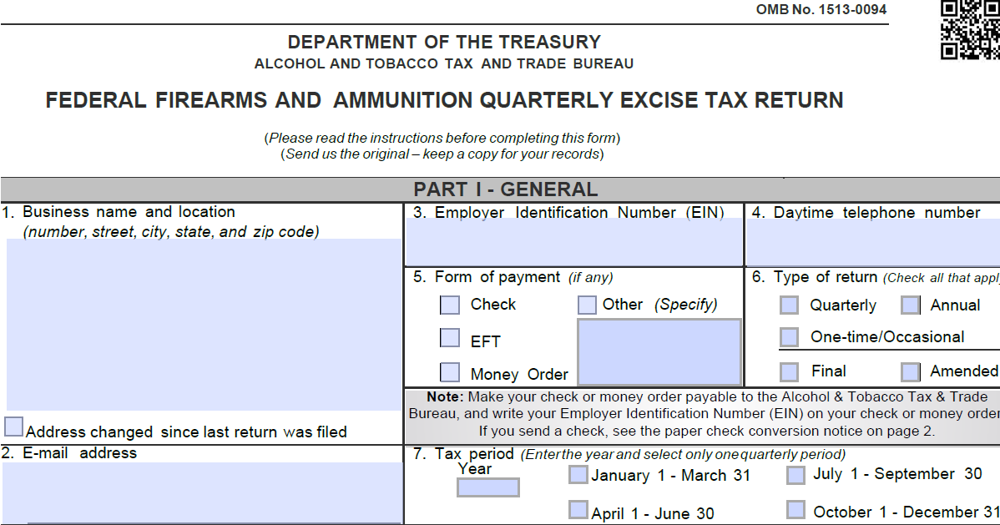
FAET Return Part I - General

Slide 20
FAET Return Part I - General
Top Ten NRC - Problems (#2, #3)
Missing Email Address – It may not be required but it greatly facilitates communication if there is a problem. TTB does not disclose or use your email address for any purpose other than communication with you about your return.
Missing Address – This is required on the return. Should the address change, it is helpful if the taxpayer sends a separate letter to the NRC stating that fact. This will ensure the industry member record in the computer system is updated.

Slide 21

FAET Return Part I - General
Top Ten NRC - Problem (#4)
Incorrect Tax Period – Industry members are urged not to simply copy the last tax return to use as a starting point for the current one. A common problem is that line 7, Tax period, does not get updated. Even if TTB notices a possible discrepancy we cannot assume it was a mistake.

Slide 22
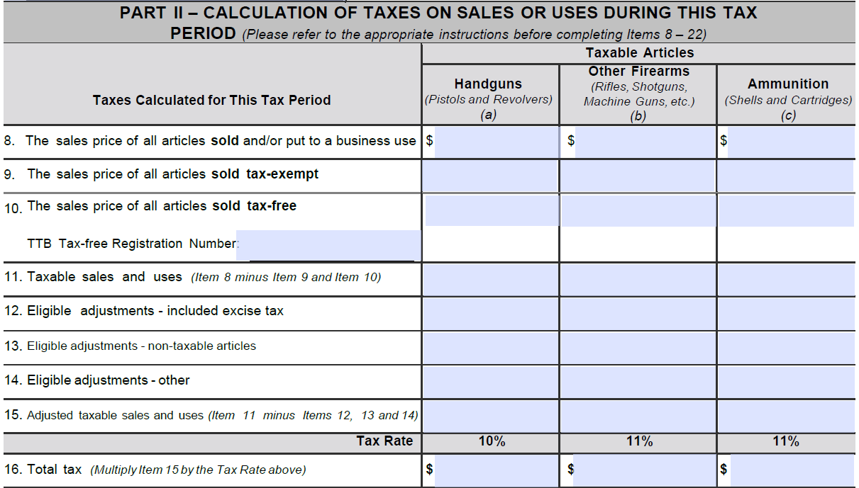
FAET Return Part II – Calculation of Taxes

Slide 23
Line 8 – The sales price of all articles sold and/or put to a business use
Because of the importance of this line, we will go through each instruction one-by-one.
Combining sales and business uses on the same line is an important change on the new form version.
Instruction 1: “Include FAET if it is included in the sales price.”
If there is a separate invoice line for FAET, care must be taken to ensure it is not overstated. Knowingly telling customers more tax is due than what will be paid to TTB is a misdemeanor under 26 U.S.C. 7211, False statements to purchasers or lessees relating to tax.

Slide 24

Line 8 – The sales price of all articles sold and/or put to a business use
Instruction 2: “Enter the dollar amount of your total sales of taxable articles, including tax-exempt or tax-free sales during the tax period stated in Item 7.”
One thing to think about here: used guns.
Domestic used firearms are nontaxable articles that should be excluded from line 8. Imported used firearms, however, are often taxable. A good source for more information is https://www.ttb.gov/images/pdfs/faet_importation_information.pdf

Slide 25
Line 8 – The sales price of all articles sold and/or put to a business use
Instruction 3: “Do not include articles if you are not the manufacturer, producer, or importer for purposes of this tax.”
One situation this addresses is nominal importers. If someone else is “driving” the transaction and causing the importation to occur, the importer of record might be just a nominal importer not liable for FAET. In such a case, the person causing the importation may be viewed as a beneficial owner liable for the tax. For more details, see 27 CFR 53.11, Revenue Rulings 69-393 and 72-215, and https://www.ttb.gov/firearms/importers.

Slide 26
Line 8 – The sales price of all articles sold and/or put to a business use
Instruction 4: “Except for leases and certain installment sales, you must include all sales regardless of whether your customers paid you.”
Instruction 5: “The sales price is usually stated on the customer’s invoices. You should also include the dollar value of things other than money given as consideration for the article. This includes services, personal property, and articles traded in.”

Slide 27



Line 8 – The sales price of all articles sold and/or put to a business use
Instruction 6: “Do not include the sales price of a non-taxable article unless you sold it as a unit with the taxable article.”
“Sold it as a unit” means for a single, combined price. If sold separately on the same invoice, exclude the nontaxable article from line 8. Examples of nontaxable parts and accessories per 27 CFR 53.61 include:
Cleaning Equipment
Extra magazines
Gun Case

Slide 28

Line 8 – The sales price of all articles sold and/or put to a business use
Instruction 7: “When a taxable article is sold as a unit with a non-taxable article (for example, a pistol and holster) or with extra parts or accessories, you should enter the sale price of the unit. If a taxable sale, you must adjust the unit’s sales price in Item 13 to exclude the non-taxable article, part, or accessory.”

Slide 29

Line 8 – The sales price of all articles sold and/or put to a business use
Instruction 8: “You must pay the tax on your business use of taxable articles that you manufactured or imported. If you regularly sell the articles, you must compute the tax based on the lowest established wholesale price.”
Instruction 9: “Include the sum of the prices for articles used. Uses Include: loans of articles for display, demonstration or familiarization, or further manufacture of an article not subject to any FAET. (Please refer to 27 CFR 53.111 – 115 for more information.)”
Common Use – Loans to Writers

Slide 30
Line 9 – The sale price of all articles sold tax-exempt
Top Ten NRC - Problem (#5)
Confusing tax-exempt (line 9) and tax-free (line 10) sales. Tax-exempt sales fall into the following categories (see, in general, 27 CFR 53.62):
Firearms on which the National Firearms Act (NFA) transfer tax has been paid (26 U.S.C. 4182(a))
Sales by small manufacturers, producers, and importers (26 U.S.C. 4182(c))
Sales to the Defense Department (26 U.S.C. 4182(b))
Sales to the Coast Guard (14 U.S.C. 943)
Sales to the Federal Reserve (12 U.S.C. 531)
Note: tax-exempt sales do not require a tax-free registration.

Slide 31
Line 9 – The sales price of all articles sold tax-exempt
Sales to the Federal Government its Agencies and Instrumentalities
Where the United States or an instrumentality thereof is to be relieved from a tax, the statutes generally so provide.
Do not assume that a sale to the Federal government, its agencies or instrumentalities will be tax-exempt.
A specific exemption must exist pertaining to the specific buyer.

Slide 32
Line 9 – The sales price of all articles sold tax-exempt
Four Important Caveats to Tax-Exempt Sales
NFA Firearms – Sales are only tax-exempt if the $200 or $5 transfer tax has been paid.
Defense Department – Sales are only tax-exempt if “purchased with funds appropriated for a military department of the United States.” Meaning: Departments of the Army, Air Force, and Navy (which includes Marine Corps). Examples of what is NOT included:
Pentagon Police Department (funded at the DOD level)
Foreign Military Sales (usually tax-free, though, with proper docs)
1
2

Slide 33
Line 9 – The sales price of all articles sold tax-exempt
Four Important Caveats to Tax-Exempt Sales
Direct Sale – In general, sales must be made directly to the tax-exempt entity. Unlike some tax-free sales, the regulations contain no provision allowing tax-exempt sales to be routed through a dealer or other intermediary.
3

Slide 34
Line 9 – The sales price of all articles sold tax-exempt
Four Important Caveats to Tax-Exempt Sales
Small manufacturer – Sales are tax-exempt if the manufacturer/importer manufactures/imports less than 50 firearms in a calendar year, regardless of when sold. So…
If an importer in Year 1 imports 20 firearms but sells 0, then in Year 2 imports 40 firearms and sells all 60, FAET is due on none of them.
If an importer in Year 1 imports 50 firearms, sells 25 in Year 1 and 25 in Year 2, FAET is due on all 50. BEWARE: That 50th gun is expensive!
4

Slide 35


Line 10 – The sales price of all articles sold tax-free
Five Types of Tax-Free Sales
State or Local Government
Export

Slide 36



Line 10 – The sales price of all articles sold tax-free
Five Types of Tax-Free Sales (cont)
Nonprofit Educational Institution
Supplies for Vessels or Aircraft
Further Manufacture

Slide 37
Line 10 – The sales price of all articles sold tax-free
Registration Required
The requirement for the manufacturer/importer to enter their tax-free registration number on the FAET return is a blunt reminder that a registration is generally required.
There are only two exceptions to the requirement that the manufacturer/importer be registered:
If the seller happens to be part of the U.S. Government (let’s assume you aren’t)
If the tax-free purpose is for supplies for vessels and aircraft

Slide 38
Line 10 – The sales price of all articles sold tax-free
Top Ten NRC - Problem (#6)
“Pending” is not a valid tax-free registration number. If a registration hasn’t been obtained but is needed, tax must be paid on the sale in question. A claim may be allowed after-the-fact.
Some industry members have registrations that are decades old. Stop and think:
Do I still have the registration?
Does it authorize the types of tax-free activity I engage in?
Have I experienced a change of name, address, ownership, or control?

Slide 39
Line 10 – The sales price of all articles sold tax-free
Customer Registration Requirement Exceptions
The tax-free customer must be registered as well unless one of four exceptions applies under 27 CFR 53.141.
State or Local Government – In the absence of a registration, the state or local government must provide a properly executed exemption certificate or a purchase order containing the same information.
Sales or resales to foreign purchasers for export – “Persons whose principal place of business is not within the United States may, but are not required to, register in order to purchase articles tax free for export.” See 27 CFR 53.141(b) for more information.
1
2

Slide 40
Line 10 – The sale price of all articles sold tax-free
Customer Registration Requirement Exceptions
United States – The Federal Government as a whole does not enjoy tax-free status (although certain parts are tax-exempt). This covers limited circumstances where a federal agency that is not tax-exempt purchases firearms for a tax-free purpose. For example, the Drug Enforcement Administration wants to purchase guns for export to Colombia. The DEA does not need a tax-free registration.
Supplies for vessels and aircraft – Registration not required if the requirements of 27 CFR 53.134(d)(2) are satisfied.
3
4

Slide 41
Line 10 – The sales price of all articles sold tax-free
Exportation Example 1
A manufacturer sells 200 hunting rifles to a customer in Norway for $300 each. The manufacturer has tax-free registration number FAM-RI-20001-AB. The customer is not registered. To treat as a tax-free sale, reporting on the FAET return should be as follows while the documentation needed to support the sale is discussed on the next two slides:
Line 8: The sales price of all articles sold… $60,000
Line 10: The sales price of all articles sold tax-free $60,000
        Tax-Free Registration # FAM-RI-20001-AB must be entered in the appropriate space.

Slide 42
Line 10 – The sales price of all articles sold tax-free
Pre-Export Documentation Requirement
Per 27 CFR 53.133(b), “To establish the right to sell articles tax free for export to a purchaser who is not registered and who is located in a foreign country or a possession of the United States, the manufacturer must obtain from such purchaser at the time title to the article passes or at the time of shipment, whichever is earlier, either:
(1) A written order or contract of sale showing that the manufacturer is to ship the article to a foreign destination; or
(2) Where delivery by the manufacturer is to be made within the United States, a statement from the purchaser showing:
(i) That the article is purchased either to fill existing or future orders for delivery to a foreign destination or for resale to another person engaged in the business of exporting who will export the article, and
(ii) That such article will be transported to its foreign destination in due course prior to use or further manufacture and prior to any resale except for export…”

Slide 43
Line 10 – The sales price of all articles sold tax-free
Post-Export Documentation Requirement
Per 27 CFR 53.133(d)(1), “Exportation may be evidenced by:
(i) A copy of the export bill of lading issued by the delivering carrier,
(ii) A certificate by the agent or representative of the export carrier showing actual exportation of the article,
(iii) A certificate of landing signed by a customs officer of the foreign country to which the article is exported,
(iv) Where the foreign country has no customs administration, a statement of the foreign consignee showing receipt of the article, or
(v) Where a department or agency of the United States Government is unable to furnish any one of the foregoing four types of proof of exportation, a statement or certification on the department or agency stationery, executed by an authorized officer, that the listed or identified articles have, in fact, been exported.”

Slide 44
Line 10 – The sales price of all articles sold tax-free
Proof of export must be obtained within 6 months or tax is due!
See 27 CFR 53.133(c)

Slide 45
Line 10 – The sales price of all articles sold tax-free
Exportation Example 2
A manufacturer sells 200 hunting rifles to a U.S. company that exports to various countries. The manufacturer has tax-free registration number FAM-RI-20001-AB. The customer has tax-free registration number FAM-RI-15010-C. The customer exports half the rifles to Belize two months after purchase; the other half to Namibia four months after purchase.
To treat as a tax-free sale, reporting on the FAET return is the same as in Exportation Example 1. The documentation needed to support the sale is discussed on the next two slides:

Slide 46
Line 10 – The sales price of all articles sold tax-free
Pre-Export Documentation Requirement
Per 27 CFR 53.131(c), “Every purchaser who is required to be registered…shall furnish to the seller, as evidence in support of each tax-free sale made by the seller to such purchaser, the exempt purpose for which the article or articles are being purchased and the registration number of the purchaser. Such information must be in writing and may be noted on the purchase order or other document furnished by the purchaser to the seller in connection with each sale.”
In this example, the U.S. exporting company is required to be registered and must positively assert it will export the rifles. The manufacturer cannot assume such, even if that is the customer’s normal line of business.

Slide 47
Line 10 – The sales price of all articles sold tax-free
Post-Export Documentation Requirement
It is a common misconception that, in a situation like this one (sale by a manufacturer to a domestic purchaser who exports the firearms or resells them to a second purchaser who exports them), proof of export such as an export bill of lading must be obtained. The regulatory requirement is actually different.
27 CFR 53.133(d)(2) states, “In any case where the manufacturer is not the exporter, the manufacturer must have in its possession a statement from the vendee to whom the manufacturer sold the article stating the following:
continued on next slide

Slide 48
Line 10 – The sales price of all articles sold tax-free
Post-Export Documentation Requirement
(i) Date statement was executed.
(ii) Name and address of manufacturer's vendee (if other than the person executing statement).
(iii) Certificate of registry number held by vendee.
(iv) Specify article(s) purchased tax-free, by whom purchased, and date of purchase.
(v) Statement that article(s) was either exported in due course by the vendee or was sold to another person who in due course exported the article(s).
(vi) Name and address of vendee who will maintain possession of the proof of exportation documents, description of the documents, and statement that vendee will maintain documents for 3 years and make them available to TTB for inspection.
(vii) Statement that a previous statement has not been executed in respect of the articles covered by this statement and that fraudulent use of this statement may subject person executing statement and all parties making fraudulent use of statement to all applicable criminal penalties under the Code.
(viii) Name, signature, title, and address of individual executing certificate.”

Slide 49
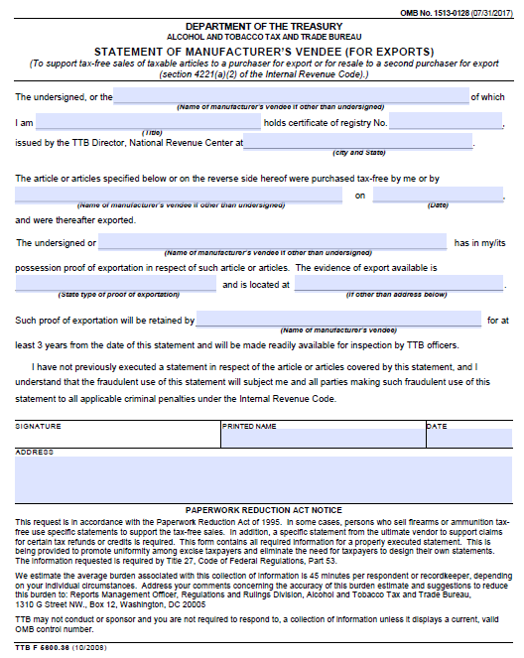
Line 10 – The sales price of all articles sold tax-free
Post-Export Documentation Requirement
27 CFR 53.133(d)(3) states, “The statement executed and signed by the manufacturer's vendee, as provided in paragraph (d)(2) of this section, may be executed with respect to any one or more articles purchased tax free from a manufacturer and exported within the 6-month period prescribed in section 4221(b)(2) of the Code and paragraph (c) of this section. Such statement shall be kept for inspection by the appropriate TTB officer as provided in section 6001 of the Code.”

Slide 50
Line 10 – The sales price of all articles sold tax-free
The statement required by 27 CFR 53.133(d)(2) must be obtained within 6 months or tax is due!
See 27 CFR 53.133(c)

Slide 51
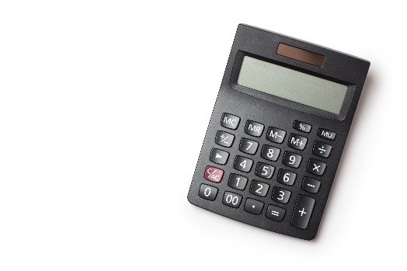
Line 11 – Taxable sales and uses
A simple calculation:
Start: Line 8: The sales price of all articles sold and/or put
to a business use
Subtract: Line 9: The sales price of all articles sold tax-exempt
Subtract: Line 10: The sales price of all articles sold tax-free
Equals: Line 11: Taxable sales and uses

Slide 52
Line 12 – Eligible adjustments – included excise tax
Note: Breaking eligible adjustments apart into three separate lines is another important change on the new form version. Industry members are required to use this latest version.
Line 12 is for the portion of line 8 that was included excise tax.
If tax excluded invoicing was used and no tax was included on line 8, this line should be zero.
If tax included invoicing was used for all sales, this line should, in general, equal line 16.
If a mix of tax included and excluded pricing was used, there is no direct tie between line 12 and line 16.

Slide 53
Line 13 – Eligible adjustments – non-taxable articles
The written instructions provide the best guidance for this line:
“In this Item you may exclude or deduct the following non-taxable articles when included in the sales price of a taxable article and not as a separate charge:
Extra and identical parts and accessories.
Non-taxable articles when sold in combination with a taxable article.”

Slide 54
Line 13 – Eligible adjustments – non-taxable articles
Determining the Exclusion Amount
The regulations, in 27 CFR 53.91(e), envision two scenarios:
Where separate sales prices exist for the taxable and nontaxable articles, a relative sales price method should be used.
Where the manufacturer/importer does not sell the taxable and nontaxable articles separately, a relative cost method must be used.
In practice, the relative cost method is more common, in part due to exclusions of nontaxable accessories such as gun locks. Since a sales price usually doesn’t exist for the firearms without the gun locks, the relative cost method must be used.

Slide 55
Line 13 – Eligible adjustments – non-taxable articles
Example – Relative Sales Method
Pistol sold with holster (tax included): $200
Established sale price for just the pistol (tax excluded): $180
Established sale price for just the holster: $15
Revenue Ruling 69-394 provides detailed guidance on how to determine the tax and line 13 adjustment. The next two slides follow that guidance but in a manner designed to be easier to understand.

Slide 56
Line 13 – Eligible adjustments – non-taxable articles
Step 1: Determine the taxable ratio as follows
Step 2: Determine the tax excluded sale price of the combination as follows
Taxable Article Separate
Sale Price (Tax Excluded)
$180
=
=
0.923
Taxable Article Separate
Sale Price (Tax Excluded)
+
Nontaxable Article Separate Sale Price
$180 + $15
Tax Included Sale Price of the Combination
$200
=
=
$183.10
1 + (tax rate)(step 1 taxable ratio)
1 + (0.10)(0.923)

Slide 57
Line 13 – Eligible adjustments – non-taxable articles
Step 3: Determine line 12 tax amount as follows
Step 4: Determine the line 13 eligible adjustment as follows
Note: If the taxable ratio in step 1 is 0.923 or 92.3%, the corresponding nontaxable ratio is 0.077, or 7.7%.
Combination Sales Price (Tax Included)
-
Step 2 Combination Sales Price (Tax Excluded)
=
$200 - $183.10
=
$16.90
Step 2 Combination
Sales Price
(Tax Excluded)
Nontaxable
Ratio
x
=
$183.10 x 0.077
=
$14.10

Slide 58
Line 13 – Eligible adjustments – non-taxable articles
Summary – Relative Sales Method Example
Line 8: The sales price of all articles sold… $200.00
Line 12: Eligible adjustments – included excise tax $ 16.90
Line 13: Eligible adjustments – non-taxable articles $ 14.10
Line 15: Adjusted taxable sales and uses $169.00
Check: Is the tax we calculated ($16.90) equal to the adjusted taxable sale price ($169.00) times the tax rate (10%)? YES!

Slide 59
Line 13 – Eligible adjustments – non-taxable articles
Example – Relative Cost Method
Pistol sold with 25th anniversary belt buckle (tax incl): $200
Established sale price for just the pistol: $195
Established sale price for just the belt buckle: None
Cost of the pistol: $100
Cost of a belt buckle: $3
The relative sales method can’t be used (the commemorative belt buckle isn’t sold separately). The relative cost method must be used.

Slide 60
Line 13 – Eligible adjustments – non-taxable articles
Step 1: Determine the taxable ratio as follows
Step 2: Determine the tax excluded sale price of the combination as follows
Taxable Article Cost
$100
=
=
0.971
Taxable Article Cost
Nontaxable Article Cost
+
$100 + $3
Tax Included Sale Price of the Combination
$200
=
=
$182.30
1 + (tax rate)(step 1 taxable ratio)
1 + (0.10)(0.971)

Slide 61
Line 13 – Eligible adjustments – non-taxable articles
Step 3: Determine line 12 tax amount as follows
Step 4: Determine the line 13 eligible adjustment as follows
Note: If the taxable ratio in step 1 is 0.971 or 97.1%, the corresponding nontaxable ratio is 0.029, or 2.9%.
Combination Sales Price (Tax Included)
-
Step 2 Combination Sales Price (Tax Excluded)
=
$200 - $182.30
=
$17.70
Step 2 Combination
Sales Price
(Tax Excluded)
Nontaxable
Ratio
x
=
$182.30 x 0.029
=
$5.29

Slide 62
Line 13 – Eligible adjustments – non-taxable articles
Summary – Relative Cost Method Example
Line 8: The sales price of all articles sold… $200.00
Line 12: Eligible adjustments – included excise tax $ 17.70
Line 13: Eligible adjustments – non-taxable articles $ 5.29
Line 15: Adjusted taxable sales and uses $177.01
Check: Is the tax we calculated ($17.70) equal to the adjusted taxable sale price ($177.01) times the tax rate (10%)? YES!

Slide 63
Line 14 – Eligible adjustments – other
These adjustments often decrease the amount of taxable sales but they can increase that amount as well.
Most common:
Freight expenses incurred in connection with the delivery of an article to the purchaser
Constructive sales price adjustments
Less common: Not an all-inclusive list – see form instructions for more details
Cost of credit (when all legal requirements met)
Local advertising charges (when all legal requirements met)
Additional charges not included on line 8 (for example, for an optional warranty)

Slide 64
Line 14 – Eligible adjustments – other
Freight – Important Points
The cost of freight must have been included in the price declared on line 8.
Actual freight expense must be used (no estimating).
Only the freight on taxable sales may be deducted (no freight deduction allowed for tax-exempt or tax-free sales).
If taxable and nontaxable articles are sold as a unit and a deduction is made on line 13 for the nontaxable articles, freight expense is limited to the portion allocable to the taxable articles.
The allocation required in the prior bullet must be done, in general, by weight unless you have authorization from TTB to use another method.

Slide 65
Line 14 – Eligible adjustments – other
Freight Example 1 of 3
Pistol Sales Price (tax included): $100
Invoiced Freight Charge: $ 0
Actual Freight Expense: $ 10
Line 8: The sales price of all articles sold… $100.00
Line 14: Eligible adjustments – other $ 10.00
Difference: Adjusted taxable sales price + tax $ 90.00
Line 15: Adjusted taxable sales and uses $ 81.82
$90.00 ÷ (1 + 10% tax rate)
Line 16: Total tax $ 8.18
$81.82 x 10% tax rate – Also goes on line 12

Slide 66
Line 14 – Eligible adjustments – other
Freight Example 2 of 3
Pistol Sales Price (tax included): $100
Invoiced Freight Charge: $ 15
Actual Freight Expense: $ 10
Line 8: The sales price of all articles sold… $115.00
Line 14: Eligible adjustments – other $ 10.00
Difference: Adjusted taxable sales price + tax $105.00
Line 15: Adjusted taxable sales and uses $ 95.45
$105.00 ÷ (1 + 10% tax rate)
Line 16: Total tax $ 9.55
$95.45 x 10% tax rate – Also goes on line 12

Slide 67
Line 14 – Eligible adjustments – other
Freight Example 3 of 3
Pistol + Extra Magazine Sales Price (tax included) $150
Invoiced Freight Charge: $ 15
Actual Freight Expense: $ 10
Sales Price of Pistol Alone (tax excluded): $140
Sales Price of Magazine Alone: $ 8
Total Weight of Package: 3.5 lbs
Weight of Pistol Alone: 3.0 lbs
Weight of Extra Magazine Alone: 0.5 lbs

Slide 68
Line 14 – Eligible adjustments – other
Step 1: Determine the line 14 exclusion for freight
Step 2: Determine the total consideration received (tax included) less the allowed freight exclusion.
Weight of Taxable Articles
Actual Freight Expense
3.0
X
=
$10
X
=
$8.57
Weight of Taxable Articles
Weight of Nontaxable Articles
3.0 + 0.5
+
Tax Included Combination Sales Price
Invoiced Freight
Allowed Freight Exclusion
+
-
=
$150 + $15 - $8.57
=
$156.43

Slide 69
Line 14 – Eligible adjustments – other
Step 3: Determine the taxable ratio as follows
Step 4: Determine the tax excluded adjusted sale price of the combination as follows
Taxable Article Separate
Sale Price (Tax Excluded)
$140
=
=
0.946
Taxable Article Separate
Sale Price (Tax Excluded)
+
Nontaxable Article Separate Sale Price
$140 + $8
Step 2 Tax Included Total Consideration Less Freight
$156.43
=
=
$142.91
1 + (tax rate)(step 3 taxable ratio)
1 + (0.10)(0.946)

Slide 70
Line 14 – Eligible adjustments – other
Step 5: Determine line 12 tax amount as follows
Step 6: Determine the line 13 eligible adjustment as follows
Note: If the taxable ratio in step 3 is 0.946 or 94.6%, the corresponding nontaxable ratio is 0.054, or 5.4%.
Step 2 Tax Included Total Consideration Less Freight
Step 4 Tax Excluded Adjusted Sale Price
-
=
$156.43 - $142.91
=
$13.52
Step 4 Combination
Sales Price
(Tax Excluded)
Nontaxable
Ratio
x
=
$142.91 x 0.054
=
$7.72

Slide 71
Line 14 – Eligible adjustments – other
Summary - Freight Example 3 of 3
Line 8: The sales price of all articles sold… $165.00
Line 12: Eligible adjustments – included excise tax $ 13.52
Line 13: Eligible adjustments – non-taxable articles $ 7.72
Line 14: Eligible adjustments – other $ 8.57
Line 15: Adjusted taxable sales and uses $135.19
Check: Is the tax we calculated ($13.52) equal to the adjusted taxable sale price ($135.19) times the tax rate (10%)? YES!

Slide 72
Line 14 – Eligible adjustments – other
Constructive Sales Price (CSP)
A full discussion of this topic is too complex for a two hour presentation. There are two general themes to the CSP rules.
FAET is designed to be based on a wholesale price. Congress knew sales to retailers or end consumers (aka “at retail”) could occur and would likely have a higher markup. The CSP rules are designed so manufacturers/importers are not penalized, in the form of a higher tax liability, by selling to a level further down the distribution chain.
FAET is designed to be based on sales at arm’s length and at fair market price. The CSP rules are designed so tax liability is not artificially reduced by selling to a related party or otherwise not at arm’s length and for less than fair market price.

Slide 73
Line 14 – Eligible adjustments – other
Simple CSP Example
An importer regularly sells a pistol to:
Wholesalers for either $200, $220, or $240
Over the internet to end consumers for $300
Under the applicable CSP rule, tax on the internet sales to end consumers may be based on the $240 price rather than the $300 price. See 26 U.S.C. 4216(b)(2) and 27 CFR 53.96.
CSP can be a complicated topic. This example is provided simply to illustrate the basic principle. Taxpayers should carefully research the applicable guidance if their sales are subject to a CSP adjustment.

Slide 74
Line 14 – Eligible adjustments – other
Simple CSP Example (cont)
The sale would be reported as follows (assume all prices were tax included):
Line 8: The sales price of all articles sold… $300.00
Line 14: Eligible adjustments – other $ 60.00
Difference: Adjusted taxable sales price + tax $240.00
Line 15: Adjusted taxable sales and uses $218.18
$240 ÷ (1 + 10% tax rate)
Line 16: Total tax $ 21.82
$218.18 x 10% tax rate – Also goes on line 12

Slide 75
Line 15 – Adjusted taxable sales and uses
A simple calculation:
Start: Line 11: Taxable sales and uses
Subtract: Line 12: Eligible adjustments – included excise tax
Subtract: Line 13: Eligible adjustments – non-taxable articles
Subtract: Line 14: Eligible adjustments - other
Equals: Line 15: Adjusted taxable sales and uses

Slide 76
Line 16 – Total tax
A simple calculation:
And we are done! That is, we are done calculating the tax liability on current period sales and uses. Everything in lines 8 through 16 should relate to sales and uses that occurred in the period declared on line 7.

Slide 77
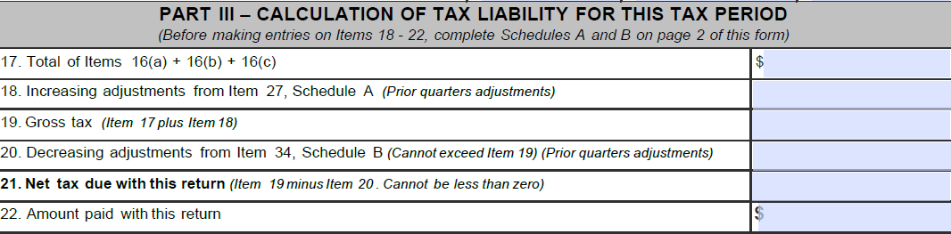
FAET Return Part III – Calculation of Taxes
Generally self explanatory. We will not go through each line in depth. Note, however, lines 18 and 20 are for prior period adjustments. Part II (lines 8 through 16) accounts for current period activity; Part III calculates total tax due and accounts for any necessary adjustments related to sales from a prior period.

Slide 78
FAET Return Part III – Calculation of Taxes
Top Ten NRC - Problem (#7)
Line 19, Gross tax, must be completed. For returns filed on paper, contractors manually enter the information into TTB’s computer system. Leaving this line blank causes a problem.

Slide 79
FAET Return Part III – Calculation of Taxes
Top Ten NRC - Problem (#8)
Line 22 should match line 21 and the line 22 payment must be made at the time the return is filed. Substantial penalties and interest exist for failure to remit tax timely, and the regulatory standard to qualify for an extension is high: taxpayers must be facing substantial financial loss, such as the loss that would be incurred if forced to sell property at sacrifice prices (see 27 CFR 53.156).

Slide 80
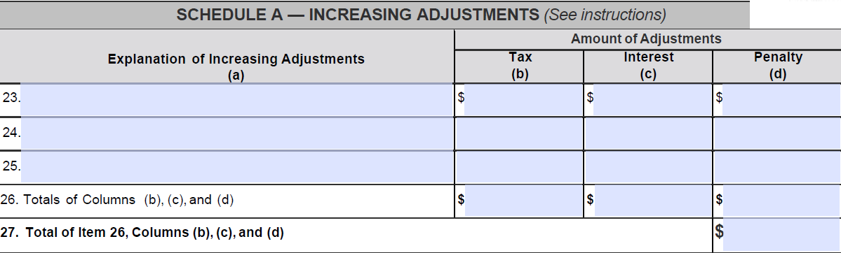
Schedule A – Increasing Adjustments

Slide 81
Schedule A – Increasing Adjustments
Per the written instructions: “Use this Item to report increasing adjustments (Note: These increasing adjustment account for underpayments from prior quarters). Examples include:
Errors you made in calculating the tax you owed in a previous tax return period which resulted in an underpayment of your tax.
Penalties and/or interest you owe on increasing adjustments.”
These were two examples, not an exhaustive list. One additional example: an increasing adjustment should be made to pay tax on prior period exports for which proof of export was not obtained within 6 months.

Slide 82
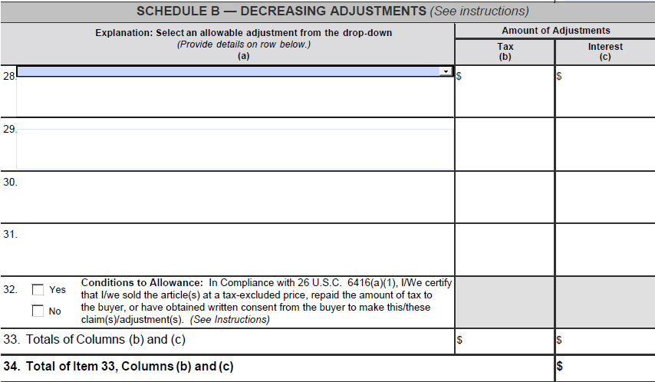
Schedule B – Decreasing Adjustments

Slide 83
Schedule B – Decreasing Adjustments
The instructions are similar to those for Schedule A – Increasing Adjustments. Again, they should relate to overpayments from prior quarters. The two given examples are to correct errors on previous returns and claim interest owed.
Three other common types of decreasing adjustments will be discussed on the following slides. Note: all of these are formal claims for credit (an allowable alternative to filing a separate claim for refund). While these claims are easy to file, they still require substantial support to be submitted with the return or kept on file. For full details, see 27 CFR 53.171 – 53.185 and 27 CFR 70.123.

Slide 84
Schedule B – Decreasing Adjustments
Product Return Example
The pistol sold over the internet to an end consumer for $300 in the Simple CSP Example is returned for a full refund.
The pistol had been used and was returned under an express warranty given on all of the importer’s sales.
The sale occurred in Q1 2019 and the return is being made in Q2 2019.
A claim for credit for the $21.82 in tax originally paid may be declared as a decreasing adjustment on the Q2 2019 FAET return.
This is viewed as a price readjustment. Two regulatory sections set forth the support needed for a price readjustment claim…

Slide 85
Schedule B – Decreasing Adjustments
1
27 CFR 53.176 – Requires that a claim for credit or refund caused by a price readjustment must be accompanied by a statement:
Describing the circumstances which gave rise to the price readjustment.
Identifying the article in respect of which the price readjustment was allowed.
Showing the price at which the article was sold, the amount of tax paid in respect of the article, and the date on which the tax was paid.
Giving the name and address of the purchaser to whom the article was sold, and
Showing the amount repaid to the purchaser or credited to the purchaser’s account.

Slide 86
Schedule B – Decreasing Adjustments
27 CFR 70.123 – Makes clear that a claim must comply with the statute of limitations and be executed under penalties of perjury. Outlines other conditions related to specific types of claims.
2

Slide 87
Schedule B – Decreasing Adjustments
Prompt Payment Example
The pistol in freight example 1 of 3 was sold in Q1 2019 for $100.
$8.18 in tax was paid on the Q1 2019 return.
Invoice terms included a prompt payment discount of 2% if paid within 60 days.
In Q2 2019, the customer paid $98 in full payment of the $100 invoice.
The $2 discount is seen as containing $0.18 in tax, calculated as follows:
10% tax rate x ($2 discount ÷ (1 + 10% tax rate).
A claim for credit of $0.18 may be taken as a decreasing adjustment on the Q2 2019 tax return.
As a price readjustment, the required support is the same as was discussed for the product return example.

Slide 88
Schedule B – Decreasing Adjustments
Subsequent Tax-Free Sale Example
The pistol in the 1st freight example is sold taxpaid to a distributor in Q1 2019.
The distributor sold it to a local police department in Q2 2019.
The distributor informs the manufacturer that it sold the firearm to an eligible tax-free customer and the manufacturer reimburses the distributor for the $8.18 in tax originally paid.
A claim for credit for the $8.18 in tax originally paid may be declared as a decreasing adjustment on the Q2 2019 FAET return.
27 CFR 53.179 refers to the following requirements needed to support this claim…

Slide 89
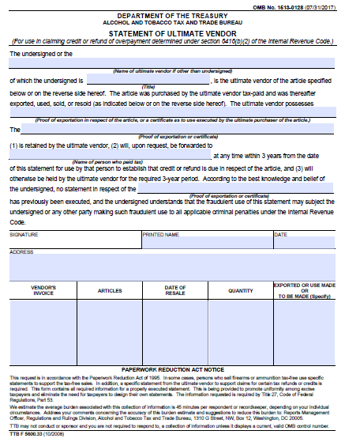
Schedule B – Decreasing Adjustments
Subsequent Tax-Free Sale Example
27 CFR 53.179(b)(1) – Certificate of ultimate purchaser or certificate of ultimate vendor must be kept on hand by the claimant (in other words, not submitted with the claim)
1

Slide 90
Schedule B – Decreasing Adjustments
Subsequent Tax-Free Sale Example
27 CFR 53.179(a) – Requires that a claim for credit or refund caused by a sale such as this one must be accompanied by a statement:
Showing the amount claimed in respect of each category of exportations, uses, sales, or resales on which the claim is based and which give rise to a right of credit or refund.
Identifying the article, both as to nature and quantity, in respect of which credit or refund is claimed.
Showing the amount of tax paid in respect of the article or articles and the dates of payment.
Indicating that the person claiming a credit or refund possesses evidence (as set forth in 27 CFR 53.179(b)(1) – see previous slide) that the articles has been exported, or has been used, sold, or resold in a manner or for a purpose which gives rise to an overpayment.
2

Slide 91
Schedule B – Decreasing Adjustments
Subsequent Tax-Free Sale Example
27 CFR 53.172(b)(2) - Requires that a claim for credit or refund caused by a sale such as this one must be accompanied by a statement asserting that:
The person neither included the tax in the price of the article with respect to which it was imposed nor collected the amount of the tax from a vendee, and identifying the nature of the evidence available to establish these facts, or
The person repaid, or agreed to repay, the amount of the tax to the ultimate vendor of the article, or
The person has secured, and will submit upon request of the appropriate TTB officer, the written consent of the ultimate vendor to the allowance of the credit or refund.
This statement can now be made by “checking the box.” Specifically…
3

Slide 92
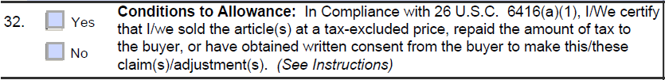
Schedule B – Decreasing Adjustments
Condition to Allowance
Per the written instructions, “This ‘Yes’ or ‘No’ checkbox only applies if you are claiming a decreasing adjustment based on one of the first two descriptions from the Schedule B dropdown list; either “1. No liability exists of FAET paid in error,” or “2. Exportation, uses and resale of articles (tax-free sales by manufacturer).”

Slide 93

Schedule B – Decreasing Adjustments
Condition to Allowance
The general purpose of this rule is tax fairness. In most instances the Internal Revenue Code does not want the manufacturer or importer to benefit from the claim for credit or refund due to the fact that the tax is passed along to the customers in the sale price. In other words---those who bore the ultimate burden of the tax (customers) will, in most instances, receive the benefit of the refund.

Slide 94
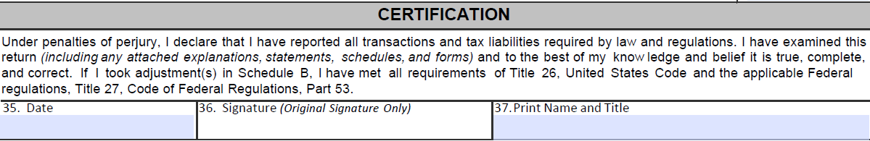
Certification
It is the industry member’s responsibility to ensure an authorized person signs the return. Per 27 CFR 53.21, “An individual’s signature on a return, statement, or other document made by or for a corporation or a partnership shall be prima facie evidence that the individual is authorized to sign the return, statement, or other document.”

Slide 95
Certification
Top Ten NRC - Problems (#9, #10)
Leaving lines blank: The return needs each line filled out. Think of it as part of the completeness being certified with the signature.
Typos and simple math errors: Typos in the employer identification number (EIN) are particularly problematic. Please double check paper returns to ensure they are mathematically accurate. Using Pay.gov helps eliminate mistakes in this area.

Slide 96
Questions
?

