Slide 1
Malt Beverage Formulas
CHRISTIAN FAY
Formula Specialist

Slide 2
Common Formula Questions
What is a formula?
Why is a formula required?
When is a formula required?
How is a formula submitted?

Slide 3
What is a Formula?
A formula is the recipe for your beer/malt beverage
It must include a quantitative list of ingredients
It must include a description of how the product is produced
It must indicate a total yield or batch size
In some instances a sample of the product must also be submitted to TTB for laboratory analysis
See Formula Basics page on TTB.gov
  https://www.ttb.gov/formulation/pre_cola.shtml

Slide 4
Why is a Formula Required?
It’s required by TTB regulations
  Domestic (27 CFR 25.55)
  Imported (27 CFR 7.31(d))
We use the information found in the formula to:
  Classify the product for tax and labeling purposes
  Ensure that the product does not contain any prohibited ingredients
  Determine if limited ingredients are used within prescribed limitations or if they will impact labeling
  Provide a suggested statement of composition for labeling purposes

Slide 5
At What Stage do I Apply for Formula Approval?
Domestic - Formula approval is required prior to producing certain types of beer
Imported - Certain malt beverages are required to undergo formula review prior to issuance of a certificate of label approval

Slide 6
When is a Formula Required?
Formula approval is required if the brewer uses any of the following ingredients/processes*:
  Flavors with alcohol
  Compounded flavors
  Colors (unless exempted by TTB Ruling 2015-1)
  Artificial sweeteners
  Flavors or other agricultural ingredients (unless exempted by TTB Ruling 2015-1)
  The beverage is frozen and ice crystals are removed (e.g., ice beer)
  *Not a complete list

Slide 7
When is a Formula Required?
FAQ B13: Am I Exempt from Formula Requirements if I Sell my Malt Beverage only at my Brewpub or only within my State?
No
If a brewer is required to obtain formula approval for a product then approval of the formula must be obtained prior to production, even if the product will be sold only at the brewer’s brewpub or otherwise sold only within the state in which it is produced
Formula requirements also apply regardless of whether the product is sold on tap at the brewer’s brewpub or is bottled, canned, or kegged

Slide 8
Which Beers Require Formula Approval?
Use our online formula tool or check the list in TTB G 2016-1A to determine which kinds of beer require formula approval
  Tool: https://www.ttb.gov/formulation/formula_approval_tool_mb.shtml
  List: https://www.ttb.gov/public-guidance/TTB-G-2016-1A.shtml
27 CFR 25.53, 25.55 & 7.31(d)

Slide 9
Which Beers Require Formula Approval?
Products that Require
Formula Approval
Products that Require Formula with Laboratory Sample Analysis
Ice beer
Kombucha (when regulated by TTB)
Malt beverage specialty products, such as flavored beer or beer made with non-traditional processes (unless exempted by TTB Ruling 2015-1)
Saké
“Alcohol Free” malt beverages (0.0 percent alcohol by volume)
See TTB G 2016-1A for additional information
https://www.ttb.gov/public-guidance/TTB-G-2016-1A.shtml
27 CFR 25.53, 25.55 & 27 CFR 7.31(d)

Slide 10
Ingredients and Processes that are Exempt from Formula Requirements
TTB Ruling 2015-1 exempts certain traditional ingredients and processes
Attachment 1 specifies which ingredients and processes are exempt, for example:
  Honey, vanilla beans
  Barrel-aging
The ruling does not exempt flavors containing alcohol or extracts, for example:
  Vanilla beans are exempt, but vanilla extract is not exempt
Please note that exempt ingredients cannot comprise more than 49 percent of the fermentables
TTB can still request a formula and samples for analysis at any time, even when exempt ingredients are used

Slide 11
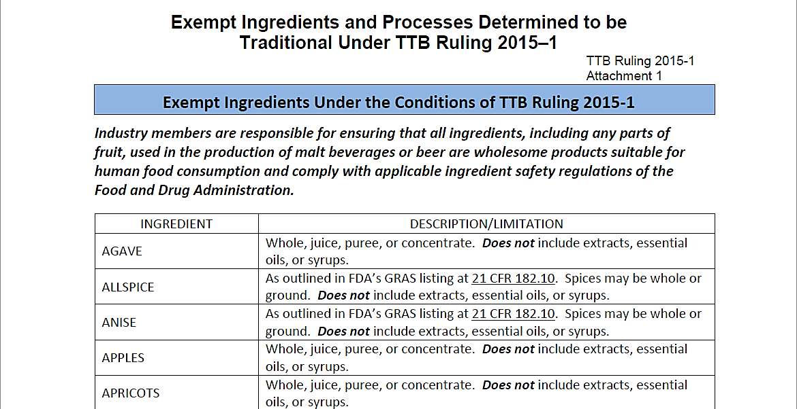
TTB Ruling 2015-1 | Attachment 1

Slide 12
Combinations of Exempt and Non Exempt Ingredients
If you use both exempt and non exempt ingredients, formula is required
Passion- fruit, vanilla Beans
Guava
Passionfruit and vanilla beans are exempt
Guava is not exempt

Slide 13
What TTB Looks For When Reviewing Formulas
Correct designation (Class and Type) – Is the base produced according to the stated standard?
GRAS (Generally Recognized As Safe) status of certain ingredients
Any limited or prohibited ingredients used
Correct supporting documentation for certain ingredients
  Ingredient Specification Sheet (Spec Sheet)
  Flavor Ingredient Data Sheets
  Limited Ingredient Calculation Worksheet

Slide 14
Compounded Flavors
Are one of the following:
  All natural
  Natural and artificial containing up to 0.1% artificial content topnote
  Natural and artificial containing greater than
  0.1% artificial content topnote
  All artificial
  Non-flavor: product is not flavor (e.g., Cloud Emulsion)
Submitted to TTB Nonbeverage Lab for Review
May contain colors

Slide 15
Flavor Ingredient Data Sheet
(FID Sheet or FIDS)
A FID Sheet is a spreadsheet that includes information about certain ingredients used to make a compounded flavor
Submit one for each compounded flavor used in your product
The FID Sheet allows TTB to:
  Ensure that the compounded flavor has been evaluated by the TTB Nonbeverage Products Laboratory (NPL)
  Verify that your beverage does not contain any ingredients in excess of the limits prescribed by TTB or by FDA
  Ensure the appropriate labeling of your product
  Ensure your product complies with TTB restrictions governing how much of the alcohol in your beverage may be derived from flavors and other nonbeverage ingredients containing alcohol
See TTB G 2017-4 for additional information and examples

Slide 16
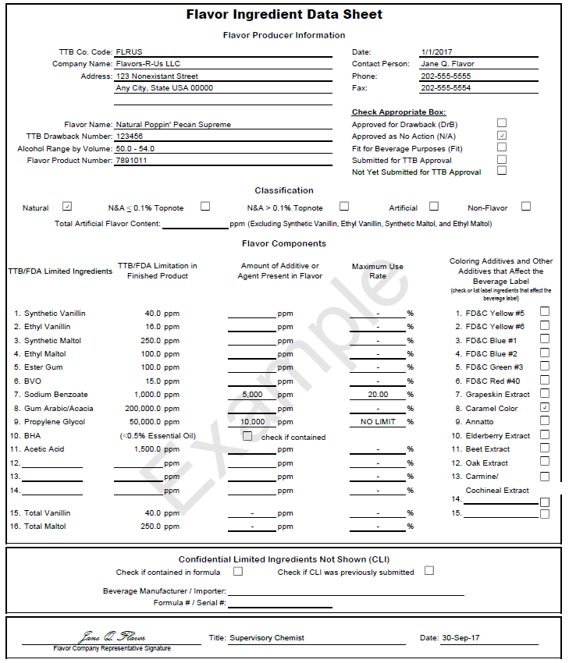
Flavor Ingredient Data Sheet
(FID Sheet or FIDS)
Flavor manufacturer supplies form to the brewer
FID based on exchange between flavor producer and TTB Nonbeverage Laboratory
It lists concentration of limited ingredients in PPM
Lists any colors used in flavor
States alcohol content of flavor
This information, combined with the use rate, determines classification of flavor

Slide 17
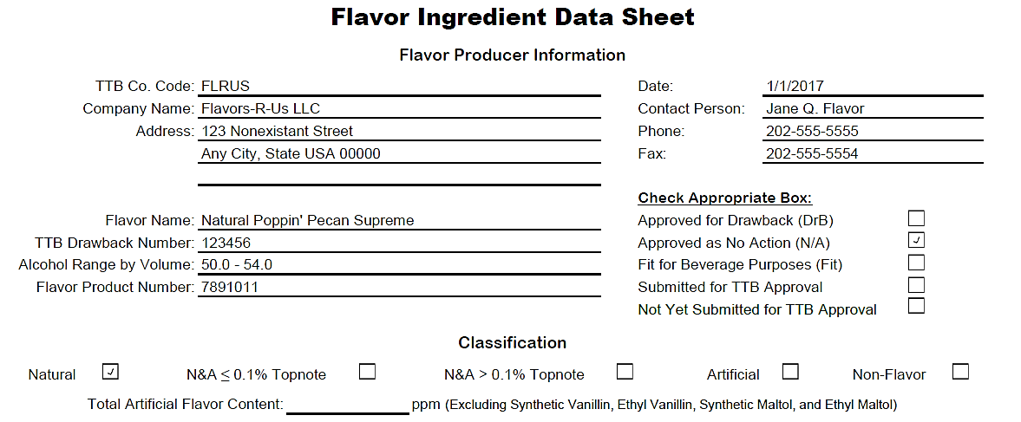
FID Sheet: Header

Slide 18
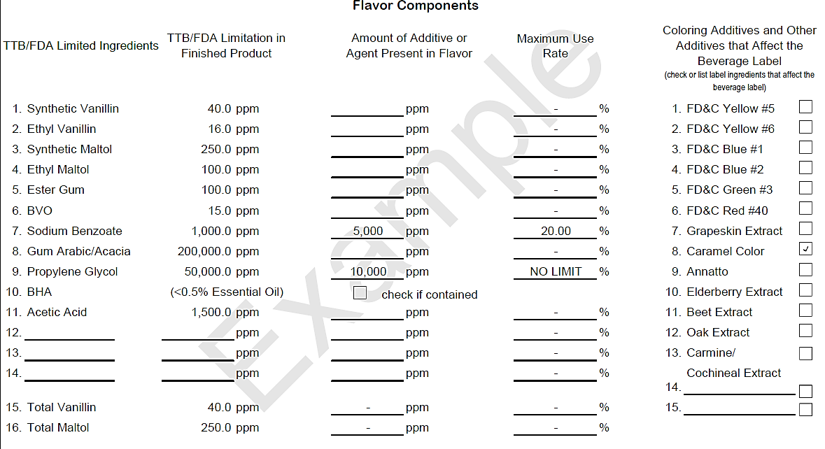
FID Sheet: Limited Ingredients Section

Slide 19
Limited Ingredient Calculation Worksheets
Used to calculate the total amounts of ingredients that have limits on their use per TTB and FDA requirements
Complete and submit one for each malt beverage made with one or more compounded flavors
Also useful as a product development tool
  Allows you to confirm that new product formulas are in compliance with limited ingredient requirements, and whether a flavor will be labeled as artificial prior to submitting the formula
See TTB G 2017-6 for additional information and examples

Slide 20
Ingredient Specification Sheet
(Spec Sheet or Technical Data Sheet)
A spec sheet is a document or label that lists or describes the contents of an ingredient that is made from more than one component
Submit a spec sheet for each ingredient that is made from more than one component, e.g., a fruit juice made from water, apples, and sugar
Should not be used for compounded flavors (use FID sheet)
See TTB G 2017-3 for additional information and examples

Slide 21
Certified Colors
21 CFR part 74, Subpart A*
FD&C Blue #1 | (Brilliant Blue FGF) | (E 133)
FD&C Blue #2 | (Indigotine) | (E 132)
FD&C Green #3 | (Fast Green FCF) | (E 143)
FD&C Red #40 | (Allura Red AC) | (E 129)
FD&C Red #3 | (Erythosine lake only) | (E 127)
FD&C Yellow #5** | (Tartrazine) | (E 102)
FD&C Yellow #6 | (Sunset Yellow FCF) | (E 110)
*Regulations of the U.S. Food and Drug Administration (FDA) **Requires specific declaration on labels for finished alcohol beverages

Slide 22
Non-Certified Colors*
21 CFR part 73, subpart A
Annatto Extract
Dehydrated beets
(beet powder)
Canthaxanthin
Caramel Color
Carmine
(Cochineal Extract)**
Carrot oil
β-Apo-8′-carotenal
β-Carotene
Fruit Juice
Grape color extract
Grapeskin Extract (Enocianina)
*This is a partial list. See 21 CFR part 73, Subpart A for a complete list of FDA regulations
**Requires specific declaration on labels of finished alcohol beverages

Slide 23

FDA Requirements
FDA has authority over food and ingredient safety
  Approved Food Additives
    21 CFR parts 170-186
  Generally Recognized as Safe
    Traditional use in food prior to 1958
    Scientific determination
Traditional medicines/dietary supplements are not necessarily GRAS
Importer/producer is responsible for proving that an ingredient is GRAS

Slide 24
GRAS and Restricted Ingredients
GRAS – Generally Recognized As Safe
  Under sections 201(s) and 409 of the Federal Food, Drug, and Cosmetic Act, any substance that is intentionally added to food is a food additive, that is subject to premarket review and approval by FDA, unless the substance is generally recognized, among qualified experts, as having been adequately shown to be safe under the conditions of its intended use, or unless the use of the substance is otherwise excluded from the definition of a food additive
Having GRAS status does not impact formula requirements
FDA maintains a list of prohibited ingredients at 21 CFR part 189
Certain non-prohibited ingredients may be used within limits
  http://www.ttb.gov/ssd/limited_ingredients.shtml

Slide 25
TTB Limited Ingredients
There are 4 artificial flavor materials that TTB allows to be present at certain levels in alcohol beverages without affecting the label declaration:
  Synthetic maltol
  Ethyl maltol
  Synthetic vanillin
  Ethyl vanillin
If these limits are exceeded, a “natural flavor” is treated as an “artificial flavor” in the product

Slide 26
Beer/Malt Beverages with Flavors that Contain Alcohol*
Final ABV is less than or equal to 6 percent:
  at least 51 percent of the alcohol in the final product must come from the malt base
  no more than 49 percent of the alcohol in the final product can come from the flavor and other nonbeverage materials
Final ABV is greater than 6 percent:
  no more than 1.5 percent of the volume of the malt beverage can consist of alcohol from flavors and other nonbeverage ingredients containing alcohol
An alcohol content statement must appear on the label if any alcohol in the malt beverage was derived from added flavors
27 CFR 7.11 & 22(a)(5), 27 CFR 25.15

Slide 27
How to Submit a Formula
The recommended method is completing the full application electronically using Formulas Online
  See webinar handout: How to Register and Submit Formulas through Formulas Online (July 2018)
Although TTB strongly encourages you to use Formulas Online, a paper alternative is also available
  TTB Form 5100.51 mailed to TTB (use address on the form)

Slide 28
Benefits of Using Formulas Online
Secure method for drafting, submitting, and tracking your formula applications electronically
Includes:
  Step-by-step guidance
  Data validation checks along the way
  Application status updates via email
  Facilitates record keeping
    Approved formulas are stored online
    Copies of approved formulas can be printed if needed

Slide 29
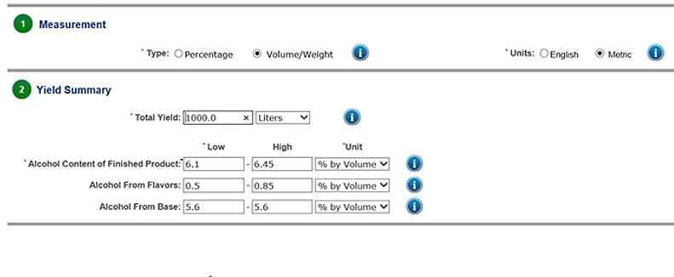
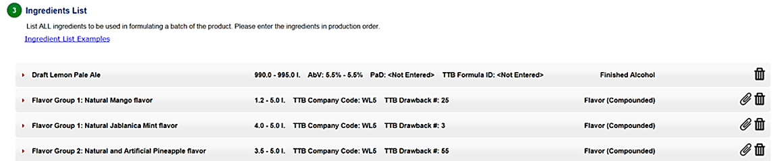

Slide 30
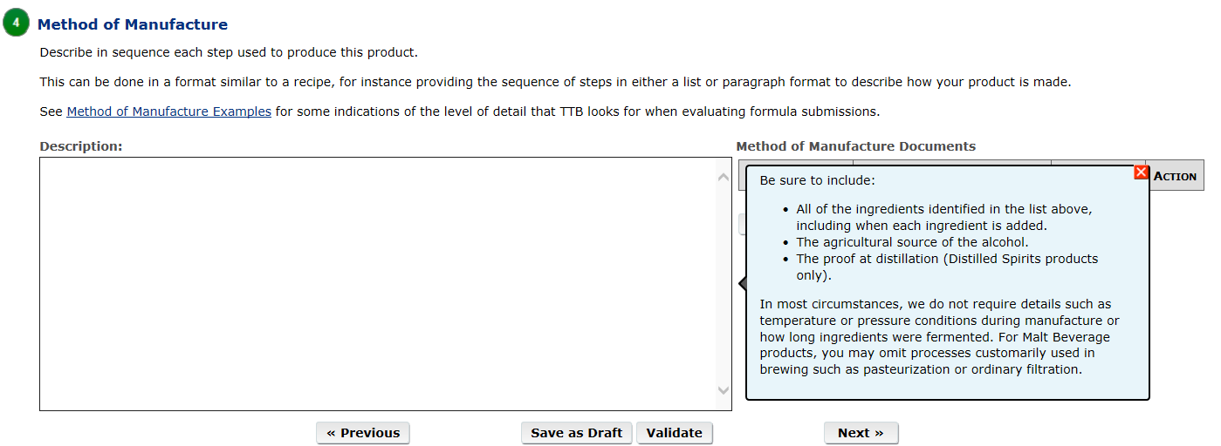
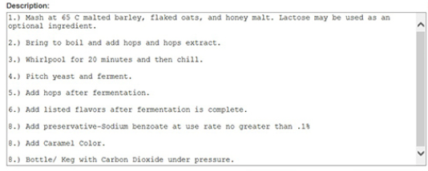
Method of Manufacture

Slide 31
Helpful Hints
Supply a quantitative list of ingredients
Provide a complete method of manufacture
Indicate at what stage flavors are added to the product
Flavor Ingredient Data Sheets (FIDS) should include a TTB number, a Flavor Product Number, and the TTB Approval status (Nonbeverage Lab Approval)
Provide the common name and scientific name (genus and species) for any unusual herbal ingredients
Ensure that ingredients are considered GRAS (generally recognized as safe) by the FDA

Slide 32
Common Reasons Formulas Must be Returned for Correction
Ingredient Specification Sheet (Spec Sheet) is missing for ingredients composed of more than one component
Limited Ingredient Calculation Worksheet is missing when compounded flavors are used
Flavor Ingredient Data (FID) is missing when compounded flavors are used
Formula approval is not required for this product because it is composed of exempt ingredients or processes (See TTB Ruling 2015-1)

Slide 33
Summary & Questions

