Slide 1
TTB Bootcamp for Brewers
Craft Brewers Conference
Denver | April 8, 2019

Slide 2
TTB Disclaimer
This information is being presented to help the public to understand and comply with the laws and regulations that the Alcohol and Tobacco Tax and Trade Bureau (TTB) administers.
It is not intended to establish any new, or change any existing, definitions, interpretations, standards, or procedures regarding those laws and regulations.
In addition, this presentation may be made obsolete by changes in laws and regulations.
Please consult the applicable laws and regulations for the most current requirements.
Sample documents (such as records, returns, and labels) and can images are for illustrative purposes only and contain fictitious data.

Slide 3
TTB 2019 Bootcamp Schedule
Time | Subject | Speaker
12:00 to 12:20 | TTB Overview | Susan Evans
12:20 to 12:30 | Hemp Update | Janelle Christian
12:30 to 1:15 | Brewer’s Notices | Susan Evans
1:15 to 2:00 | Records, Reports, and Returns | Charyl Sjowall Missy Keller
2:00 to 2:15 | Break
2:15 to 3:00 | Formulas | Christian Fay
3:00 to 4:00 | Labeling | Michael Webster

Slide 4
TTB Overview
SUSAN EVANS
Director, Office of Industry and State Outreach

Slide 5
TTB Overview
We are a bureau within the Department of the Treasury
We currently have about 480 employees
Our headquarters are in Washington, DC
The National Revenue Center is in Cincinnati, Ohio
We have field offices located across the country
We have 4 laboratories, located in Maryland and California

Slide 6
Our Mission
COLLECT the taxes on alcohol, tobacco, firearms, and ammunition
PROTECT the consumer by ensuring the integrity of alcohol products
ENSURE only qualified businesses enter the alcohol and tobacco industries
PREVENT unfair and unlawful market activity for alcohol and tobacco products

Slide 7
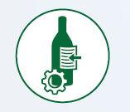
Our 5-Year Strategic Goals
GOAL 1: Facilitate Commerce
through the Timely Issuance of Permits to Qualified Applicants
GOAL 4: Address Cross-Border
Tax Risk through Data Driven
Enforcement
GOAL 2: Facilitate Commerce
through a Modern Labeling Program
Focused on Service and Market
Compliance
GOAL 5: Equip the Workforce
for Professional Growth and
Development by Revitalizing TTB
Training
GOAL 3: Improve Tax Compliance
through Increased Voluntary
Compliance and Enhanced
Enforcement
TTB Strategic Plan FY 2018-2022

Slide 8
Follow the TTB Path for Brewers
Qualify as a brewery/brewpub with Brewer’s Notice
Apply for formula approval
(if needed)
Apply for label approval
(if needed)
File tax return, pay taxes, file operational report
Produce beer/malt beverages
Bottle/keg and remove/sell
Ongoing once your Brewer’s Notice is approved:
1) Keep records of brewery operations 2) report changes to your business or brewery to TTB

Slide 9
TTB Organizational Chart
Administrator
John Manfreda
Field Operations
Headquarters Operations
Permitting and Taxation
Tax Audit Division
Trade Investigations Division
Alcohol Labeling and Formulation Division
Regulations and Rulings Division
Scientific Services Division
National Revenue Center

Slide 10
National Revenue Center
Issues permits/notices/registrations
Processes tax returns, operational reports, and claims
Located in Cincinnati, Ohio
Toll-Free: 877-882-3277
Web Form: Submit Online Inquiry

Slide 11
TTB Organizational Chart
Administrator
John Manfreda
Field Operations
Headquarters Operations
Permitting and Taxation
Tax Audit Division
Trade Investigations Division
Alcohol Labeling and Formulation Division
Regulations and Rulings Division
Scientific Services Division
National Revenue Center

Slide 12
Alcohol Labeling and Formulation Division
Processes applications for formula approval
Processes applications for label approval
Located in Washington, DC
Toll-Free: 866-927-2533
Web Form: Submit Online Inquiry

Slide 13
TTB Organizational Chart
Administrator
John Manfreda
Field Operations
Headquarters Operations
Permitting and Taxation
Tax Audit Division
Trade Investigations Division
Alcohol Labeling and Formulation Division
Regulations and Rulings Division
Scientific Services Division
National Revenue Center

Slide 14
Scientific Services Division
Beverage Alcohol Laboratory
Performs analysis of samples for formula approval for certain domestic and imported products
Located in Beltsville, Maryland
240-264-1665
Web Form: Submit an Online Inquiry

Slide 15
TTB Organizational Chart
Administrator
John Manfreda
Field Operations
Headquarters Operations
Permitting and Taxation
Tax Audit Division
Trade Investigations Division
Alcohol Labeling and Formulation Division
Regulations and Rulings Division
Scientific Services Division
National Revenue Center

Slide 16
Regulations and Rulings Division
Develops and publishes new and amended TTB regulations
Develops and publishes industry guidance
Evaluates requests for variances/alternate procedures
Located in Washington, DC
202-453-2265
Web form: Submit Online Inquiry

Slide 17
TTB Organizational Chart
Administrator
John Manfreda
Field Operations
Headquarters Operations
Permitting and Taxation
Tax Audit Division
Trade Investigations Division
Alcohol Labeling and Formulation Division
Regulations and Rulings Division
Scientific Services Division
National Revenue Center

Slide 18
Tax Audit & Trade Investigations Divisions (Field Enforcement)
Ensures the proper payment of excise taxes
Ensures compliance with laws and regulations
Conducts trade practice investigations
Located throughout the U.S.A.
For questions about trade practices:
202-453-2251
TradePractices@ttb.gov

Slide 19
Registration is Open for the Free TTB Trade Practice Seminars
Location | Date | Time | Registration Link
New York, New York Ted Weiss Federal Building | April 24, 2019 | 8:30 AM-Noon | Register Now
 |  | 1:00 PM-5:00 PM | Register Now
San Diego, California DoubleTree by Hilton Hotel San Diego – Mission Valley | June 4, 2019 | 8:00 AM-Noon | Register Now
 |  | 1:00 PM-5:00 PM | Register Now
Seattle, Washington Crowne Plaza Seattle Downtown | June 6, 2019 | 8:00 AM-Noon | Register Now
 |  | 1:00 PM-5:00 PM | Register Now
St. Louis, Missouri Robert A Young Federal Building | August 1, 2019 | 8:00 AM-Noon | Register Now
https://www.ttb.gov/news/registration-open-2019-trade-practice-seminars.shtml

Slide 20
TTB Laws and Regulations
QUICK OVERVIEW

Slide 21
TTB Laws and Regulations* Domestic Breweries
Internal Revenue Code (IRC)
26 U.S.C. Chapter 51 (the law)
27 CFR part 25 – Beer (the regulations implementing the law)
Federal Alcohol Administration Act (FAA Act)
27 U.S.C. 205 (the law)
27 CFR part 7 – Labeling and Advertising of Malt Beverages (the regulations implementing the law)
* Not a complete list

Slide 22
IRC Definition of Beer
Beer is: Beer, ale, porter, stout, and other similar fermented beverages (including saké and similar products) of any name or description containing one-half of one percent or more of alcohol by volume, brewed or produced from malt, wholly or in part, or from any substitute for malt
Only rice, grain of any kind, bran, glucose, sugar, and molasses are substitutes for malt
In addition, brewers may also use the following materials as adjuncts in fermenting beer: honey, fruit, fruit juice, fruit concentrate, herbs, spices, and other food materials
You may use flavors and other nonbeverage ingredients containing alcohol in producing beer in certain amounts
27 CFR part 25

Slide 23
FAA Act Definition of Malt Beverage
A malt beverage is: A beverage made by the alcoholic fermentation of an infusion or decoction, or combination of both, in potable brewing water, of
malted barley with hops, or their parts, or their products, and
with or without other malted cereals, and
with or without the addition of unmalted or prepared cereals, other carbohydrates or products prepared therefrom, and
with or without the addition of carbon dioxide, and
with or without other wholesome products suitable for human food consumption
27 CFR part 7

Slide 24
As a Result...
A beer is not regulated as a malt beverage under the FAA Act, unless it contains both:
Malted barley AND hops
Malt beverages with less than 0.5% alcohol by volume are not taxed as beer under the IRC, but may be subject to FAA Act requirements
See TTB Ruling 2008-3 for additional information

Slide 25
Therefore...
Saké is beer under the IRC but is not a malt beverage under the FAA Act (it’s wine)
Near beer (less than 0.5% ABV) and alcohol free malt beverages (0.0% ABV) are potentially subject to TTB label approval
Sorghum beers and other beers made without both malted barley and hops are never subject to TTB label approval, but must be labeled in accordance with Food and Drug Administration (FDA) food labeling requirements

Slide 26
IRC Requirements for (Domestic) Beer
Applies to all beer produced in the U.S.
Includes:
Qualification of the Brewery/Brewpub
Recordkeeping requirements and reports
Taxes
Formulas (for some beers)
Minimum marks, brands and labels requirements
27 CFR part 25

Slide 27
FAA Act Requirements for Malt Beverages
Applies to domestic and imported malt beverages, but only if they are sold or shipped ... in interstate commerce*
Includes:
Labeling requirements for malt beverages
Certificates of Label Approval (COLA)
Advertising of malt beverages
Trade practices
*Other conditions apply for labeling and COLA requirements
27 CFR part 7

Slide 28
Craft Beverage Modernization & Tax Reform Act
CHANGES EFFECTIVE DURING
2018 AND 2019

Slide 29
Tax Rates for Domestic Beer
Tax Rates for Domestic Beer Removed During Calendar Years 2018 and 2019*
 | Beer Produced by the Brewer |  | Beer Not Produced by the Brewer
Domestic Brewer who brews 2,000,000 barrels or less per calendar year | First 60,000 BBLs | Over 60,000 up to 2,000,000 | All BBLs
 | $3.50 | $16.00 | $18.00
Domestic Brewer who brews more than 2,000,000 barrels per calendar year | First 6,000,000 BBLs | Over 6,000,000 BBLs
 | $16.00 | $18.00
* Additional rules regarding controlled groups and single taxpayers apply

Slide 30
What is “Production”
For purposes of taking the reduced rates of tax, beer is considered to have been “produced” if it is lawfully brewed or produced at a qualified brewery premises, including beer brewed by fermentation or produced by the addition of water or other liquids during any stage of production
Blending or combining two beers does not count as production for purposes of the reduced tax rates
Beer received in bond in containers and subsequently removed subject to tax, without any production activity occurring, is not eligible for the reduced tax rates
Beer received in bond and merely bottled is also not eligible for the reduced tax rates

Slide 31
What is “Production”
The entire volume of beer to which water or other liquids is added is considered “produced” for purposes of applying the reduced tax rates
TTB expects production activities to be undertaken in good faith in the ordinary course of production, and not solely for the purpose of obtaining a reduced rate
The eligibility for the reduced rate is also subject to controlled group and single taxpayer rules, which may further limit the beer subject to the reduced rate upon removal by the brewer

Slide 32
Controlled Group and Single Taxpayer Rules
Controlled Group: The Act provides that the quantities to which the credits and reduced rates apply shall be applied to the controlled group. The Act also provides that an importer electing to receive an assignment of a credit or reduced tax rate from a foreign manufacturer shall be deemed a member of the controlled group of the foreign manufacturer.
Single Taxpayer: The Act provides that two or more entities (whether or not under common control) that produce products marketed under a similar brand, license, franchise, or other arrangement shall be treated as a single taxpayer for purposes of the credits and reduced rates.
See TTB Industry Circular 2018-5 for additional details on single taxpayers

Slide 33
Tax Rates for Imported Beer
Tax Rates for Beer that is Imported During Calendar Years 2018 and 2019*
 | First 6,000,000 BBLs | Over 6,000,000 BBLs
Beer Importer | $16.00 | $18.00
* Additional controlled group, single taxpayer, and foreign producer assignment rules apply.

Slide 34
Foreign Manufacturer Election
In the case of beer brewed or produced outside of the United States and imported, foreign brewers may assign the reduced rates to importers who elect to receive it
U.S. Customs and Border Protection (CBP) is responsible for the collection of tax on imported alcohol products and for issuing guidance about foreign manufacturer elections
CBP has issued interim guidance (CSMS #18-000403) for importers

Slide 35
Transfer of Beer in Bond
The Act authorizes the transfer of beer in bond between brewers who are not owned by the same corporation or other entity
See 2018-1 Transfer of Beer Between Breweries Not of the Same Ownership

Slide 36
Summary & Questions

Slide 37
Using Hemp and Hemp Derivatives in Alcohol Beverages
JANELLE CHRISTIAN
Industry Outreach Program Manager
Note: Policy may have changed since publication of this presentation. Please consult TTB.gov for the latest information

Slide 38
2000 Hemp Policy
When drafted, “hemp” referred to the parts of the cannabis plant excluded from the definition of marijuana in the Controlled Substances Act (CSA), 21 U.S.C. Section 802(16) (such as sterilized seeds and seed oil)
All components in the beverage must comply with FDA and DEA regulations
Finished product cannot contain a controlled substance
TTB formula approval is required, even for products sold only intrastate
You must submit a report of laboratory analysis of the hemp component

Slide 39
Recent Amendment to Law
The 2018 Farm Bill amended the definition of marijuana under the CSA to exempt “hemp,” as follows:
The term ‘hemp’ means the plant Cannabis sativa L. and any part of that plant, including the seeds thereof and all derivatives, extracts, cannabinoids, isomers, acids, salts, and salts of isomers, whether growing or not, with a delta-9 tetrahydrocannabinol concentration of not more than 0.3 percent on a dry weight basis
The law explicitly preserved FDA’s authority to regulate products containing cannabis or cannabis-derived compounds under the Federal Food, Drug and Cosmetic Act (FD&C Act)
TTB defers to FDA on whether the use of hemp ingredients would violate the FD&C Act

Slide 40
CBD and other Hemp Ingredients in Food
Any substance intentionally added to food (including alcohol beverages) is a food additive, and therefore subject to premarket review and approval by FDA, unless the substance is generally recognized as safe (GRAS)
Aside from three hemp seed ingredients, no other cannabis-derived ingredients have been the subject of a food additive petition, an evaluated GRAS notification, or have otherwise been approved for use in food by FDA
After enactment of the 2018 Farm Bill, FDA stated that it is unlawful under the FD&C Act to introduce into interstate commerce any food to which CBD has been added (FD&C Act Section 301(ll))
See also: FDA Regulation of Cannabis and Cannabis-Derived Products: Questions and Answers

Slide 41
Terpenes and Botanical Extracts
“Terpene” refers to a class of organic chemical compounds that may be sourced from plants or synthesized in a laboratory
FDA has issued regulations that authorize individual synthetic terpenes for use in food (see, e.g., 21 CFR 182.60)
Many forms of botanical extracts are authorized for use in food in specific FDA regulations; botanical extracts from cannabis (hemp) are not included in these regulations
FDA has advised that alcohol beverage industry members interested in using botanical extracts containing mixtures of terpenes sourced from hemp, or any other plant, should consider submitting a GRAS notice

Slide 42
Alcohol Beverage Formulas for Products Containing Hemp Ingredients
Based on FDA’s public statements and TTB’s ongoing consultations with FDA, at this time TTB will return for correction any applications for formulas containing hemp ingredients (other than ingredients derived from hemp seeds or hemp seed oil)
The correction notices will advise formula applicants that they have the option of resubmitting the formula upon receipt of an individual determination from FDA on the regulatory status of their ingredients
In light of the changes in the 2018 Farm Bill, TTB will update guidance on the use of hemp and hemp derivatives

Slide 43
Summary & Questions

Slide 44
Brewer’s Notices
SUSAN EVANS
Director, Office of Industry and State Outreach

Slide 45
Definitions
Brewery: The land and buildings described in the Brewer's Notice…where beer is produced and packaged
Brewer: Any person who brews beer (except [for home brewers] under 26 U.S.C. 5053(e)) and any person who produces beer for sale
Brewer’s Notice: the TTB document issued to qualified applicants that authorizes a brewer to produce beer for sale and, optionally, to operate a tavern on the brewery premises
27 CFR 25.11

Slide 46
What is a “Brewpub”?
“Brewpub” is synonymous with “tavern on premises,” which is defined as a portion of the brewery premises where beer is sold to consumers
Food, and/or taxpaid wine, and/or taxpaid distilled spirits may be sold
Taxpaid beer produced by other brewers may be sold
27 CFR 25.25

Slide 47
Brewpub vs. Tasting/Tap Room
Brewpub on Premises
Tasting Room Off Premises
Area where beer is sold to consumers (the tavern) that is part of the brewery premises
You may run lines from the cellar to the serving tanks in the tavern
Beer transferred to the tavern must be tax-determined, and tax is paid on the entire tank in the next return period
Beer may be served by the glass or in containers
Area where beer is sold that is NOT part of the brewery premises, but may be adjacent to it
You may NOT run lines from the brewery to tasting room (or any areas not qualified as part of the brewery)
Beer transferred to tasting room must be taxpaid when removed from the brewery
All beer transferred to tasting room must be in consumer containers, and labeled as per TTB regulations

Slide 48
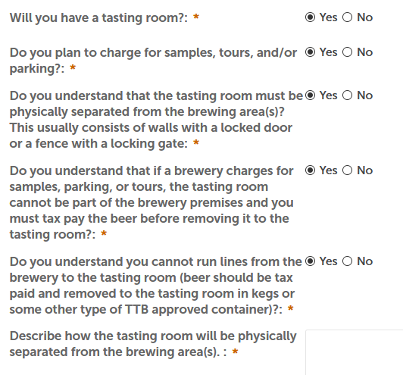
Tasting Rooms
Brewery applicants are asked a series of questions in Permits Online to help distinguish what can and cannot be done by a brewery

Slide 49
Alternation of Premises
When the premises is used by the same owner/same EIN to conduct another TTB - regulated business, such as a winery or distilled spirits plant
If you are an already established brewery and wish to add a winery or distilled spirits plant, you must submit:
A new application for the commodity operations that you are adding
Updated diagram showing which areas will be alternating
Variance request to use brewery for another purpose
Variance from the requirement to submit notification of each alternation
Change in Bond (Consent of Surety) TTB Form 5000.18 – if applicable

Slide 50
Alternation of Proprietorship
When two or more proprietors with different EINs are operating at the same premises and sharing space and/or equipment. Generally, the proprietor of an existing brewery, the “host brewer,” agrees to rent space and equipment to a new “tenant brewer.”
The host brewer is required to submit:
An alternating proprietorship agreement (a contract between the host and tenant)
Updated diagram showing which areas will be alternating and which will be the permanent non-alternating space of both the host and tenant
Variance Requests:
Application to Use Brewery for Other Purposes
Change in Premises to allow the use of brewery records in lieu of filing an amended brewer’s notice with each alternation of the premises

Slide 51
Alternation of Proprietorship
The tenant brewer is required to submit:
An alternating proprietorship agreement (a contract between the host and tenant)
Variance Requests:
Retention and Preservation of Records - Place of Maintenance - if the host, under POA for the tenant, plans to prepare or store records on the premises of the host brewery
Notice of Alternation - to allow the establishment of an alternating proprietorship with the host brewer
Change in Premises to allow the use of brewery records in lieu of filing an amended brewer’s notice with each alternation of the premises
A business plan showing the development plans for the business.
See TTB Industry Circular 2005–2 for more information

Slide 52
Did You Know…?
Before you submit your application generally construction should be complete with necessary equipment in place or on order
You cannot begin producing beer until you receive your approved Brewer’s Notice
A brewery cannot be located in a residence
If you have an adjacent tasting room you must describe it in the description of the premises and it should also be shown on your diagram

Slide 53
The Benefits of Using Permits Online
You can self-register
Contains step-by-step guidance
Some fields are auto-filled
You may “Save and resume” applications to complete later
You have 24/7 access
You’ll receive email notifications of status changes
You’ll see cost and time savings on mailing, copying, paper storage

Slide 54
Register for an Account in Permits Online
https://www.ttbonline.gov/permitsonline/Default.aspx

Slide 55
What to Gather Before You Apply
There are number of supporting documents that you’ll be required to submit with your application
Plan ahead and review the list before you begin the application
Use our What to Gather Before You Apply tool to see the full list

Slide 56
Business Entity and Commodity Operations
Your information in Permits Online is organized in two different kinds of records
The entity record equates to a single company or business entity, represented by a unique Employer Identification Number (EIN)
A commodity operations record is created for each TTB-regulated operation or permit, registration, or notice the entity is approved for
A typical entity record will have at least one, but may have multiple commodity operations records associated with it

Slide 57
Business Entity and Commodity Operations
Entity Record
Our Business, Inc.
(EIN 12-3456789)
Commodity Operations Record
Brewers Notice
Commodity Operations Record
Winery Permit
Commodity Operations Record
Importers Permit

Slide 58
Business Entity and Commodity Operations
When applying to start a new TTB-regulated business, you’ll complete both a new entity application and a new commodity operations application for each permit, registration, or notice you need
If you need to file an amendment related to the business entity, you file one application and the changes are associated with each TTB permit, registration, or notice held by that company

Slide 59
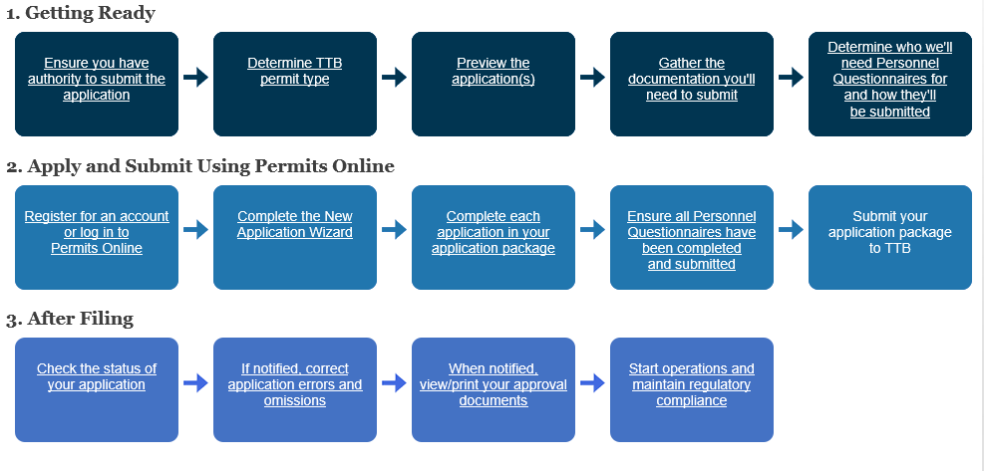
Overview of the Application Process
https://www.ttb.gov/ponl-help/application-process-overview.shtml

Slide 60
Changes You Must Report to TTB
Change in:
the legal business name
controlling ownership
any partner or general partner
any stockholder or members holding ownership of 10 percent or more
corporate officer, directors, or any titled positions
Adding, revoking, or changing:
signing authority
power of attorney

Slide 61
Changes You Must Report to TTB
Change in:
premises location
bond
construction or use of building
operations
DBA/Operating name
mailing address
Adding or removing:
trade names
noncontiguous premises
alternation of premises
alternation of proprietor
variance or alternate method
Termination of operations

Slide 62
Termination of Business
If you are discontinuing business:
File a final Operations Report (TTB Form 5130.9 or TTB Form 5130.26) showing all beer on hand as paid or transferred to new owner before termination
The Report must be marked "FINAL REPORT" and have 0.0 "on hand" amount end-of-period
File final TTB Form 5000.24, Excise Tax Return, covering the last period of liability marked "FINAL RETURN"
The period should cover up to the last day of business as a brewery and should include all removals

Slide 63
Permits Online Guidance
Permits Online will guide you through the entire application process, but if you want to see guidance before you start:
Permits Online Help Center
Permits Online tutorial

Slide 64
Summary & Questions

Slide 65
Brewery Records, Reports, and Returns
CHARYL SJOWALL
Investigator
MISSY KELLER
Tax Specialist

Slide 66
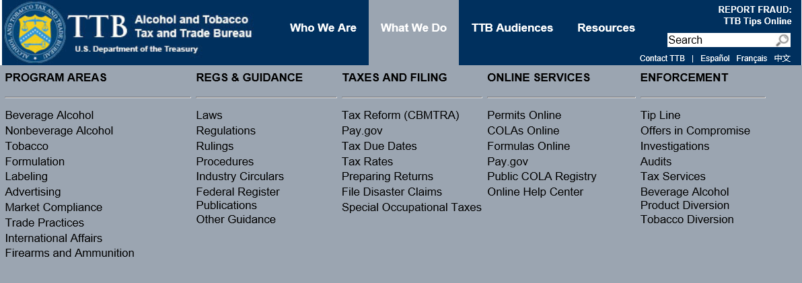
Using TTB.gov
https://www.ttb.gov/index.shtml

Slide 67
Records, Reports & Returns
Records
Operations Report
Excise Tax Return

Slide 68
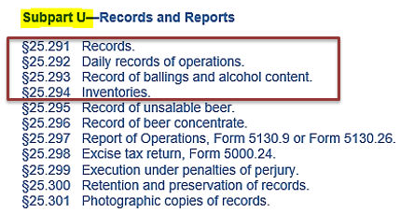
Required Records | Purpose
Captures each day’s brewery operations
Source documents for all entries on the Brewers Reports and Excise Tax Returns
What a TTB auditor reviews to support your tax liability and compliance
See 27 CFR part 25 – Beer
Subpart U
Sections 25.291 - 25.301

Slide 69
Records | Basic Info 27 CFR 25.291
Brewers are required to:
maintain daily records that capture brewery operations
make required daily transactions by the close of the next business day
maintain records at the brewery and make them available for inspection by TTB
Retain required records for 3 years
If certain requirements are met, electronic records may be retained on equipment located off the brewery premises

Slide 70
Daily Records | General 27 CFR 25.291
There is generally no required format for required records
Records may be self-created spreadsheets/documents, invoices, computer-generated summaries, commercial or business documents, bills of lading, credit memos, or TTB required forms
Records must accurately and clearly reflect the details of each operation and/or transaction, and must contain all the necessary data

Slide 71
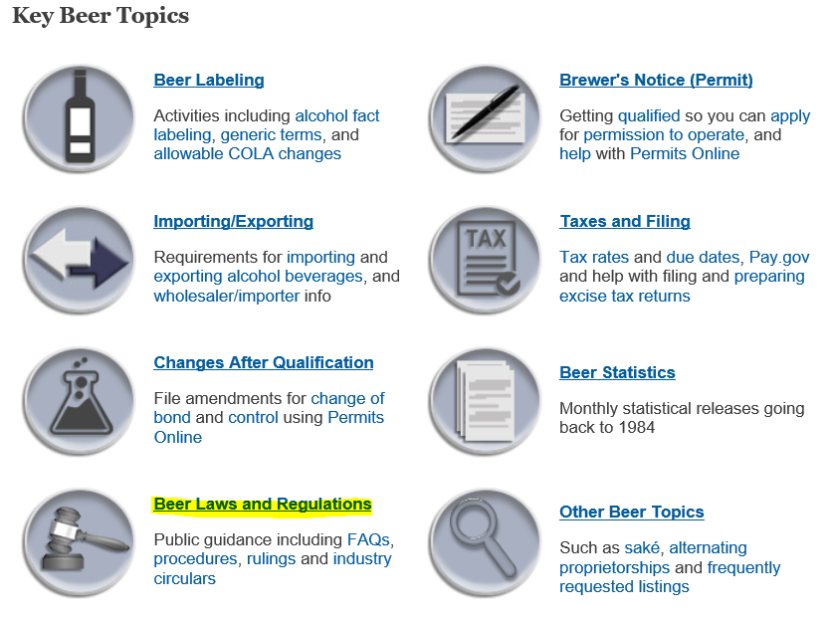
Electronic Code of Federal Regulations (CFR)
TTB.gov/beer/beer-regs
ecfr.gov/Title27/27cfr25

Slide 72
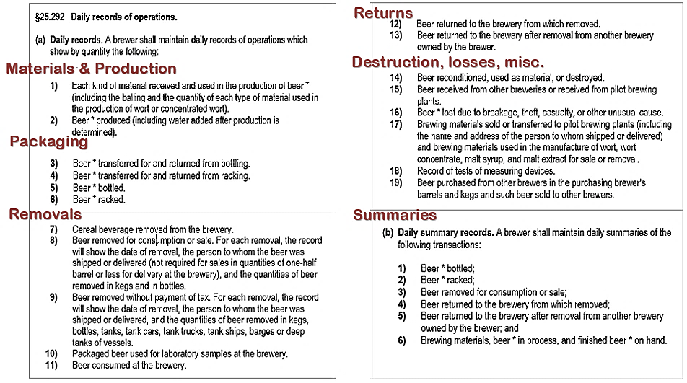
Daily Records of Operations & Daily Summaries
25.292 has two parts:
(a): Daily Records
(b): Daily Summaries
25.292(a) basically
has five subject areas:
materials & production
packaging
removals
returns
other
Beer * = beer & cereal beverage

Slide 73
Daily Records of Operations 27 CFR 25.292(a)(1) – (19)
Most Commonly Used Records:
Raw materials received (used for beer production)
Beer produced by fermentation
Beer transferred to/from packaging (bottling and/or racking)
Beer packaged (bottled and/or racked)
Beer removed for consumption or sale – beer transferred to serving/tax-determined tanks, or packaged and transferred to a cooler/taxpaid storage
Beer returned to brewery
Beer lost due to breakage, theft, or destroyed
NOTE: when used here, “Beer” means “beer or cereal beverage”

Slide 74
Daily Summary Records 27 CFR 25.292(b)(1)–(6)
Each day, brewers must also summarize a few of the daily records:
Beer packaged (bottled and/or racked)
Beer removed for consumption or sale
Beer returned to the brewery from which removed
Beer returned after removed from another brewery owned by the brewer
Brewing materials, beer in process, and finished beer on hand
You may maintain daily summary records on the associated daily records

Slide 75
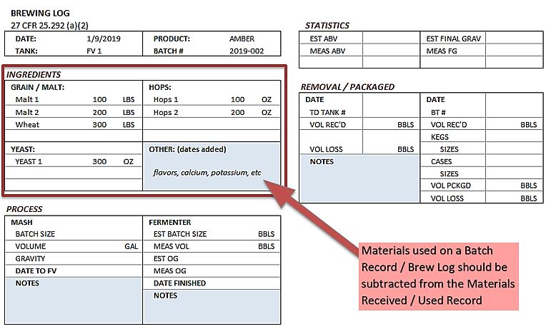
Example Production Record – Batch Record / Brewing Log

Slide 76
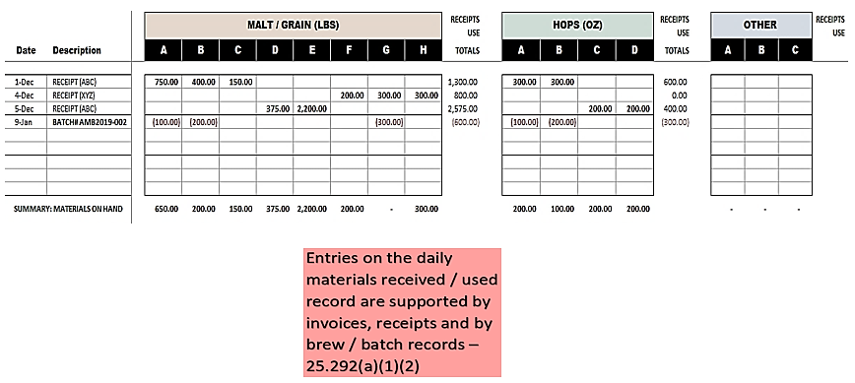
Example Materials Received/Used Record
27 CFR 25.292(a)(1)(2) & (b)(6)

Slide 77
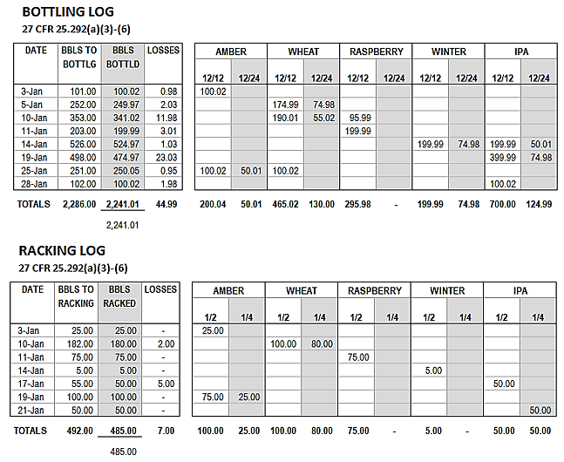
Example Packaging Record

Slide 78
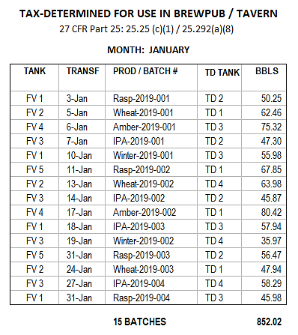
Example Removal Record (Brewpub)
Finished beer transferred (removed) from a fermenter to a serving tank/tax-determined tank

Slide 79
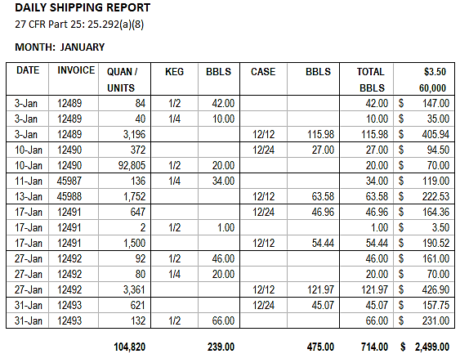
Example Removal Record
Packaged beer removed from bonded storage area, and sold or delivered to retailers/the public

Slide 80
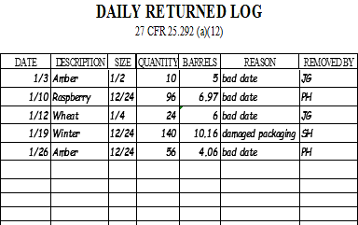
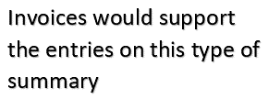
Example Returns to Brewery Record
Lost due to breakage, theft, etc.
Destroyed
Returned to brewery

Slide 81
Beer Removed Without Payment of Tax 27 CFR 25.292(a)(9)–(11)
Beer may be removed without tax payment ONLY when:
Transferred in bond to another brewery
Unfit for beverage use
Used for analysis or testing
Transferred to a distilled spirits plant
Exported/used as supplies for vessels and aircraft
For personal use: only sole proprietorships and partnerships. The annual limit is 100 gallons per household with one adult or 200 gallons for households with two or more adults (27 CFR 25.207)
See 27 CFR Subpart L 25.181 – 207 for details on these kinds of removals

Slide 82
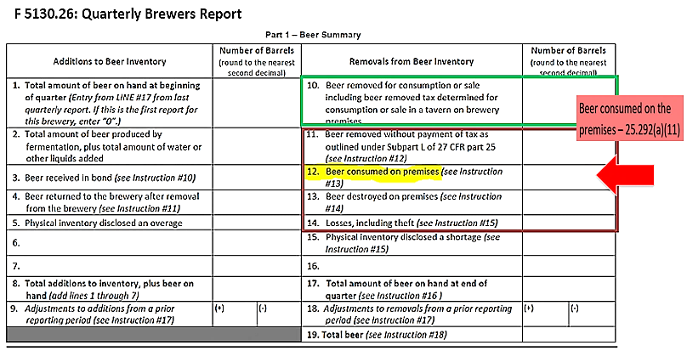
Beer Removed Without Payment of Tax Consumed on Premises - 27 CFR 25.292(a)(9)–(11)
Quarterly Report: Lines 11 – 14: removed without payment of tax

Slide 83
Beer Removed Without Payment of Tax Exports - 27 CFR 25.292(a)(9)
Beer Exported – for details see 27 CFR part 28
Direct export without payment of tax
Industry Circular 2004-3 Alcohol and Tobacco Export Documentation Procedures
TTB Form 5130.12 - Beer for Exportation
Export tax paid with benefit of drawback
TTB F 5130.6 - Drawback on Beer Exported

Slide 84
Inventory Records 27 CFR 25.294
Monthly Physical Inventory
Required every month
May be taken within 7 days of the end of the month
Must include the following information
Date taken
Quantity of beer on hand
Losses, gains, shortages
Signature under penalty of perjury

Slide 85
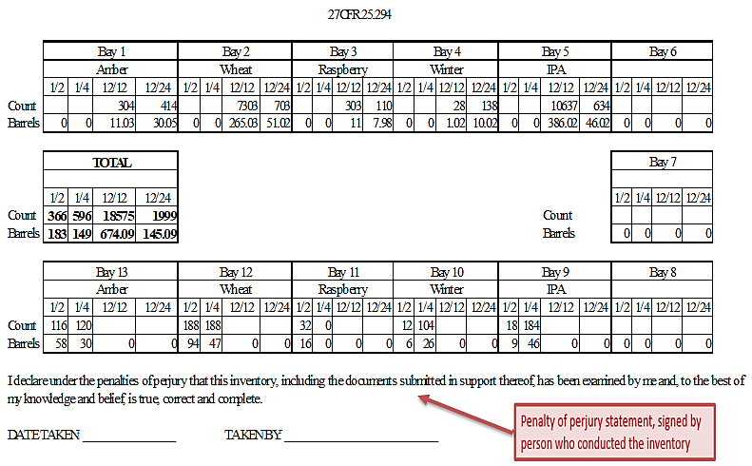
Example Inventory Record Larger Breweries Reporting on TTB Form 5130.9

Slide 86
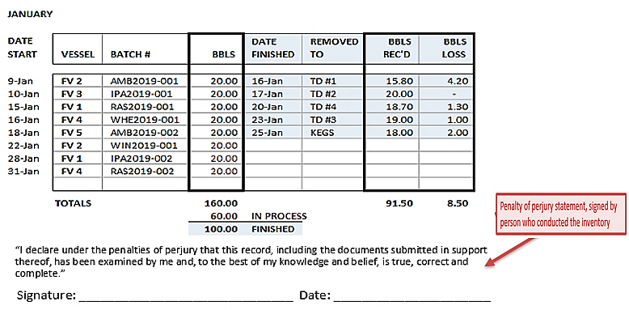
Example Inventory Record Smaller Breweries Reporting on TTB Form 5130.26
NOTE to Small breweries/brewpubs: A similar format could also be used for your Daily Summary of Daily Production Records/ Brew Logs
27 CFR 25.292(a)(2) or (b)(5)

Slide 87
Common Issues: Loss vs. Shortage 27 CFR 25.292(a)(16)
Loss: beer lost due to a known event like breakage, spillage or theft
Losses are NOT taxed
Shortage: missing quantity of beer disclosed by physical inventory count/unexpected
Shortages MAY be taxed
Brewer must submit a claim and provide a plausible explanation for the shortage, identify/address defects, or tax may be assessed
For details on filing claims see 27 CFR 25.283

Slide 88
Common Issues: Recording Beer Destructions 27 CFR 25.292(a)(14)
Destructions ON Brewery Premises
BEER NOT TAX PAID / TAX DETERMINED
Note the batch record or prepare a destruction record as detailed in §25.225
Prior notice and reporting is not required as per §25.221
BEER TAX PAID / TAX DETERMINED
Prepare a destruction record as detailed in §25.225
May file a claim for credit of taxes paid
For details on destructions see 27 CFR Subpart N 25.221–25.225

Slide 89
Common Issues: Recording Beer Destructions 27 CFR 25.292(a)(14)
Destructions OFF Brewery Premises:
Submit Notice of Intent of Destruction on brewery letterhead and fax it to the NRC: (202) 453-2979
For credit on taxes paid, within 6 months show as adjustment on the tax return and/or file a claim
For details on destructions, see 27 CFR subpart N: 25.221–25.225

Slide 90
Common Issues: Recording Returns 27 CFR 25.292(a)(12)(13)
Removed from/returned to same brewery:
May take an offset against that day’s removals
Removed from/returned to a different brewery, same ownership:
May file a claim for refund of tax or make a decreasing adjustment on the tax return – but may not take an offset
27 CFR 25.212 & 25.213

Slide 91
Records | Best Practices
Familiarize yourself with 27 CFR 25.292 and 25.294
Build recordkeeping duties into the daily work schedule
Keep detailed records: who, what, when, where, why, and how much
Be vigilant about recording production, removals, returns, destructions, losses and shortages
IN SUMMARY: record all operations and transactions at the brewery as soon as possible

Slide 92
Records, Reports & Returns
Records
Operations Report
Excise Tax Return

Slide 93
Beer Barrel Equivalency
1 barrel = 31 gallons
Barrels are the standard unit for tax and reporting
Taxable removals in kegs must be computed as barrels by using the tables found in 27 CFR 25.156
Taxable removals in bottles and cans must be computed as barrels by using the tables found in 27 CFR 25.158
If beer is to be removed in OTHER sizes, the brewer shall notify the NRC in advance and request to be advised of the fractional barrel equivalent

Slide 94
Beer Barrel Equivalency
Example: Barrel equivalent factor for 24/12 = 0.07258
24 oz. bottles
12 bottles per case
75 cases removed x 0.07258 = 5.4435 beer barrels
Use 5.44 beer barrels to compute tax
You must compute to 5 decimal places on removal records
The sum of the quantities computed for any one day will be rounded to 2 decimal places and the tax will be calculated and paid on the rounded sum

Slide 95
Operations Report
Reports are due the 15th day following the close of the reporting period
You must file a report even if there was no activity during period
File quarterly if your tax liability does not exceed $50,000 in the current or prior calendar year
File monthly if your tax liability is more than $50,000 in the current or prior a calendar year
There is no annual filing option for reports

Slide 96
Operations Reports
TTB Form 5130.26 – Quarterly Brewer’s Report of Operations (if eligible)
- OR -
TTB Form 5130.9 - Brewer’s Report of Operations
Note: Instructions are available for each form:
TTB Form 5130.26i and TTB Form 5130.9i

Slide 97
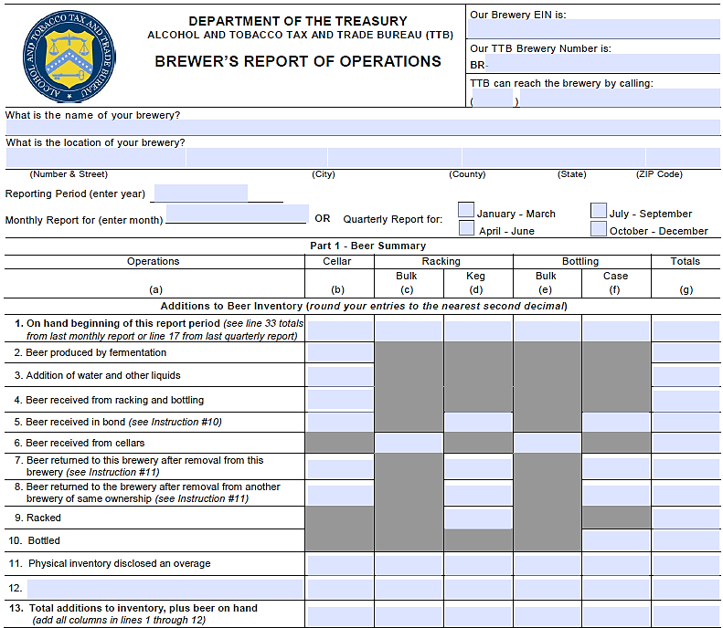
TTB Form 5130.9 - Brewer’s Report of Operations

Slide 98
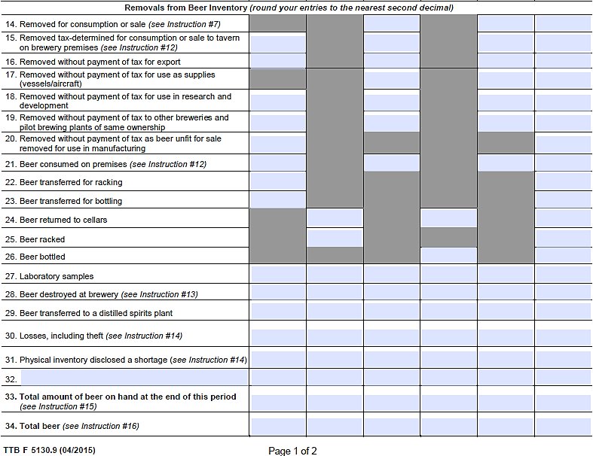
TTB Form 5130.9 - Brewer’s Report of Operations

Slide 99
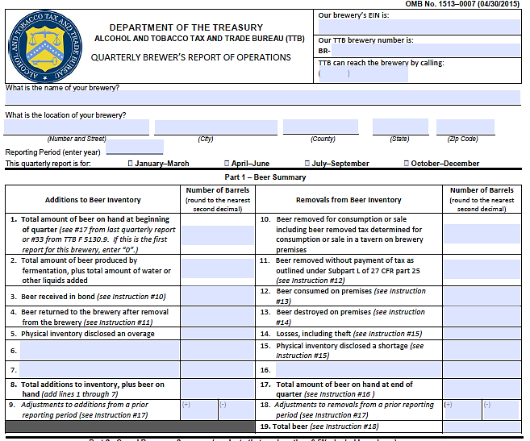
TTB Form 5130.26 – Quarterly Brewer’s Report of Operations

Slide 100
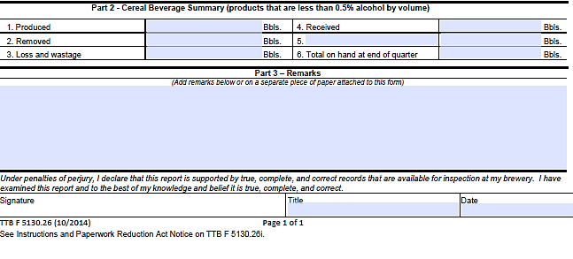
TTB Form 5130.26 – Quarterly Brewer’s Report of Operations

Slide 101
Records, Reports & Returns
Records
Operations Report
Excise Tax Return

Slide 102
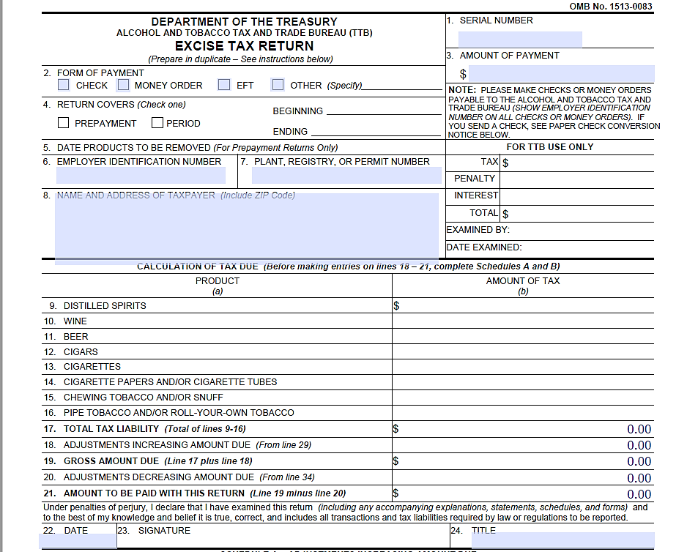
TTB Form 5000.24sm

Slide 103
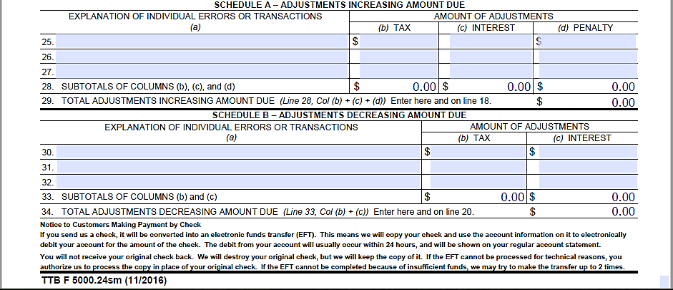
TTB Form 5000.24sm

Slide 104
Tax Rates for Domestic Beer
Tax Rates for Domestic Beer Removed During Calendar Years 2018 and 2019*
 | Beer Produced by the Brewer |  | Beer Not Produced by the Brewer
Domestic Brewer who brews 2,000,000 barrels or less per calendar year | First 60,000 BBLs | Over 60,000 up to 2,000,000 | All BBLs
 | $3.50 | $16.00 | $18.00
Domestic Brewer who brews more than 2,000,000 barrels per calendar year | First 6,000,000 BBLs | Over 6,000,000 BBLs
 | $16.00 | $18.00
* Additional rules regarding controlled groups and single taxpayers apply

Slide 105
When is There Beer Tax Liability?
“Tax is hereby imposed on all beer brewed or produced and removed for consumption or sale within the U.S. or imported into the U.S.”
26 U.S.C. 5051(a)

Slide 106
Excise Tax Return Filing Frequency
Annually: You may file 1 tax return per year if you are liable for $1,000 or less of tax on beer in the current and prior calendar year
Quarterly: You may file quarterly if you are liable for $50,000 or less of tax on beer in the current and prior calendar year
Quarters end March, June, September, December
NOTE: Additional rules apply to controlled groups and multiple breweries with the same EIN
27 CFR 25.164

Slide 107
Excise Tax Return Filing Frequency
Semi-Monthly: You must file a tax return two times per month if you are liable for more than $50,000 in beer tax in the current and prior calendar year
The return periods are:
1st through the 15th
16th through the end of month
Special rule for September — there is a third return period
1st through the 15th
16th through the 25th*
26th through the 30th*
27 CFR 25.164
* See 27 CFR 25.164a(a)(1) for return periods if required to pay by EFT

Slide 108
Excise Tax Return - TTB Form 5000.24
Tax returns (and payment, if any) are due the 14th day after the close of the tax period
If the due date falls on a weekend or legal holiday, the due date is the immediately preceding business day
Due date schedule for each year is available on our website
https://ttb.gov/tax_audit/fed_ex_tax_due.shtml
You must file a return even if you have $0 taxes due
27 CFR 25.164

Slide 109
Email Reminders for Filing Tax Returns and Reports
Stay current with due dates by subscribing to receive automated email reminders about when to file tax returns and reports of operations
Visit https://www.ttb.gov/news/automated-reminders-filing.shtml to sign up for email reminders

Slide 110
Tax Calculation
Operations
Report
Excise Tax Return
?

Slide 111
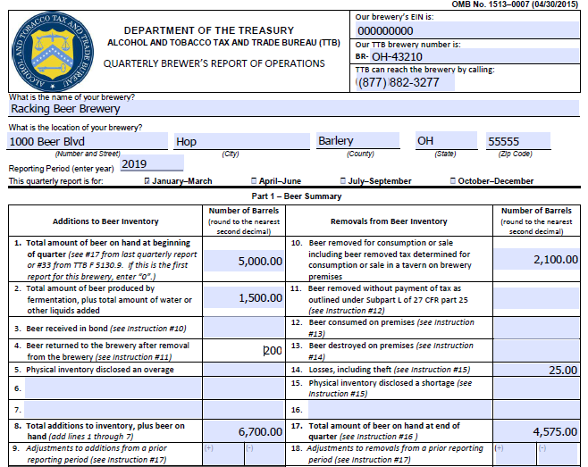

Slide 112
Example Reconciliation of Tax Returns to Report of Operations

Slide 113
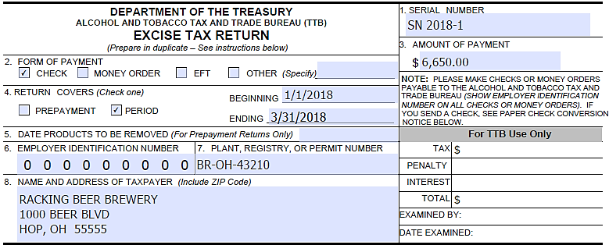
Tax Return – TTB Form 5000.24
2019-1
01/01/2019
03/31/2019

Slide 114
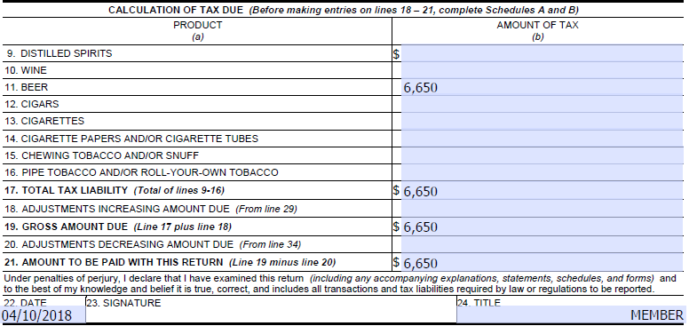
Tax Return – TTB Form 5000.24
04/08/2019

Slide 115
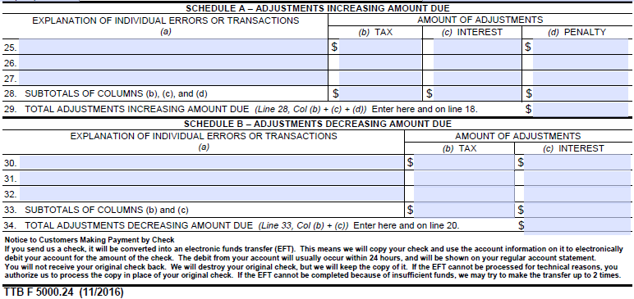
Tax Return – TTB Form 5000.24

Slide 116
Pay.gov
You may electronically file tax returns, file operations reports, and pay taxes through Pay.gov
Secure
Convenient and fast
Free
Checks entries and totals for accuracy
For more information on how to register, go to
https://www.ttb.gov/epayment/epayment.shtml

Slide 117
Mailing Address for Returns & Payments
If filing by mail, please be sure to use the correct address
Late returns or payment are subject to penalties and interest
DO NOT mail returns or payments to the National Revenue Center in Cincinnati, Ohio
TTB
Excise Tax
P.O. Box 790353
St. Louis, MO 63179-0353

Slide 118
Mailing Address for Operations Reports
If filing operations reports by mail, please be sure to use the correct address
Director, National Revenue Center
TTB
550 Main St, Suite 8002
Cincinnati, OH 45202-5215

Slide 119
Summary & Questions

Slide 120
Malt Beverage Formulas
CHRISTIAN FAY
Formula Specialist

Slide 121
Common Formula Questions
What is a formula?
Why is a formula required?
When is a formula required?
How is a formula submitted?

Slide 122
What is a Formula?
A formula is the recipe for your beer/malt beverage
It must include a quantitative list of ingredients
It must include a description of how the product is produced
It must indicate a total yield or batch size
In some instances a sample of the product must also be submitted to TTB for laboratory analysis
See Formula Basics page on TTB.gov
https://www.ttb.gov/formulation/pre_cola.shtml

Slide 123
Why is a Formula Required?
It’s required by TTB regulations
Domestic (27 CFR 25.55)
Imported (27 CFR 7.31(d))
We use the information found in the formula to:
Classify the product for tax and labeling purposes
Ensure that the product does not contain any prohibited ingredients
Determine if limited ingredients are used within prescribed limitations or if they will impact labeling
Provide a suggested statement of composition for labeling purposes

Slide 124
At What Stage do I Apply for Formula Approval?
Domestic - Formula approval is required prior to producing certain types of beer
Imported - Certain malt beverages are required to undergo formula review prior to issuance of a certificate of label approval

Slide 125
When is a Formula Required?
Formula approval is required if the brewer uses any of the following ingredients/processes*:
Flavors with alcohol
Compounded flavors
Colors (unless exempted by TTB Ruling 2015-1)
Artificial sweeteners
Flavors or other agricultural ingredients (unless exempted by TTB Ruling 2015-1)
The beverage is frozen and ice crystals are removed (e.g., ice beer)
*Not a complete list

Slide 126
When is a Formula Required?
FAQ B13: Am I Exempt from Formula Requirements if I Sell my Malt Beverage only at my Brewpub or only within my State?
No
If a brewer is required to obtain formula approval for a product then approval of the formula must be obtained prior to production, even if the product will be sold only at the brewer’s brewpub or otherwise sold only within the state in which it is produced
Formula requirements also apply regardless of whether the product is sold on tap at the brewer’s brewpub or is bottled, canned, or kegged

Slide 127
Which Beers Require Formula Approval?
Use our online formula tool or check the list in TTB G 2016-1A to determine which kinds of beer require formula approval
Tool: https://www.ttb.gov/formulation/formula_approval_tool_mb.shtml
List: https://www.ttb.gov/public-guidance/TTB-G-2016-1A.shtml
27 CFR 25.53, 25.55 & 7.31(d)

Slide 128
Which Beers Require Formula Approval?
Products that Require
Formula Approval
Products that Require Formula with Laboratory Sample Analysis
Ice beer
Kombucha (when regulated by TTB)
Malt beverage specialty products, such as flavored beer or beer made with non-traditional processes (unless exempted by TTB Ruling 2015-1)
Saké
“Alcohol Free” malt beverages (0.0 percent alcohol by volume)
See TTB G 2016-1A for additional information
https://www.ttb.gov/public-guidance/TTB-G-2016-1A.shtml
27 CFR 25.53, 25.55 & 27 CFR 7.31(d)

Slide 129
Ingredients and Processes that are Exempt from Formula Requirements
TTB Ruling 2015-1 exempts certain traditional ingredients and processes
Attachment 1 specifies which ingredients and processes are exempt, for example:
Honey, vanilla beans
Barrel-aging
The ruling does not exempt flavors containing alcohol or extracts, for example:
Vanilla beans are exempt, but vanilla extract is not exempt
Please note that exempt ingredients cannot comprise more than 49 percent of the fermentables
TTB can still request a formula and samples for analysis at any time, even when exempt ingredients are used

Slide 130
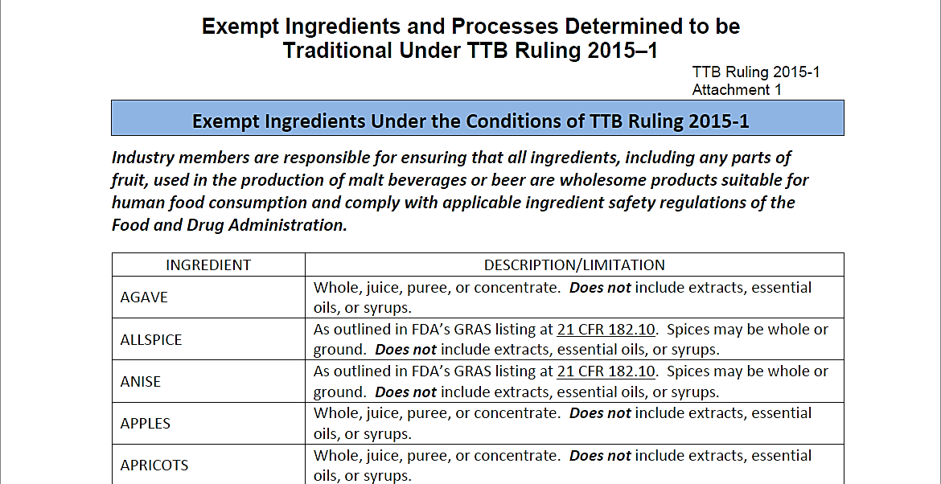
TTB Ruling 2015-1 | Attachment 1

Slide 131
Combinations of Exempt and Non Exempt Ingredients
If you use both exempt and non exempt ingredients, formula is required
Passion- fruit, vanilla Beans
Guava
Passionfruit and vanilla beans are exempt
Guava is not exempt

Slide 132
What TTB Looks For When Reviewing Formulas
Correct designation (Class and Type) – Is the base produced according to the stated standard?
GRAS (Generally Recognized As Safe) status of certain ingredients
Any limited or prohibited ingredients used
Correct supporting documentation for certain ingredients
Ingredient Specification Sheet (Spec Sheet)
Flavor Ingredient Data Sheets
Limited Ingredient Calculation Worksheet

Slide 133
Compounded Flavors
Are one of the following:
All natural
Natural and artificial containing up to 0.1% artificial content topnote
Natural and artificial containing greater than 0.1% artificial content topnote
All artificial
Non-flavor: product is not flavor (e.g., Cloud Emulsion)
Submitted to TTB Nonbeverage Lab for Review
May contain colors

Slide 134
Flavor Ingredient Data Sheet (FID Sheet or FIDS)
A FID Sheet is a spreadsheet that includes information about certain ingredients used to make a compounded flavor
Submit one for each compounded flavor used in your product
The FID Sheet allows TTB to:
Ensure that the compounded flavor has been evaluated by the TTB Nonbeverage Products Laboratory (NPL)
Verify that your beverage does not contain any ingredients in excess of the limits prescribed by TTB or by FDA
Ensure the appropriate labeling of your product
Ensure your product complies with TTB restrictions governing how much of the alcohol in your beverage may be derived from flavors and other nonbeverage ingredients containing alcohol
See TTB G 2017-4 for additional information and examples

Slide 135
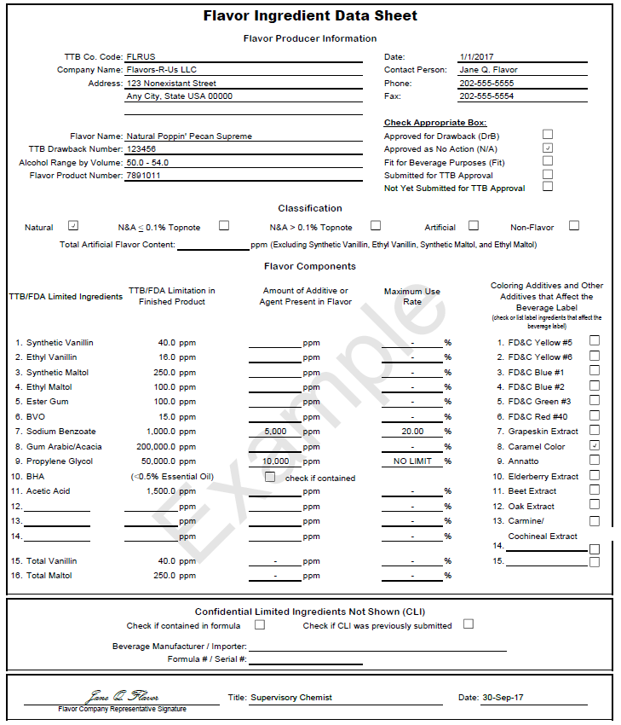
Flavor Ingredient Data Sheet (FID Sheet or FIDS)
Flavor manufacturer supplies form to the brewer
FID based on exchange between flavor producer and TTB Nonbeverage Laboratory
It lists concentration of limited ingredients in PPM
Lists any colors used in flavor
States alcohol content of flavor
This information, combined with the use rate, determines classification of flavor

Slide 136
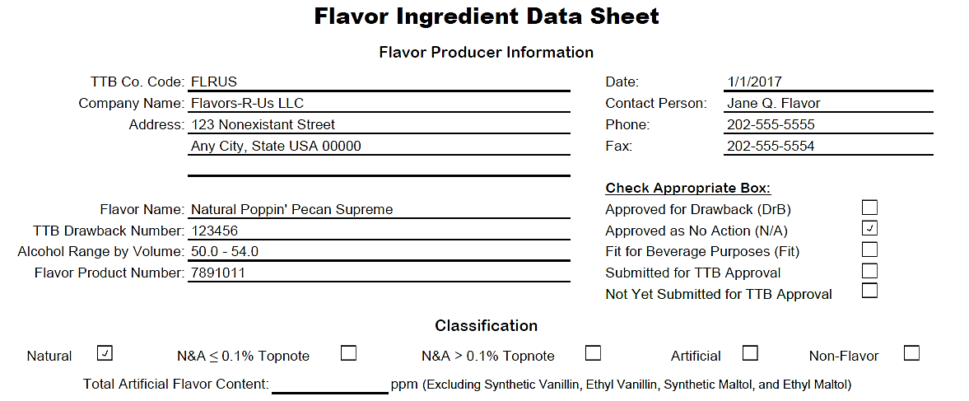
FID Sheet: Header

Slide 137
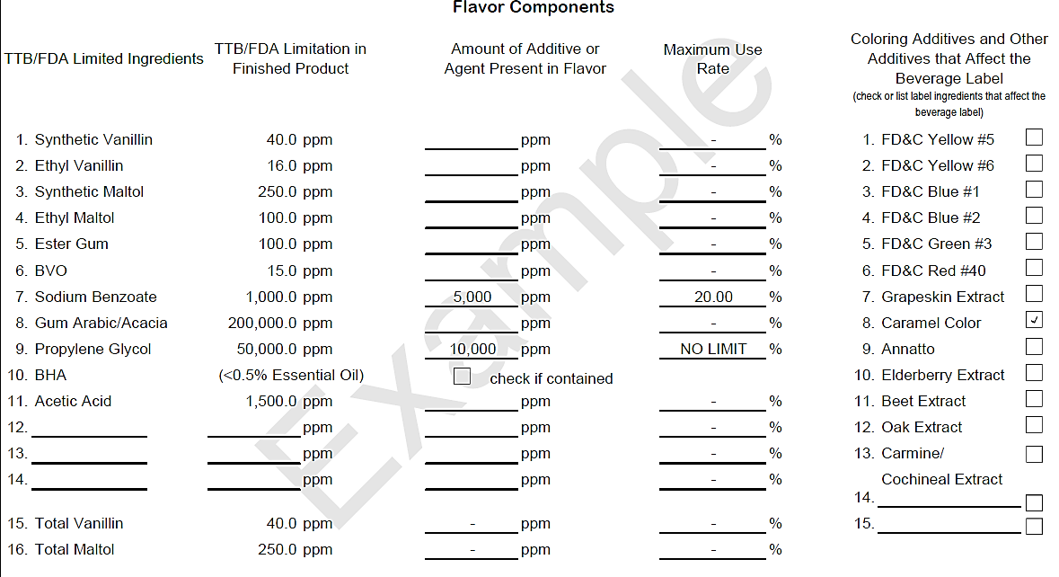
FID Sheet: Limited Ingredients Section

Slide 138
Limited Ingredient Calculation Worksheets
Used to calculate the total amounts of ingredients that have limits on their use per TTB and FDA requirements
Complete and submit one for each malt beverage made with one or more compounded flavors
Also useful as a product development tool
Allows you to confirm that new product formulas are in compliance with limited ingredient requirements, and whether a flavor will be labeled as artificial prior to submitting the formula
See TTB G 2017-6 for additional information and examples

Slide 139
Ingredient Specification Sheet (Spec Sheet or Technical Data Sheet)
A spec sheet is a document or label that lists or describes the contents of an ingredient that is made from more than one component
Submit a spec sheet for each ingredient that is made from more than one component, e.g., a fruit juice made from water, apples, and sugar
Should not be used for compounded flavors (use FID sheet)
See TTB G 2017-3 for additional information and examples

Slide 140
Certified Colors 21 CFR part 74, Subpart A*
FD&C Blue #1 | (Brilliant Blue FGF) | (E 133)
FD&C Blue #2 | (Indigotine) | (E 132)
FD&C Green #3 | (Fast Green FCF) | (E 143)
FD&C Red #40 | (Allura Red AC) | (E 129)
FD&C Red #3 | (Erythosine lake only) | (E 127)
FD&C Yellow #5** | (Tartrazine) | (E 102)
FD&C Yellow #6 | (Sunset Yellow FCF) | (E 110)
*Regulations of the U.S. Food and Drug Administration (FDA) **Requires specific declaration on labels for finished alcohol beverages

Slide 141
Non-Certified Colors* 21 CFR part 73, subpart A
Annatto Extract
Dehydrated beets
(beet powder)
Canthaxanthin
Caramel Color
Carmine
(Cochineal Extract)**
Carrot oil
β-Apo-8′-carotenal
β-Carotene
Fruit Juice
Grape color extract
Grapeskin Extract (Enocianina)
*This is a partial list. See 21 CFR part 73, Subpart A for a complete list of FDA regulations
**Requires specific declaration on labels of finished alcohol beverages

Slide 142
FDA Requirements
FDA has authority over food and ingredient safety
Approved Food Additives
21 CFR parts 170-186
Generally Recognized as Safe
Traditional use in food prior to 1958
Scientific determination
Traditional medicines/dietary supplements are not necessarily GRAS
Importer/producer is responsible for proving that an ingredient is GRAS

Slide 143
GRAS and Restricted Ingredients
GRAS – Generally Recognized As Safe
Under sections 201(s) and 409 of the Federal Food, Drug, and Cosmetic Act, any substance that is intentionally added to food is a food additive, that is subject to premarket review and approval by FDA, unless the substance is generally recognized, among qualified experts, as having been adequately shown to be safe under the conditions of its intended use, or unless the use of the substance is otherwise excluded from the definition of a food additive
Having GRAS status does not impact formula requirements
FDA maintains a list of prohibited ingredients at 21 CFR part 189
Certain non-prohibited ingredients may be used within limits
http://www.ttb.gov/ssd/limited_ingredients.shtml

Slide 144
TTB Limited Ingredients
There are 4 artificial flavor materials that TTB allows to be present at certain levels in alcohol beverages without affecting the label declaration:
Synthetic maltol
Ethyl maltol
Synthetic vanillin
Ethyl vanillin
If these limits are exceeded, a “natural flavor” is treated as an “artificial flavor” in the product

Slide 145
Beer/Malt Beverages with Flavors that Contain Alcohol*
Final ABV is less than or equal to 6 percent:
at least 51 percent of the alcohol in the final product must come from the malt base
no more than 49 percent of the alcohol in the final product can come from the flavor and other nonbeverage materials
Final ABV is greater than 6 percent:
no more than 1.5 percent of the volume of the malt beverage can consist of alcohol from flavors and other nonbeverage ingredients containing alcohol
An alcohol content statement must appear on the label if any alcohol in the malt beverage was derived from added flavors
27 CFR 7.11 & 22(a)(5), 27 CFR 25.15

Slide 146
How to Submit a Formula
The recommended method is completing the full application electronically using Formulas Online
See webinar handout: How to Register and Submit Formulas through Formulas Online (July 2018)
Although TTB strongly encourages you to use Formulas Online, a paper alternative is also available
TTB Form 5100.51 mailed to TTB (use address on the form)

Slide 147
Benefits of Using Formulas Online
Secure method for drafting, submitting, and tracking your formula applications electronically
Includes:
Step-by-step guidance
Data validation checks along the way
Application status updates via email
Facilitates record keeping
Approved formulas are stored online
Copies of approved formulas can be printed if needed

Slide 148
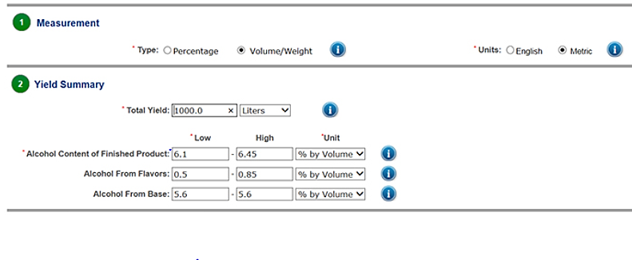

Slide 149
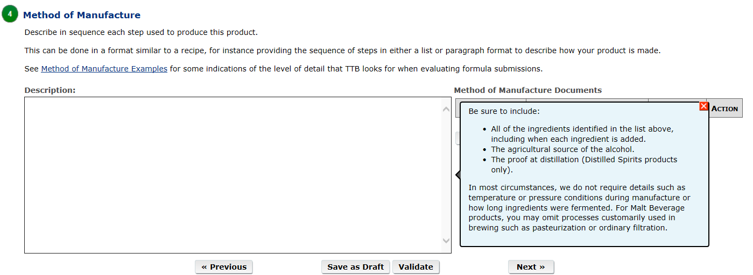
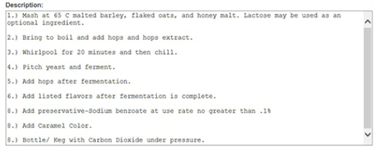
Method of Manufacture

Slide 150
Helpful Hints
Supply a quantitative list of ingredients
Provide a complete method of manufacture
Indicate at what stage flavors are added to the product
Flavor Ingredient Data Sheets (FIDS) should include a TTB number, a Flavor Product Number, and the TTB Approval status (Nonbeverage Lab Approval)
Provide the common name and scientific name (genus and species) for any unusual herbal ingredients
Ensure that ingredients are considered GRAS (generally recognized as safe) by the FDA

Slide 151
Common Reasons Formulas Must be Returned for Correction
Ingredient Specification Sheet (Spec Sheet) is missing for ingredients composed of more than one component
Limited Ingredient Calculation Worksheet is missing when compounded flavors are used
Flavor Ingredient Data (FID) is missing when compounded flavors are used
Formula approval is not required for this product because it is composed of exempt ingredients or processes (See TTB Ruling 2015-1)

Slide 152
Summary & Questions

Slide 153
Labeling
MICHAEL G. WEBSTER
Quality Assurance Coordinator, Labeling

Slide 154
Laws and Regulations
Alcoholic Beverage Labeling Act of 1988
27 U.S.C. 213 et seq.
27 CFR part 16 - Alcoholic Beverage Health Warning Statement
Federal Alcohol Administration Act
27 U.S.C. 205
27 CFR part 7 – Labeling and Advertising of Malt Beverages
Internal Revenue Code
26 U.S.C. Chapter 51
27 CFR part 25 – Beer
27 CFR part 27 – Importation of Distilled Spirits, Wines, and Beer

Slide 155
COLAs:
What, Who, Why, When
and How?

Slide 156
What is a COLA?
Certificate Of Label Approval
Authorizes:
The bottling or packing of malt beverages, or
The removal of bottled malt beverages from customs custody (Imports)
The product must bear labels identical to the labels affixed to the face of the certificate, or labels with changes authorized by the certificate
TTB’s approval of a COLA does not constitute trademark protection
See TTB Form 5100.31
27 CFR 13.11

Slide 157
Who Can File an Application for a COLA?
In order to file an application for label approval, you must have either:
A Brewer’s Notice, or
A Basic Permit (importer)
Permits and Brewer’s Notices are issued by the TTB National Revenue Center in Cincinnati, Ohio
Permits Online
(877) 882-3277 or (877) TTB-FAQS

Slide 158
Who Gets the COLA in a Contract Brewing Arrangement?
Contract Brewing is an arrangement in which one person pays a brewing company to produce beer for them
Contract Brewer is responsible for:
Brewing product
Formula submission
COLA submission
Keeping appropriate brewery records
Paying taxes upon removal from the brewery

Slide 159
Who Gets the COLA in an Alternating Proprietorship Arrangement?
An alternating proprietorship is when two or more people take turns using the physical premises of a brewery
Both the host and the tenant must qualify as a brewer and are responsible for:
Obtaining Brewer’s Notice
Producing beer
Keeping and maintaining brewing records
Obtaining COLAs and Formulas
Paying appropriate taxes upon removal

Slide 160
Why do I Need a COLA?
A COLA is required by law
The FAA Act makes it unlawful for any person engaged in the business as a brewer, importer, or wholesaler of malt beverages to sell or ship, or deliver for sale or shipment, or otherwise introduce, in interstate or foreign commerce, or to remove from customs custody for consumption, malt beverages in bottles, unless they are bottled, packaged, and labeled in conformity with the regulations in 27 CFR part 7
With regard to malt beverages sold in interstate commerce, the labeling provisions of the FAA Act apply only to the extent that there is similar state law
The FAA Act generally requires bottlers and importers of malt beverages to obtain a COLA in order to prevent the sale or other introduction of products that are bottled, packaged, or labeled in violation of law

Slide 161
At What Stage do I Apply for Label Approval?
The COLA must be obtained prior to bottling (for domestically bottled malt beverages) and prior to removal from customs custody (for imported containers of malt beverages)
Bottling includes placing malt beverages in containers such as cans and kegs
See TTB website for information processing times for COLA applications
http://www.ttb.gov/labeling/processing-times.shtml

Slide 162
When is a COLA Not Required?
When a beer is not a malt beverage under the FAA Act:
usually because it is not made with both malted barley and hops (See TTB Ruling 2008-3)
Special rules apply to saké, which is labeled as a wine under the FAA Act if it has at least 7 percent alcohol by volume
When a malt beverage will be sold exclusively in the state in which it was bottled:
Unless the state where the malt beverage is bottled requires an approved COLA from TTB
See TTB Ruling 2013-1
The following regulatory requirements apply regardless of COLA requirements:
Government Health Warning Statement per 27 CFR part 16
Markings per 27 CFR part 25, Subpart J (for domestic brewers)
Formula for domestic beers under part 25 (when applicable)

Slide 163
How to Apply for Label Approval
The recommended method is submitting electronically using COLAs Online
A paper alternative is also available
TTB Form 5100.31 mailed to TTB (use address on the form)

Slide 164
Label Information

Slide 165
Mandatory Label Information
Must be on the Brand Label:
May be on Any Label:
Brand name (27 CFR 7.23)
Class (27 CFR 7.24)
Name and address (domestic) (27 CFR 7.25)
Net contents (27 CFR 7.27)
Alcohol content (for malt beverages containing alcohol derived from added flavors or other nonbeverage ingredients (other than hops extract)) (27 CFR 7.22)
Government Health Warning (27 CFR 16.21-22)
Name and address (Imported) (27 CFR 7.25)
Country of origin (Imported)
Declaration of certain ingredients (when used): (27 CFR 7.22)
Aspartame
Sulfites
FD&C yellow #5
Cochineal extract or carmine

Slide 166
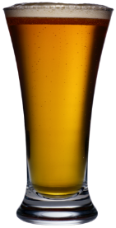
Little Egypt’s Finest Ales
Mandatory label Information:
Brand Name
Name and Address
Class/Type
Net Contents
Government Warning
Alcohol Content (Optional)
1
X & Y Brewery
Steeleville, IL
2
6
GOVERNMENT WARNING:
ACCORDING TO THE SURGEON GENERAL, WOMEN SHOULD NOT DRINK ALCOHOLIC BEVERAGES DURING PREGNANCY BECAUSE OF THE RISK OF BIRTH DEFECTS.
CONSUMPTION OF ALCOHOLIC BEVERAGES IMPAIRS YOUR ABILITY TO DRIVE A CAR OR OPERATE MACHINERY, AND MAY CAUSE HEALTH PROBLEMS.
5
1 Pint 9.4 fl oz. (750 mL) | 8.2% Alc/Vol
4
Bourbon Barrel Aged Ale
*Declarations of certain ingredients also must appear on the label, when applicable
3

Slide 167
Mandatory Label Information General Requirements
Must be readily legible under ordinary conditions, and must appear on a contrasting background
Other than the brand name, must be in English, with exceptions for malt beverages bottled for consumption in Puerto Rico
For information about type size requirements, refer to
27 CFR 7.28 General Requirements, or
TTB Malt Beverage BAM (Beverage Alcohol Manual)
27 CFR 7.28

Slide 168
Mandatory Label Information Brand Name
Name under which the malt beverage is marketed
If the malt beverage is not sold under a brand name, then the name of the bottler or importer is considered the brand name
Common mistakes:
Brand name on the label is not correctly entered on the application
Class/type is entered in the brand name field on the application
27 CFR 7.23

Slide 169
Mandatory Label Information Class and Type
The specific identity of a malt beverage
The designation of malt beverages is based on trade understandings of the characteristics generally attributed to the particular malt beverage
Ale, Beer, Malt liquor, Stout, Ice Beer, and India Pale Ale are all acceptable as the class designation of a malt beverage
Malt beverages that do not have the characteristics of the above designations must be labeled with additional information
27 CFR 7.24

Slide 170
Mandatory Label Information Class and Type
 | Examples:
Specific identity of the malt beverage | Ale Beer Stout Lager Porter Cereal Beverage (Near Beer)
Flavored malt beverages that require a formula: Fanciful Name Statement of Composition (SOC) | Jojo’s Cucumber Ale AND Ale Brewed with Cucumber
Malt beverages that are exempt from formula requirements under TTB Ruling 2015-1 must be designated in accordance with trade understanding as described in the ruling | Hayward’s Pumpkin Stout OR Stout Brewed with Pumpkins

Slide 171
Ingredients and Processes Exempt From Formulas
You will find a list of processes and ingredients that do not require formula review in TTB Ruling 2015-1
The ruling is divided into 3 separate documents (the ruling and two attachments)

Slide 172
TTB Ruling 2015-1 List of Exemptions – Attachment 1

Slide 173
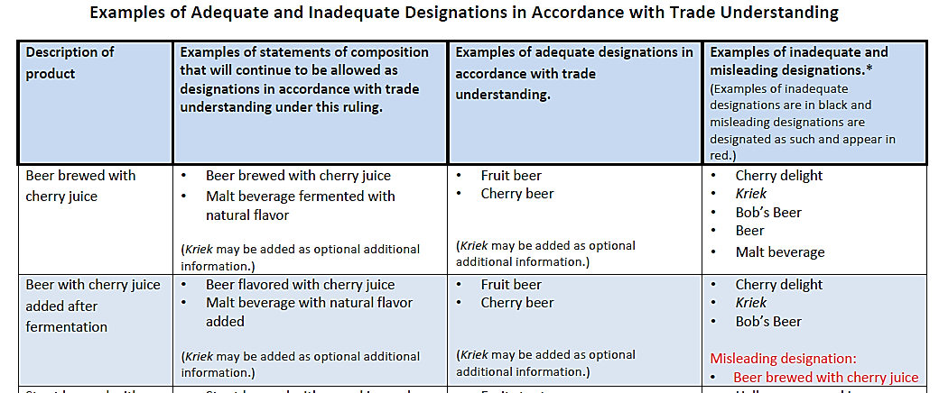
2015-1 Examples of Designations – Attachment 2

Slide 174
Example 1 – Class and Type Designations
Flavoring Ingredient used: | Raspberry puree
Is a formula required? | NO (exempt under 2015-1)
Labeling options: in accordance with trade understanding Statement of Composition | Flavored Ale Raspberry Ale Ale with Natural Flavor Ale with Raspberries

Slide 175
Example 2 – Class and Type Designations
Flavoring Ingredient used: | Elderberries
Is a formula required? | YES (Not exempt under 2015-1)
Labeling options: Requires a Fanciful Name: Requires an SOC: | Happily Elder After Ale with Elderberries Ale with Natural Flavor

Slide 176
Class and Type | Common Mistakes
Leaving the class designation (ale, stout, etc.) off of the label
For example, using just “IPA” (the word “ale” must appear on the brand label)
Using “hefeweizen,” “bock,” “tripel,” “dubbel,” “bier” (which are not sufficient class designations in and of themselves)
Using just “gose” or “wit” and not having suitable class designation or using “breakfast stout” and not having a statement of composition
Leaving the class designation of the base beer out of the statement of composition - the statement of composition must include the base designation
For example, “Ale with vanilla extract”

Slide 177
Mandatory Label Information Name and Address
City and state of bottler/packer
Trade name or DBA (doing business as) is allowed
Principal place of business of the producing brewer may be used in lieu of listing all brewing locations when owning multiple brewing locations
27 CFR 7.25

Slide 178
Principal Place of Business
Hype Brewing Co. brews lager at all three of their facilities
OR Brewery
& Admin Offices
Name and Address Statement Options:
Brewed by Hype Brewing Co. Corvallis OR, Sterling VA, & Denver CO
Brewed by Hype Brewing Co. Corvallis OR (principal place of business)
VA Brewery
CO Brewery
Image from publicdomainvectors.org

Slide 179
Name and Address | Common Mistakes
Leaving name and address off of the label
City and state on label do not match the address on the Brewer’s Notice
Not using a DBA for contract brewing
Label contains name and address for contractee and not the contract (producing) brewer

Slide 180
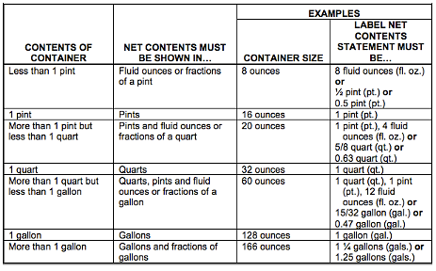
Mandatory Label Information Net Contents
Must use English units of measure (fluid ounces, pints, quarts, gallons)
May show both metric and English units on the label
1 pint 9.4 fl. oz. (750 mL)
27 CFR 7.27

Slide 181
Net Contents| Common Mistakes
Stating just “oz.” instead of “fl. oz.”
Stating “16 fl. oz.” instead of “1 pint” (may list both)
Not converting measurements into pints and fluid ounces (22 fl. oz. vs. 1 pint 6 fl. oz.)
Showing only metric units (750 mL)

Slide 182
Mandatory Label Information Alcohol Content
Mandatory if any alcohol is derived from added flavors or other added nonbeverage ingredients (other than hops extract) containing alcohol
Otherwise, it is optional (unless required by state law)
Approved Formats:
Alcohol (ALC) __% by Volume (VOL)
Alcohol (ALC) by Volume (VOL) __%
__% Alcohol (ALC) by Volume (VOL)
__% Alcohol (ALC)/Volume (VOL)
27 CFR 7.71

Slide 183
Alcohol Content | Common Mistakes
Using an incorrect format
“ABV” is not permitted - you must spell out the words or use the abbreviations allowed by 27 CFR 7.71
Leaving off part of the phrase or the percent symbol (%)
Not listing alcohol content on the label for products that contain added alcohol from a flavor

Slide 184
Mandatory Label Information Health Warning Statement
Must be readily legible under ordinary conditions and on a contrasting background
Must be separate and apart from all other label text
The words “GOVERNMENT WARNING” must appear in capital letters and bold type
GOVERNMENT WARNING: (1) According to the Surgeon General, women should not drink alcoholic beverages during pregnancy because of the risk of birth defects. (2) Consumption of alcoholic beverages impairs your ability to drive a car or operate machinery, and may cause health problems.
27 CFR Part 16

Slide 185
3) Breakfast Stout is an incorrect class designation if it’s not just a plain stout
If the product requires formula approval then a statement of composition must appear on the label
If the product is exempt under 2015-1 then it must be labeled in accordance with trade understanding and either a statement of composition or designation is required
Saint Benedicts
Breakfast Stout
3
GOVERNMENT WARNING: (1) ACCORDING TO THE SURGEON GENERAL, WOMEN SHOULD NOT DRINK ALCOHOLIC BEVERAGES DURING PREGNANCY BECAUSE OF THE RISK OF BIRTH DEFECTS. (2) CONSUMPTION OF ALCOHOLIC BEVERAGES IMPAIRS YOUR ABILITY TO DRIVE A CAR OR OPERATE MACHINERY, AND MAY CAUSE HEALTH PROBLEMS.
1
2
9.5% ABV
22 fl. oz.
Brewed by Saint Benedicts | Corpus Christi, TX
1) The abbreviation “ABV” is not allowed. May be stated as “alc/vol” or “alc by vol”
2) Net contents should be stated as “1 pint 6 fl. oz.”

Slide 186
Labels and TTB Ruling 2015-1
Common mistakes:
Product ingredients are not sufficiently conveyed by the style’s name, for example, as “gose” or “wit”
Missing statement of composition
Missing designation
For example: “breakfast stout” made with ingredients such as coffee, cinnamon, etc. use either:
Statement of composition: “Stout with coffee and spices”
Appropriate Designation: “Breakfast coffee stout” (only if all ingredients are exempt)

Slide 187
Geographical Names
Geographical names for distinctive types of malt beverages shall not be applied to malt beverages produced in any place other than the particular region indicated by the name unless qualified with text such as “STYLE” or “PRODUCT OF THE USA” or other text to indicate the true place of production
Common Mistakes
“India pale lager” or “India session ale” appearing without qualifiers (such as “style” or “product of USA”)
“Product of the USA” does not appear in direct conjunction with the brand name
27 CFR 7.24(f)-(h)

Slide 188
Geographical Names of Distinctive Types
Names that have lost geographic significance (no qualifier required)
Examples of names that still have geographic significance* (qualifier required)
India pale ale
Baltic porter
Bohemian
Russian imperial stout
Imperial Russian stout
Scotch ale
Scottish ale
Belgian
Berliner
English
Irish
Kolsch
Mexican
Vienna
New England
West Coast (or similar)
*Not a Complete List

Slide 189
Examples of Prohibited Practices Labels/Cartons/Cases
Shall not contain*:
Any false or misleading information
Claims of alcohol content strength
Text that implies that the product is a distilled spirit or contains a distilled spirit
Misleading health-related claims
Obscene or indecent material
The U.S. flag or U.S. military or government seals or emblems, if they create a misleading impression as to government endorsement or affiliation
*Not a complete list of prohibited practices
27 CFR 7.29

Slide 190
1) “Strong” must be removed as it is a prohibited strength statement
2) “Belgian” is misleading since the product is made in the U.S. Needs qualifier such as “Belgian style”
3) Additional Text: the use of “cherry and stone fruit flavor” in a plain ale implies that fruit or flavors were used, which may require a formula and SOC. To describe flavor profiles from certain grains, the label could alternatively, say “Ingredient X imparts a flavor of …”
OLD PAP
Belgian Strong Ale
GOVERNMENT WARNING:
(1) According to the Surgeon General, women should not drink alcoholic beverages during pregnancy because of the risk of birth defects.
(2) Consumption of alcoholic beverages impairs your ability to drive a car or operate machinery, and may cause health problems.
Old Pap has the fresh smooth taste of an ale with a unique cherry and stone fruit flavor.
Brewed & Bottled by Pap Brewery, Dalton, GA
2
1
3
1 pint, 6 fl. oz.

Slide 191
Non-Alcoholic, Alcohol Free, and 0.0% Alcohol By Volume
Terms for products containing less than 0.5% alcohol by volume
These terms describe the alcohol content of a product and they are not sufficient as class/type designations
Must be labeled with a class designation of “malt beverage,” “cereal beverage,” or “near beer,” under 27 CFR 7.24(d)
May not be labeled as “beer,” “stout,” “lager,” “ale,” “porter,” “malt liquor,” or “lager beer”
Other countries have different definitions

Slide 192
Non-Alcoholic
Alcohol content must be less than 0.5% ABV
Actual alcohol content may not exceed 0.5 percent (i.e., there is no tolerance above labeled ABV)
“Non-Alcoholic” is an optional statement, but if used, label must also state in direct conjunction “Contains less than 0.5% alcohol by volume”
If domestically bottled must state on the label “Non taxable under section 5051 I.R.C.” (27 CFR 25.242)
Government Warning is not required
27 CFR 7.71(e)

Slide 193
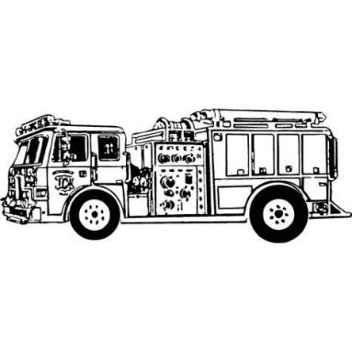
Fire Truck Brewing
UPC
Honesdale, PA
Non-taxable under section 5051 I.R.C
1 PINT NEAR BEER
BREWED BY FIRE TRUCK BREWING HONESDALE, PA
Non-Alcoholic
Contains less than 0.5% Alcohol by Volume

Slide 194
Alcohol Free & 0.0% Alcohol by Volume
“Alcohol free” and “0.0 percent alcohol by volume” may be used only on malt beverages containing no alcohol
If labeled with an alcohol content of 0.0 percent alcohol by volume label must also state “alcohol free”
“Non taxable under section 5051 I.R.C.” must appear on domestically bottled cereal beverages (27 CFR 25.242)
Government Warning is not required
Requires Formula Approval with Laboratory Sample Analysis per TTB G 2016-1A
27 CFR 7.71(c)(3) & (f)

Slide 195
Pauling Alcohol Free
An alcohol free version of our on-tap favorite!
NON TAXABLE UNDER SECTION 5051 IRC
UPC
0.0% alc./vol.
CRISP MALTY REFRESHING
12 fl oz |Brewed by Downtown Brewing Newark, NJ | Malt Beverage
Image from publicdomainvectors.org

Slide 196
Non-Alcoholic, Alcohol Free, and 0.0% Alcohol by Volume |Common Mistakes
Use of prohibited class terms (for example, ale, beer, porter, lager, stout)
“Contains less than 0.5% alc/vol” is missing or does not appear in direct conjunction with “non-alcoholic”
“Alcohol free” appears on products that are not 0.0% alc/vol

Slide 197
Allergen Disclosures
-Milk -Soybeans
-Eggs -Peanuts
-Tree nuts -Wheat
-Crustacean shellfish -Fish
You may make voluntarily disclosures of the major food allergens
Labeling requirements:
Must be specific as to the type of tree nut or crustacean shellfish
If one allergen is disclosed, then all allergens used in production of beverage must be disclosed
Voluntary statements must be formatted as follows:
Contains: Wheat, Eggs, Pecans
27 CFR 7.22(a)

Slide 198
Allergen Disclosures | Common Mistakes
Including ingredients that are not one of the seven major allergens (for example, barley or oats)
Misstating milk (for example, CONTAINS: Lactose)
Must be stated as “Contains: Milk” or “Contains: Milk (Lactose)”

Slide 199
Light/Lite Beer Claims
“Lite,” “Light,” or other nutritional claims such as “99 calories,” or “Low carbohydrate” requires that an statement of average analysis appear on the label (see TTB Ruling 2004-1)
Statement of Average analysis consists of:
Serving size (12 fl oz for malt beverages)
Calories (no units)
Carbohydrates (grams or g)
Protein (grams or g)
Fat (grams or g)
FDA Nutrition Facts panel is prohibited
Alternatively, Serving Facts Panel may be used (TTB Ruling 2013-2)
PER 12 FL.OZ.-AVERAGE ANALYSIS:
CALORIES 99, CARBOHYDRATES 6.2 g, PROTEIN 1.1 g, FAT 0.0 g

Slide 200
Light Beer | Common Mistakes
Statement of average analysis is missing information
Use of “light” in the additional text when discussing the finished product, without a statement of average analysis
Adding other nutritional information to the statement
Use of FDA or foreign nutritional panel

Slide 201
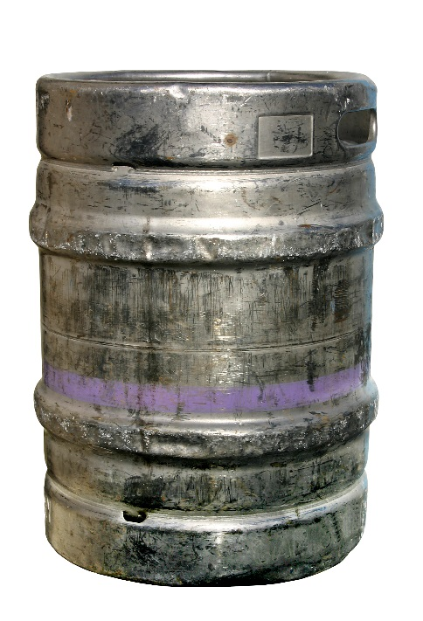
Kegs
Kegs are consumer containers, just like bottles or cans
When a COLA is required, mandatory labeling requirements must be met
Labels bearing mandatory information must be firmly affixed and may include:
Keg caps
Collars
Stickers
Combination of formats
Information can be handwritten on the label

Slide 202
Kegs | Common Mistakes
Missing class/type designation
Use of abbreviation “ABV”- Incorrect form of alcohol content statement
Label has blank spaces for mandatory information, or multiple check boxes with nothing checked
Government Health Warning is not compliant

Slide 203
X & Y COORDINATES BEER COMPANY
Missing Information:
Class/Type
Address
Net Contents
Alcohol Content
(Optional)
GOVERNMENT WARNING:
(1) ACCORDING TO THE SURGEON GENERAL, WOMEN SHOULD NOT DRINK ALCOHOLIC BEVERAGES DURING PREGNANCY BECAUSE OF THE RISK OF BIRTH DEFECTS. (2) CONSUMPTION OF ALCOHOLIC BEVERAGES IMPAIRS YOUR ABILITY TO DRIVE A CAR OR OPERATE MACHINERY, AND MAY CAUSE HEALTH PROBLEMS.

Slide 204
X & Y COORDINATES BEER COMPANY
X & Y COORDINATES BEER COMPANY
Missing Information:
Class/Type
Address
Net Contents
Alcohol Content
(Optional)
Brewed & Packaged in Steeleville IL
Brewed & Packaged in Steeleville, IL
GOVERNMENT WARNING:
(1) ACCORDING TO THE SURGEON GENERAL, WOMEN SHOULD NOT DRINK ALCOHOLIC BEVERAGES DURING PREGNANCY BECAUSE OF THE RISK OF BIRTH DEFECTS. (2) CONSUMPTION OF ALCOHOLIC BEVERAGES IMPAIRS YOUR ABILITY TO DRIVE A CAR OR OPERATE MACHINERY, AND MAY CAUSE HEALTH PROBLEMS.
GOVERNMENT WARNING:
(1) ACCORDING TO THE SURGEON GENERAL, WOMEN SHOULD NOT DRINK ALCOHOLIC BEVERAGES DURING PREGNANCY BECAUSE OF THE RISK OF BIRTH DEFECTS. (2) CONSUMPTION OF ALCOHOLIC BEVERAGES IMPAIRS YOUR ABILITY TO DRIVE A CAR OR OPERATE MACHINERY, AND MAY CAUSE HEALTH PROBLEMS.
Broken Axel
Cream Ale
5% Alc./Vol 5 Gal

Slide 205
Missing Information:
Class/type (ALL)
Net contents
Alcohol content
Checkmark for product
“Irish” requires a qualification
“Wit,” by itself, is not an adequate designation
X & Y COORDINATES BEER COMPANY
X & Y COORDINATES BEER COMPANY
Brewed & Packaged in Steeleville IL
GOVERNMENT WARNING:
ACCORDING TO THE SURGEON GENERAL, WOMEN SHOULD NOT DRINK ALCOHOLIC BEVERAGES DURING PREGNANCY BECAUSE OF THE RISK OF BIRTH DEFECTS.
CONSUMPTION OF ALCOHOLIC BEVERAGES IMPAIRS YOUR ABILITY TO DRIVE A CAR OR OPERATE MACHINERY, AND MAY CAUSE HEALTH PROBLEMS.
NET CONTENTS:
ALC/VOL:
□ MA BELL’S IRISH
□ JOJO BLONDE
□ BROKEN AXEL CREAM
□ FLOOD PLAIN WIT
□ _________________

Slide 206
Missing Information:
Class/type (ALL)
Net contents
Alcohol content
Checkmark for product
“Irish” requires a qualification
“Wit,” by itself, is not an adequate designation
X & Y COORDINATES BEER COMPANY
X & Y COORDINATES BEER COMPANY
X & Y COORDINATES BEER COMPANY
Brewed & Packaged in Steeleville IL
Brewed & Packaged in Steeleville IL
GOVERNMENT WARNING:
(1) ACCORDING TO THE SURGEON GENERAL, WOMEN SHOULD NOT DRINK ALCOHOLIC BEVERAGES DURING PREGNANCY BECAUSE OF THE RISK OF BIRTH DEFECTS. (2) CONSUMPTION OF ALCOHOLIC BEVERAGES IMPAIRS YOUR ABILITY TO DRIVE A CAR OR OPERATE MACHINERY, AND MAY CAUSE HEALTH PROBLEMS.
GOVERNMENT WARNING:
ACCORDING TO THE SURGEON GENERAL, WOMEN SHOULD NOT DRINK ALCOHOLIC BEVERAGES DURING PREGNANCY BECAUSE OF THE RISK OF BIRTH DEFECTS.
CONSUMPTION OF ALCOHOLIC BEVERAGES IMPAIRS YOUR ABILITY TO DRIVE A CAR OR OPERATE MACHINERY, AND MAY CAUSE HEALTH PROBLEMS.
NET CONTENTS:
15.5 Gal
◻ 5.16 Gal
NET CONTENTS:
ALC/VOL: 5%
ALC/VOL:
□ MA BELL’S IRISH STYLE ALE
□ JOJO BLONDE ALE
☑ BROKEN AXEL CREAM ALE
□ FLOOD PLAIN SPICED WIT BEER
□ _________________
□ MA BELL’S IRISH
□ JOJO BLONDE
□ BROKEN AXEL CREAM
□ FLOOD PLAIN WIT
□ _________________

Slide 207
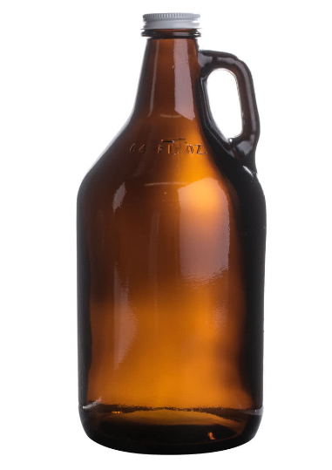
Growlers & Crowlers
TTB Beer FAQ B9
Determine the container type:
A growler/crowler is a large serving glass when a consumer uses the container to make a purchase and the brewer then fills the container
Consumers may furnish their own growler or may purchase it from the brewer
A growler/crowler is a bottle and requires labeling when the brewer fills the container in advance of sale
The brewer may fill the growler/crowler prior to removal, on the brewery premises, or after tax determination on the brewpub premises

Slide 208
Labeling Requirements for Growlers/Crowlers
If a serving glass:
Not subject to Federal labeling requirements
Some states may consider this bottling activity and regulate accordingly - brewers should check with state authorities
If a bottle:
Subject to the Federal labeling requirements of 27 CFR part 16 and part 25
In some states the requirements of 27 CFR part 7 also apply

Slide 209
Can I Change my Approved Label Without a New COLA?
Review List of Allowable COLA Revisions
Available on TTB Form 5100.31
You must be able to identify the COLA for which you are relying on to bottle a malt beverage in the event that TTB asks you to provide evidence that the label is covered by a COLA

Slide 210
Examples of Changes to Labels That Require a New COLA
Addition of new information or graphics (unless specifically authorized by the list of allowable revisions)
Addition of new location listed on label
Change in class or type

Slide 211
Allowable Changes to Labels
Change label size (for example, to fit a different container size)
Change net contents
Add, delete, or change an optional alcohol content statement
Change a mandatory alcohol content statement
Change numerical values for serving facts statement or statement of average analysis
And more…

Slide 212
Modernization of TTB Labeling and Advertising Regulations

Slide 213
Modernization of TTB Labeling and Advertising Regulations
TTB has undertaken a multi-year initiative to update our labeling and advertising regulations
Notice 176
Published November 26, 2018
Comment period extended 90 days and closes June 26, 2019
https://www.regulations.gov/document?D=TTB-2018-0007-0001

Slide 214
Proposed Clarifying Changes
Where possible, we’ve introduced consistency between parts 4, 5, and 7
We’ve included cross-references and examples to increase usability
We’ve incorporated policies and guidance for one-stop shopping

Slide 215
Proposed Clarifications
Industry members who make allowable changes to labels must keep track of which COLA applies to each product that requires a COLA
In light of COLAs Online, clarified that industry members are not required to keep paper copies of approved COLAs
The use of flags is only prohibited if used in a misleading way
Clarified the FAA Act rules for in-state only labels for malt beverages

Slide 216
Proposed Liberalizing Changes
Certain mandatory information may appear on keg collars or a tap covers, which do not have to be firmly affixed, provided that the name of the brewer is permanently or semi-permanently stated on the keg
All mandatory information may appear on any label on the malt beverage container
TTB Ruling 2015-1 is incorporated providing that certain malt beverages may be designated in accordance with trade and consumer understanding
The tolerance for alcohol content on malt beverages is expanded to one percentage point above or below the labeled alcohol content

Slide 217
Potentially Restrictive Proposed Changes
This rulemaking is not intended to cause large-scale relabeling, but we specifically request comment on that issue
New prohibited practice: you may not use labeling that creates a misleading impression that the product is a different commodity
Added cross reference to CBP requirement that imported products are required to show country of origin
We are proposing to give industry members three years to come into compliance with the proposed regulations (should they be finalized)

Slide 218
How to Comment
Federal e-Rulemaking Portal:
Use the online comment form posted within Docket No. TTB-2018-0007 on the Federal e-rulemaking portal at https://www.regulations.gov
U.S. Mail or Hand Delivery:
Director, Regulations and Rulings Division, Alcohol and Tobacco Tax and Trade Bureau, 1310 G Street NW, Box 12, Washington, DC 20005

Slide 219
Next steps
We will review all comments received
We may have to draft additional rulemaking documents to address new/revised proposals
Issue final rule(s)

Slide 220
Summary & Questions

Slide 221
Beer and Malt Beverage Resources

Slide 222
Speaker Contact Information
Susan Evans | Director, Office of Industry and State Outreach| Susan.Evans@ttb.gov | 202-453-2142
Janelle Christian| Industry Outreach Program Manager |Office of Industry and State Outreach | Janelle.Christian@ttb.gov
Charyl Sjowall| Investigator | Trade Investigations Division| Charyl.Sjowall@ttb.gov
Missy Keller | Tax Specialist | National Revenue Center | Melissa.Keller@ttb.gov
Chris Fay| Formula Specialist | Alcohol Labeling and Formulation Division | Christian.Fay@ttb.gov
Michael Webster | QA Specialist | Alcohol Labeling and Formulation Division | Michael.Webster@ttb.gov

Slide 223
TTB Beer Contacts
Brewers Notices, Taxes, Operations Reports, etc. contact the National Revenue Center:
Phone: 877-882-3277
Labeling contact the Alcohol Labeling and Formulation Division:
Phone: 866-927-2533 (option 8)
Formulas contact the Alcohol Labeling and Formulation Division:
Phone: 866-927-2533 (option 7)

Slide 224
TTB Beer Contacts
Importation/Exportation contact the International Affairs Division:
Phone: 202-453-2260
Trade Practices contact the Market Compliance Office:
Phone: 202-453-2251 (option 2)
Email: TradePractices@ttb.gov
Regulations and Rulings Division
Phone: 202-453-2265

Slide 225
Regulations & Resources
27 CFR 7.10 – Meaning of terms
27 CFR 7.24(a) – Class and Type
27 CFR 25.11 – Meaning of terms
27 CFR 25.15 – Materials for the production of beer
27 CFR 25.55-58 – Formulas
TTB Ruling 2008-3 – Classification of Brewed Products
TTB Ruling 2015-1 – Ingredients and Processes not Subject to Formula Requirements
Beverage Alcohol Manual (BAM) for Malt Beverages

Slide 226
Internet Resources
Websites
www.ttb.gov
www.fda.gov
www.ecfr.gov
27 CFR parts 7, 16, and 25
MB Beverage Alcohol Manual
Key Words
TTB
Malt Beverage or Beer
BAM
Beverage Alcohol Manual
Beer Rulings
eCFR

Slide 227
Resources on TTB.gov
Beer Industry Home Page https://www.ttb.gov/beer/index.shtml
Alcohol Beverage Formula Approval Home Page https://www.ttb.gov/formulation/index.shtml
Which Beers/Malt Beverages Require Formula Approval Tool https://www.ttb.gov/formulation/formula_approval_tool_mb.shtml
Subscribe to automatically receive the weekly TTB Newsletter https://public.govdelivery.com/accounts/USTTB/subscriber/new
Permits Online Help Center https://www.ttb.gov/ponl/permits-online-help.shtml

Slide 228
Resources on TTB.gov
Beer Rulings https://www.ttb.gov/beer/beer-rulings.shtml
Beer Procedures https://www.ttb.gov/beer/beer-rulings.shtml
Beer Industry Circulars https://www.ttb.gov/beer/beer-ic.shtml
Beer FAQs https://www.ttb.gov/beer/beer-faqs.shtml
CBMTRA page https://www.ttb.gov/alcohol/craft-beverage-modernization-and-tax-reform.shtml

