Slide 1
COLAs Online: Conditional Approval Status
Stephanie Fields, Labeling Specialist TTB – ALFD JUNE 25, 2019

Slide 2
Disclaimer
Notice:
This information is being presented to help the public to understand and comply with the laws and regulations that the Alcohol and Tobacco Tax and Trade Bureau administers. It is not intended to establish any new, or change any existing, definitions, interpretations, standards, or procedures regarding those laws and regulations.
In addition, this presentation may be made obsolete by changes in laws and regulations. Please consult the regulations for the most current regulatory requirements.
Sample documents (such as records, returns, and labels) are for illustrative purposes only and contain fictitious data.

Slide 3
CONTACT US
CUSTOMER SERVICE: 866-927-2533
EMAIL: alfd@ttb.gov

Slide 4
SUMMARY
COLAs Online, the TTB system for electronic submission of applications for certificates of label approval (COLAs), includes a new status, Conditionally Approved.
Under certain limited circumstances, TTB specialists reviewing applications in COLAs Online may propose changes to the information you entered in the application to make it match the label that was submitted along with the application. After the specialist proposes the changes, the application enters the Conditionally Approved status.
If you have an application in this status, you will be able to review and then either accept the changes, which will result in immediate approval of the application, or decline the changes, in which case you can make any necessary changes yourself and return the COLA application to TTB.

Slide 5
Which application FIELDS are involved?
Malt Bev/Distilled Spirits
Brand Name
Fanciful Name
Wine
Brand Name
Fanciful Name
Grape Varietal(s)
Appellation(s)

Slide 6
Proposed Changes Email
When the specialist puts an application into Conditionally Approved status, an email is generated detailing the following:
Take Action – 7 Days
Application Submission Summary
Link to log in to COLAs Online from the email
Summary of options – Accept/Decline/No Action

Slide 7
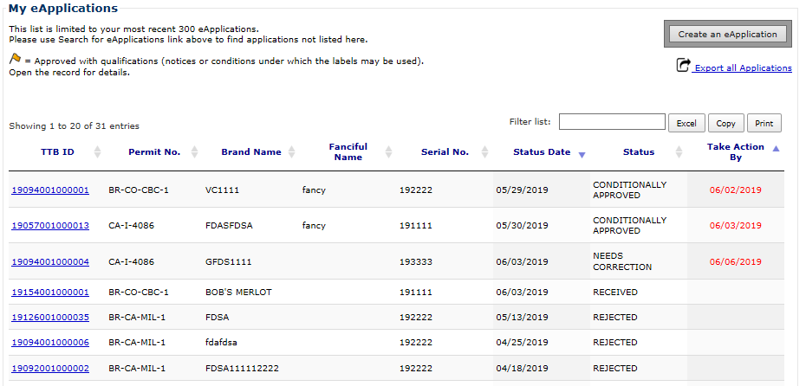
eApplications Inbox
When you log in, you will see a list of applications that require action (both Conditionally Approved and Needs Correction).
The list is sorted first by the “Take Action By” date (in reverse chronological order so shortest response time appears at the top), then by “Status Date” (most recent to oldest).
You will have 7 days to accept or decline changes for Conditionally Approved applications; after 7 days the status automatically changes to Needs Correction.
NOTE:
Brand/Fanciful name columns show changes proposed by ALFD (not the original values you submitted).

Slide 8
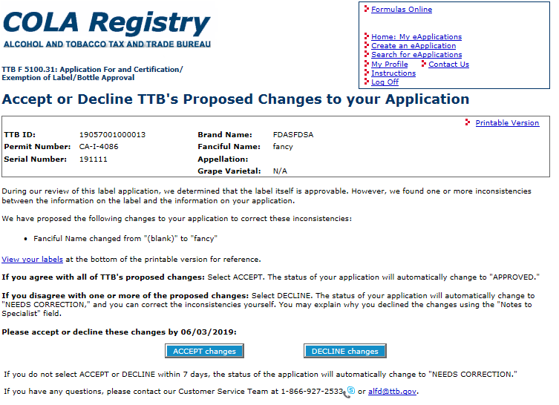
Accept/Decline Proposed Changes
After selecting a Conditionally Approved application from the My eApplications Inbox, you can accept or decline the changes.
Screen shows the proposed changes.
NOTE:
Currently you must accept or decline ALL of the changes.

Slide 9
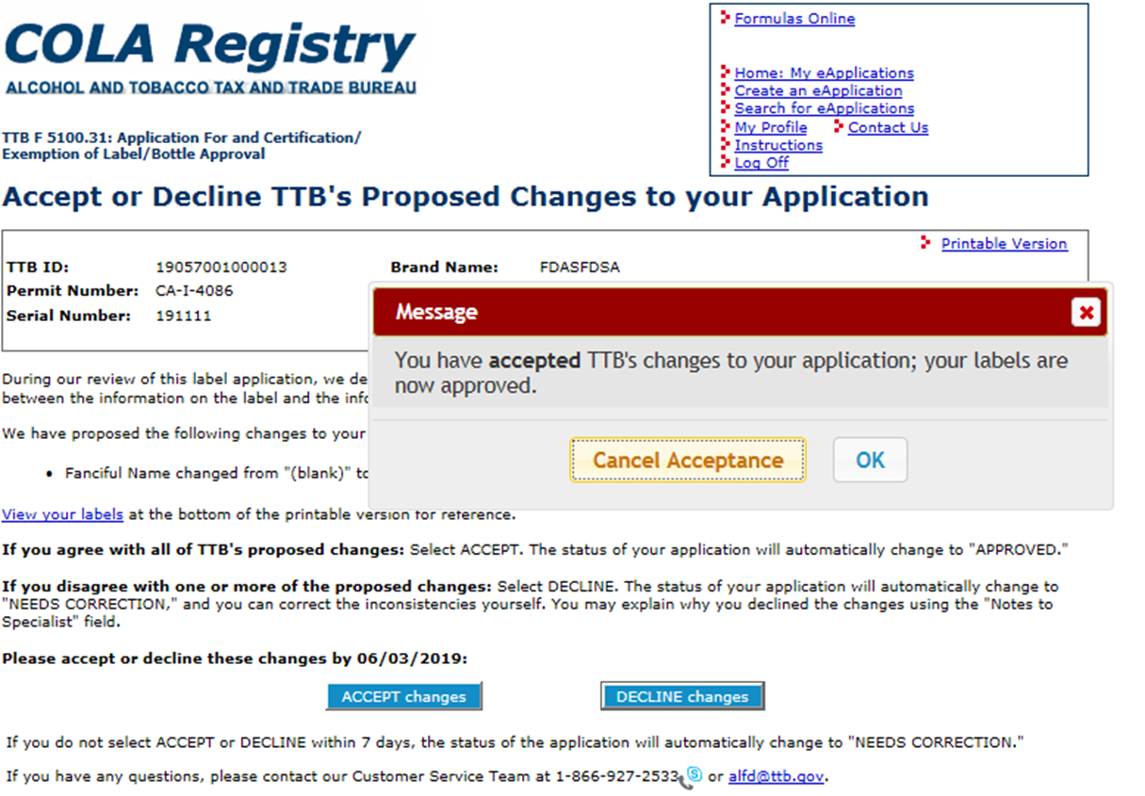
ACCEPT Proposed Changes
Upon clicking “ACCEPT changes” you see a validation message: “You have accepted TTB’s changes to your application; your labels are now approved.”
If “Cancel Acceptance” is selected, the pop up box disappears. No changes are made, and you can consider again whether to accept or decline.

Slide 10
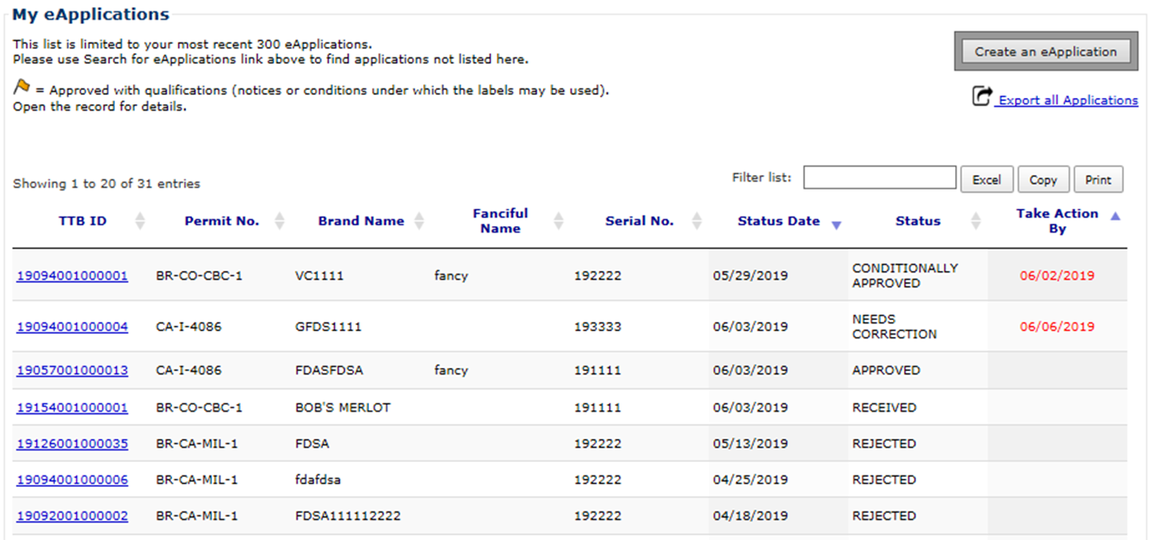
ACCEPT Proposed Changes (cont.)
If “OK” is selected (after ACCEPT changes):
Screen will refresh to Inbox; application is automatically marked “Approved”
You will receive a status change email indicating the application was approved

Slide 11
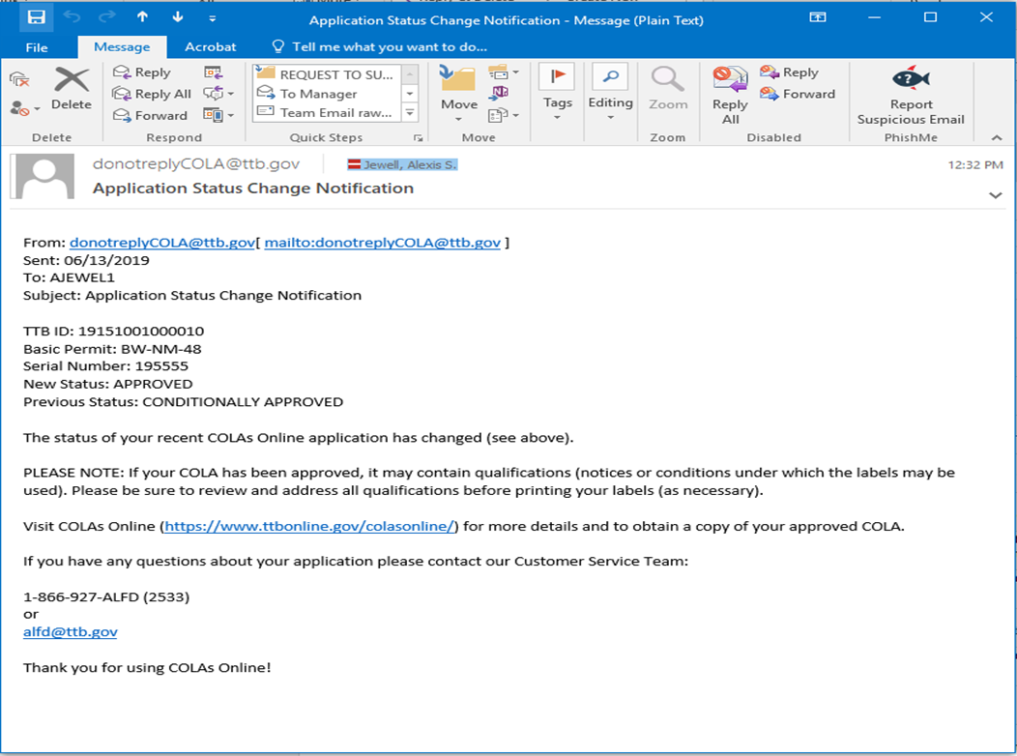
Status Change Email
If you ACCEPT TTB’s proposed changes the status of the application will immediately change to approved.

Slide 12
Decline Proposed Changes
If “DECLINE changes” is selected:
All ALFD changes are removed and the application automatically reverts to the last submission values.
The application enters Needs Correction status and opens to the Needs Correction page (using the return reasons pre-entered by the specialist).

Slide 13
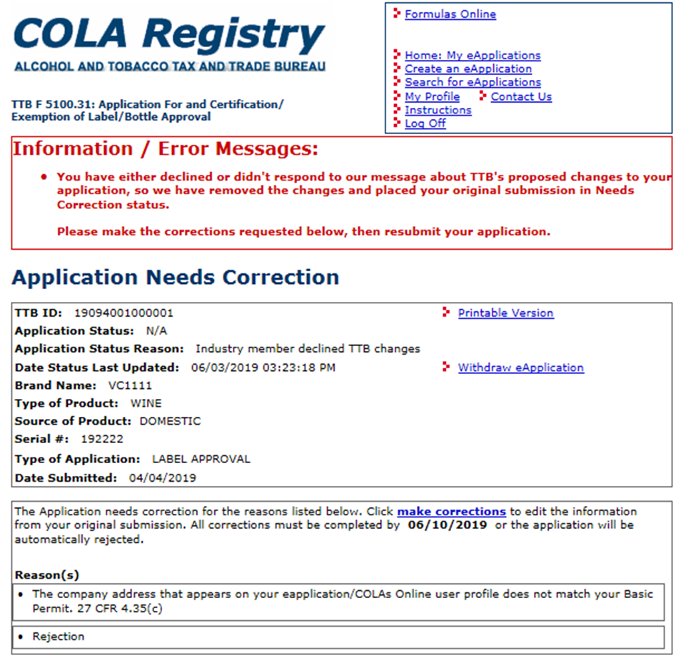
Decline Proposed Changes (Cont’d)
If “DECLINE Changes” is selected:
A red message will appear at the top of the screen informing you of the next steps.
Click “make corrections” and follow the current process of correcting the application.
NOTE: Status Change Email will be initiated showing Needs Correction status.

Slide 14
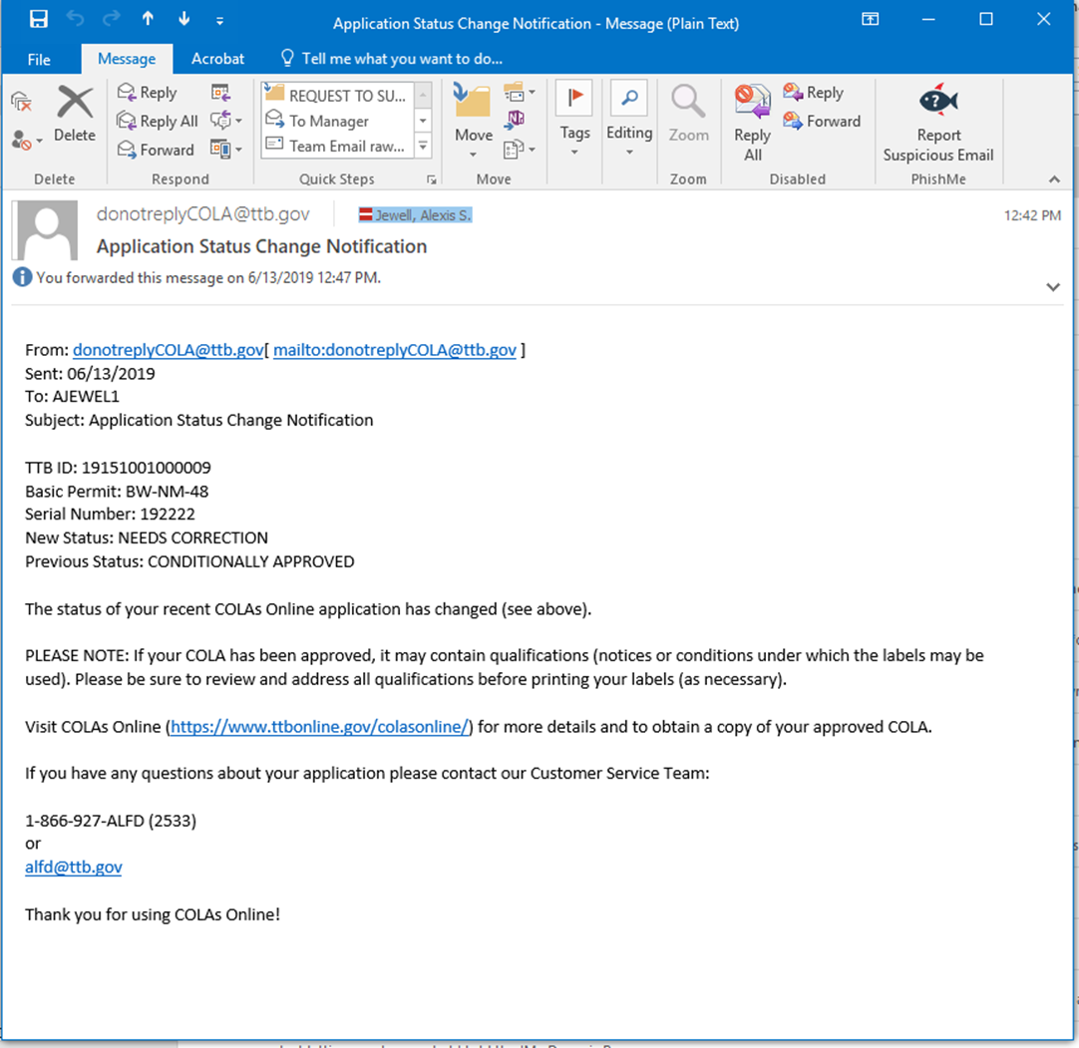
Status Change Email
When you decline the changes or do not respond with the seven (7) days the COLA reverts to Needs Correction status and you will receive a status change notification.

Slide 15
Keep In Mind…..
You have seven (7) days to either ACCEPT or DECLINE TTB’s proposed changes or the application will revert to the NEEDS CORRECTION status.
You will retain the current 30-day allowance for making corrections. It will begin from the time the application entered the Conditionally Approved status.
At this time you must either accept or decline all the changes TTB has proposed. Future enhancements will allow you to select the proposed changes you want to accept or decline.
TTB will only propose changes to the application if the rest of the application and the label can be approved. For example, if the brand name entered on the form contains a typo and the label does not include the Health Warning Statement, the specialist will return the application for correction rather than proposing changes to the brand name field and asking you to fix the label.

Slide 16
Did You Know?

Slide 17
COLAs ONLINE ENHANCED FEATURES
TAKE ACTION BY COLUMN
YELLOW FLAG INDICATOR
FILTER
EXPORT
EXCEL/ COPY/PRINT

Slide 18
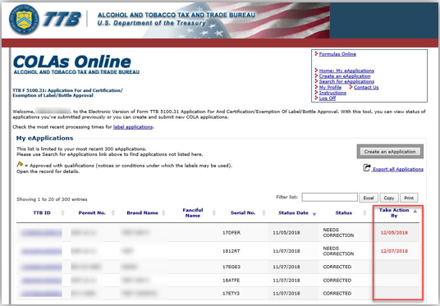
Take Action By Column
A new column - “Take Action By” - has been added to the My eApplications table. This column displays the deadline date for applications that require your attention.
The date is displayed in red, in the mm/dd/yyyy format, with the closest date on top, by default. The column will be empty for applications that require no action on your part.

Slide 19
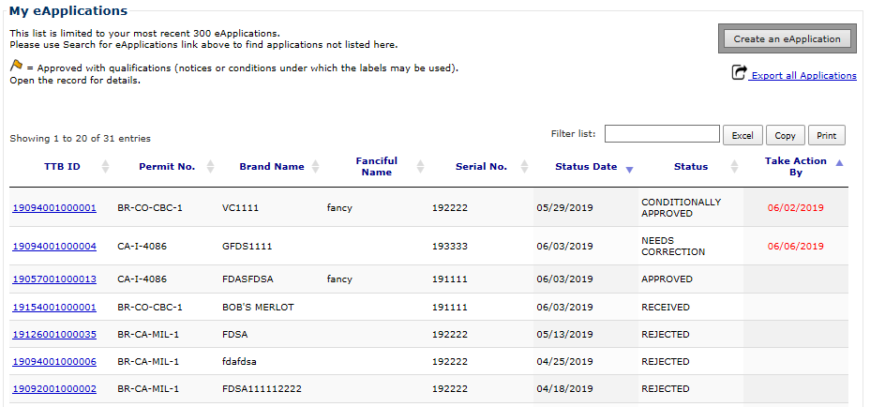
Yellow Flag Indicator
Yellow flag is an indication that the approved application has qualifications that may require you to make some changes to the label prior to printing.

Slide 20
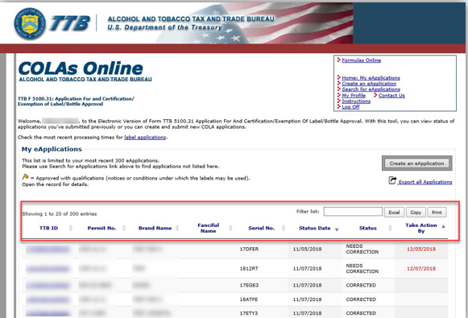
Filters
Filters the whole application list for specified values, in any column, as you type inside the filter box.
It will also display the number of matches for your filter on the top left side, above the table.

Slide 21
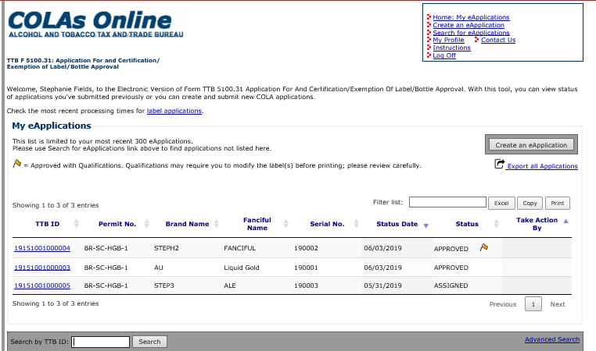
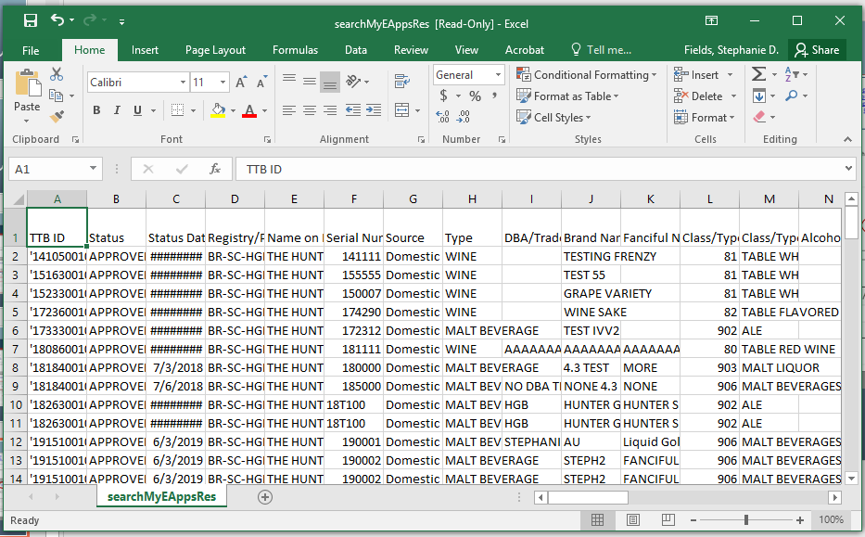
Export all Applications
Export all Applications gives you a comprehensive list of all your applications in an Excel file.

Slide 22
Excel/Copy/Print
Excel - Exports a list of applications to an Excel file.
Copy - Copies the list to a clipboard. You may then paste into a different program of your choice.
Print - Creates a printable version of your applications list.
NOTE - These options download the current list of applications displayed in the window.

Slide 23
Questions?

Slide 24
CONTACT US
CUSTOMER SERVICE: 866-927-2533
EMAIL: alfd@ttb.gov

